Slide 1
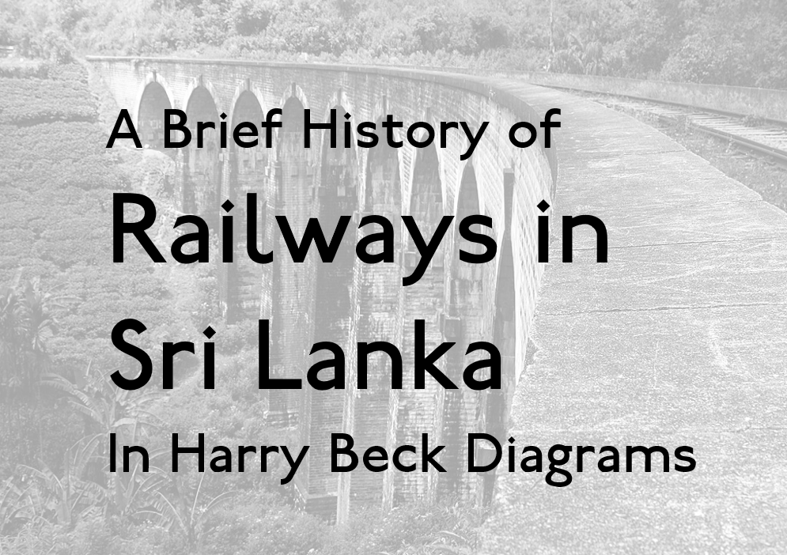
Notes:
A Brief History of Railways in Sri Lanka. In Harry Beck Diagrams.

Slide 2
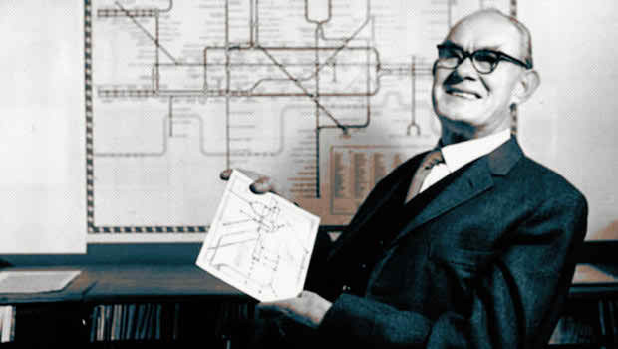
Notes:
Henry Charles Beck (also known as Harry Beck), was an English technical draughtsman who created the first diagrammatic London Underground Tube map in 1931.

Slide 3
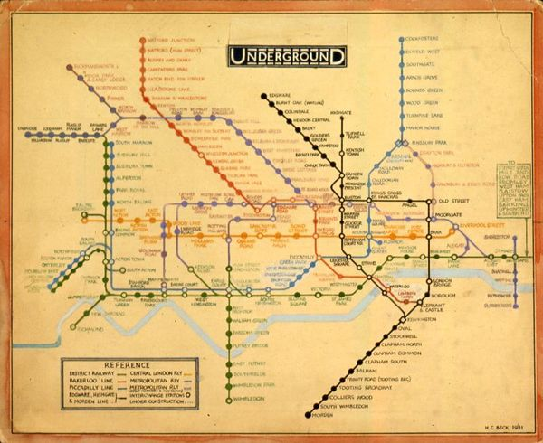
Notes:
The Design has since been referred to as the Harry Beck Map, and has been copied to represent many transport systems across the world.
In this video, we use Harry Beck diagrams to describe the various stages in the history of Sri Lanka's Railway system.

Slide 4
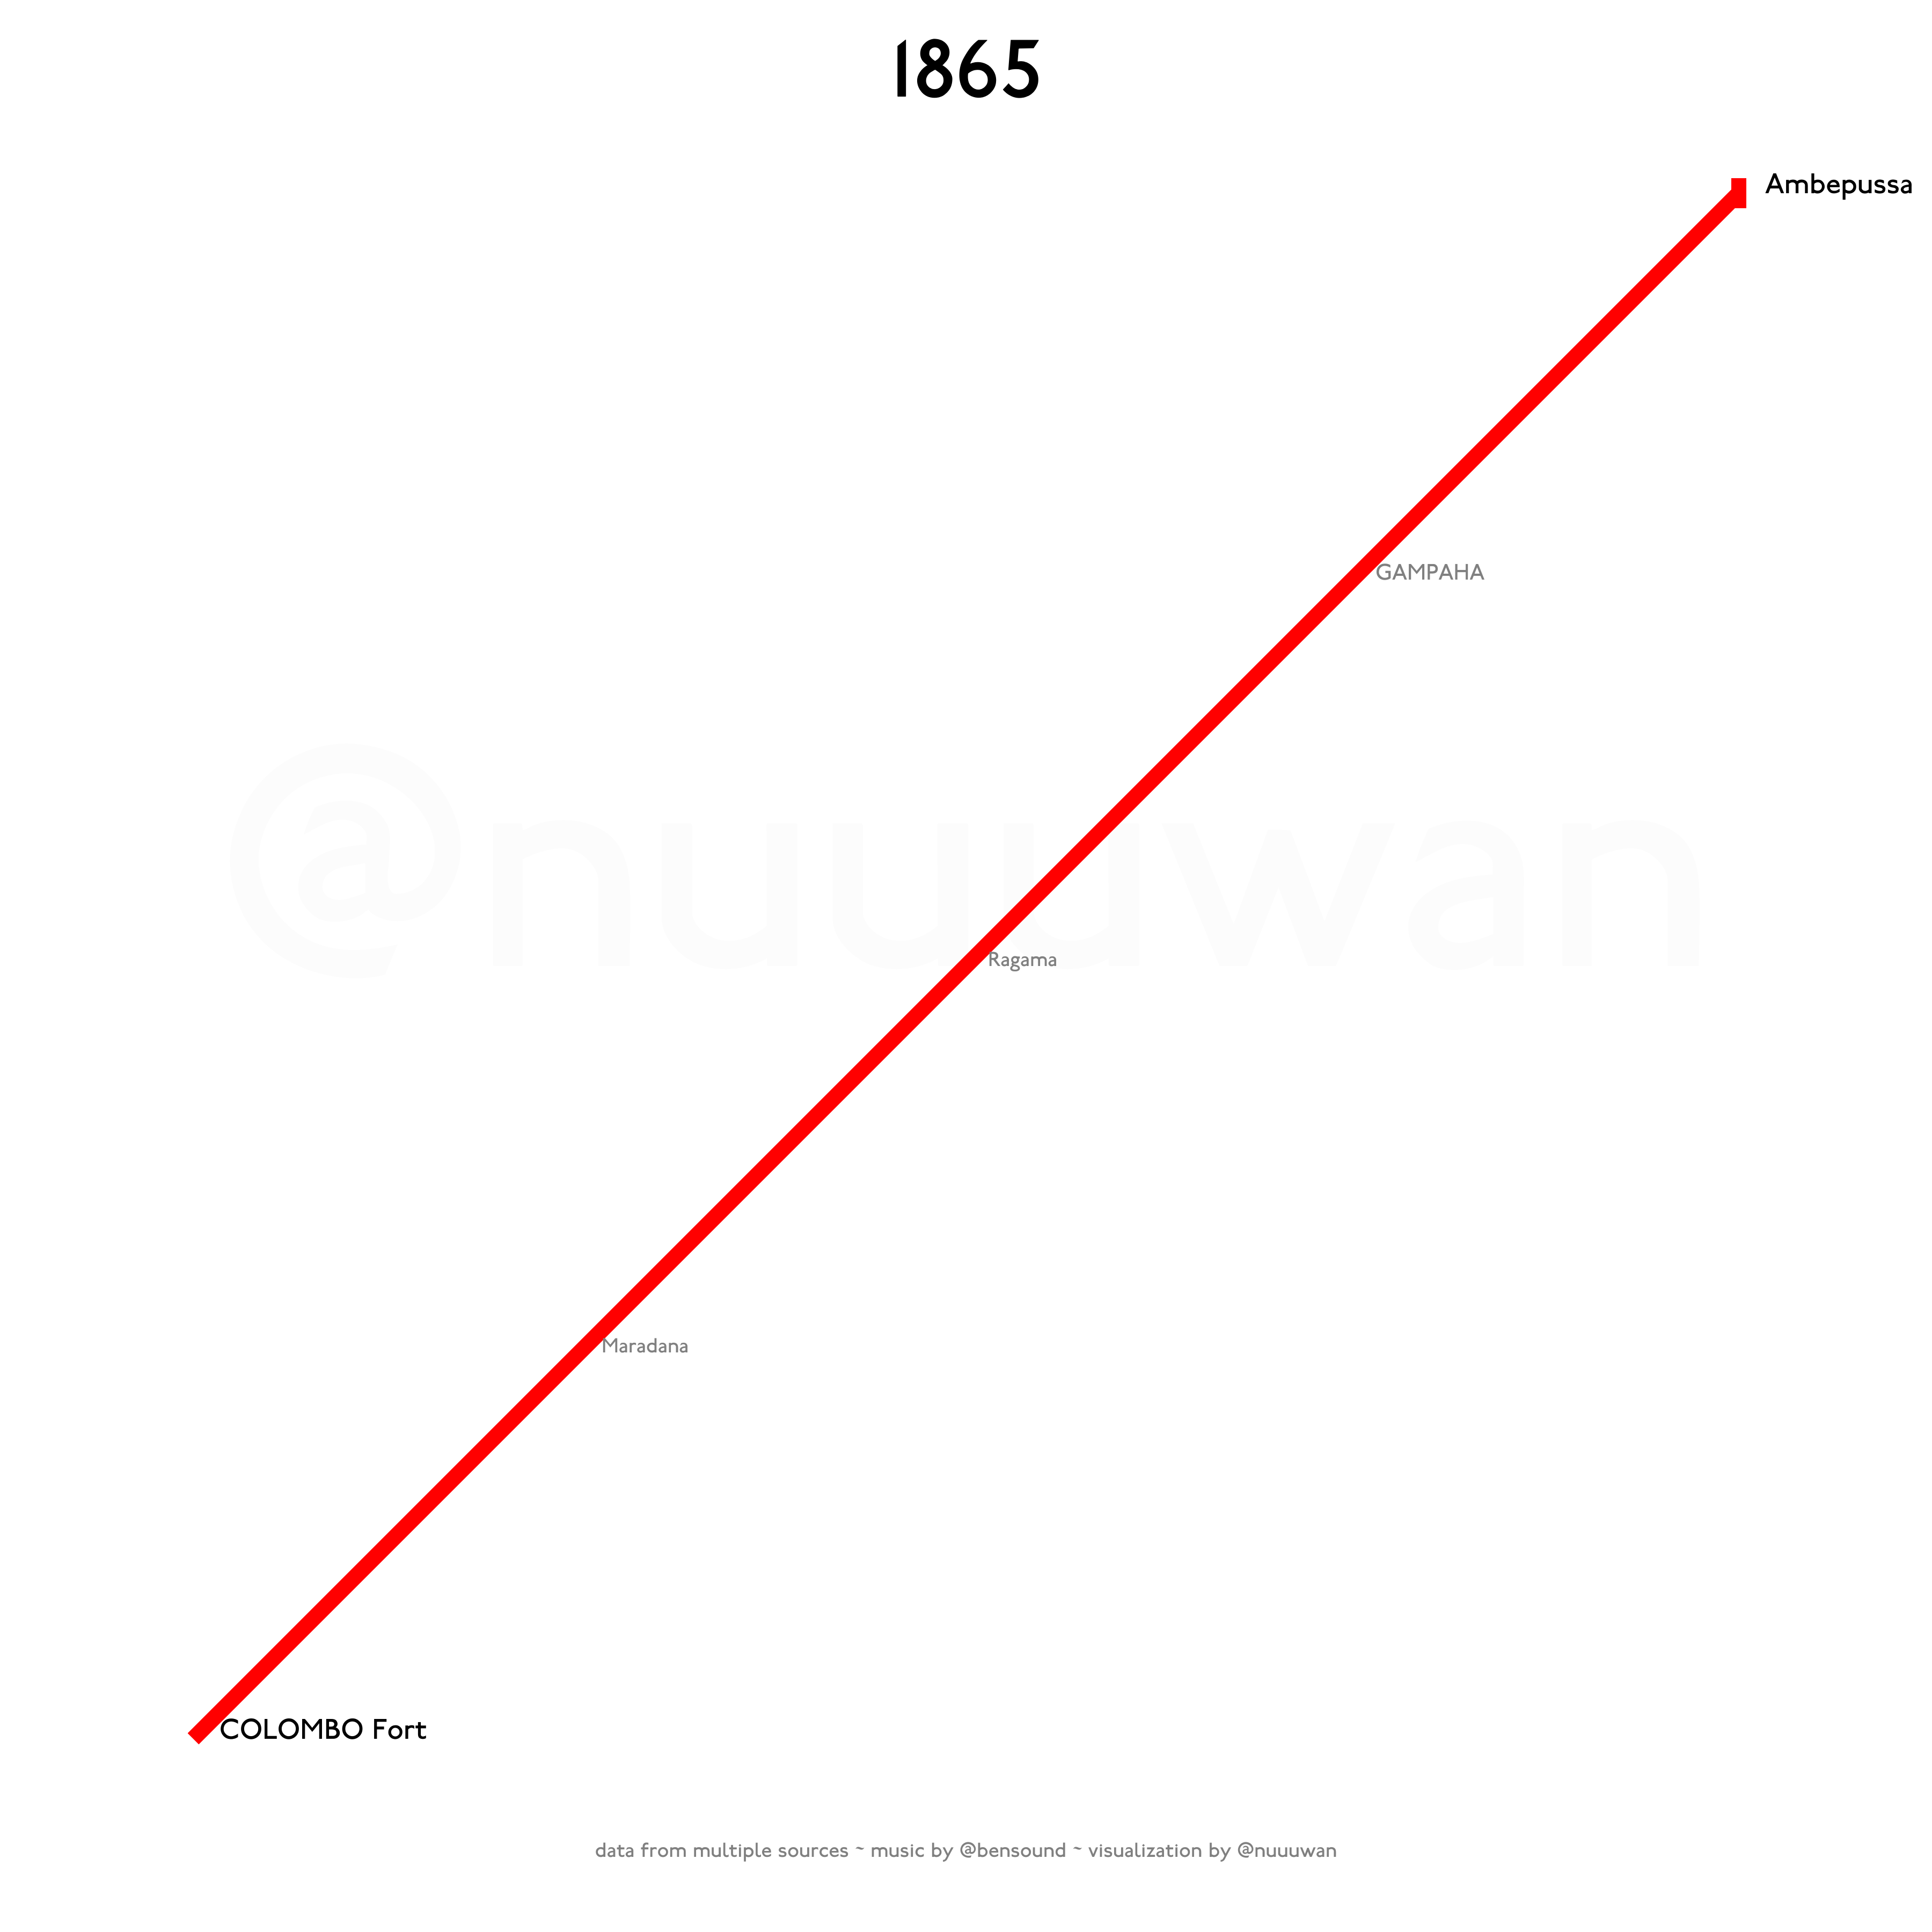
Notes:
The first segment of the Main line, from Colombo to Ambepussa, was the first rail line in Sri Lanka.
It was officially opened for traffic on 2 October 1865.
The main reason for building a railway system in Sri Lanka (then Ceylon) was to transport tea and coffee from the hill country to Colombo.

Slide 5
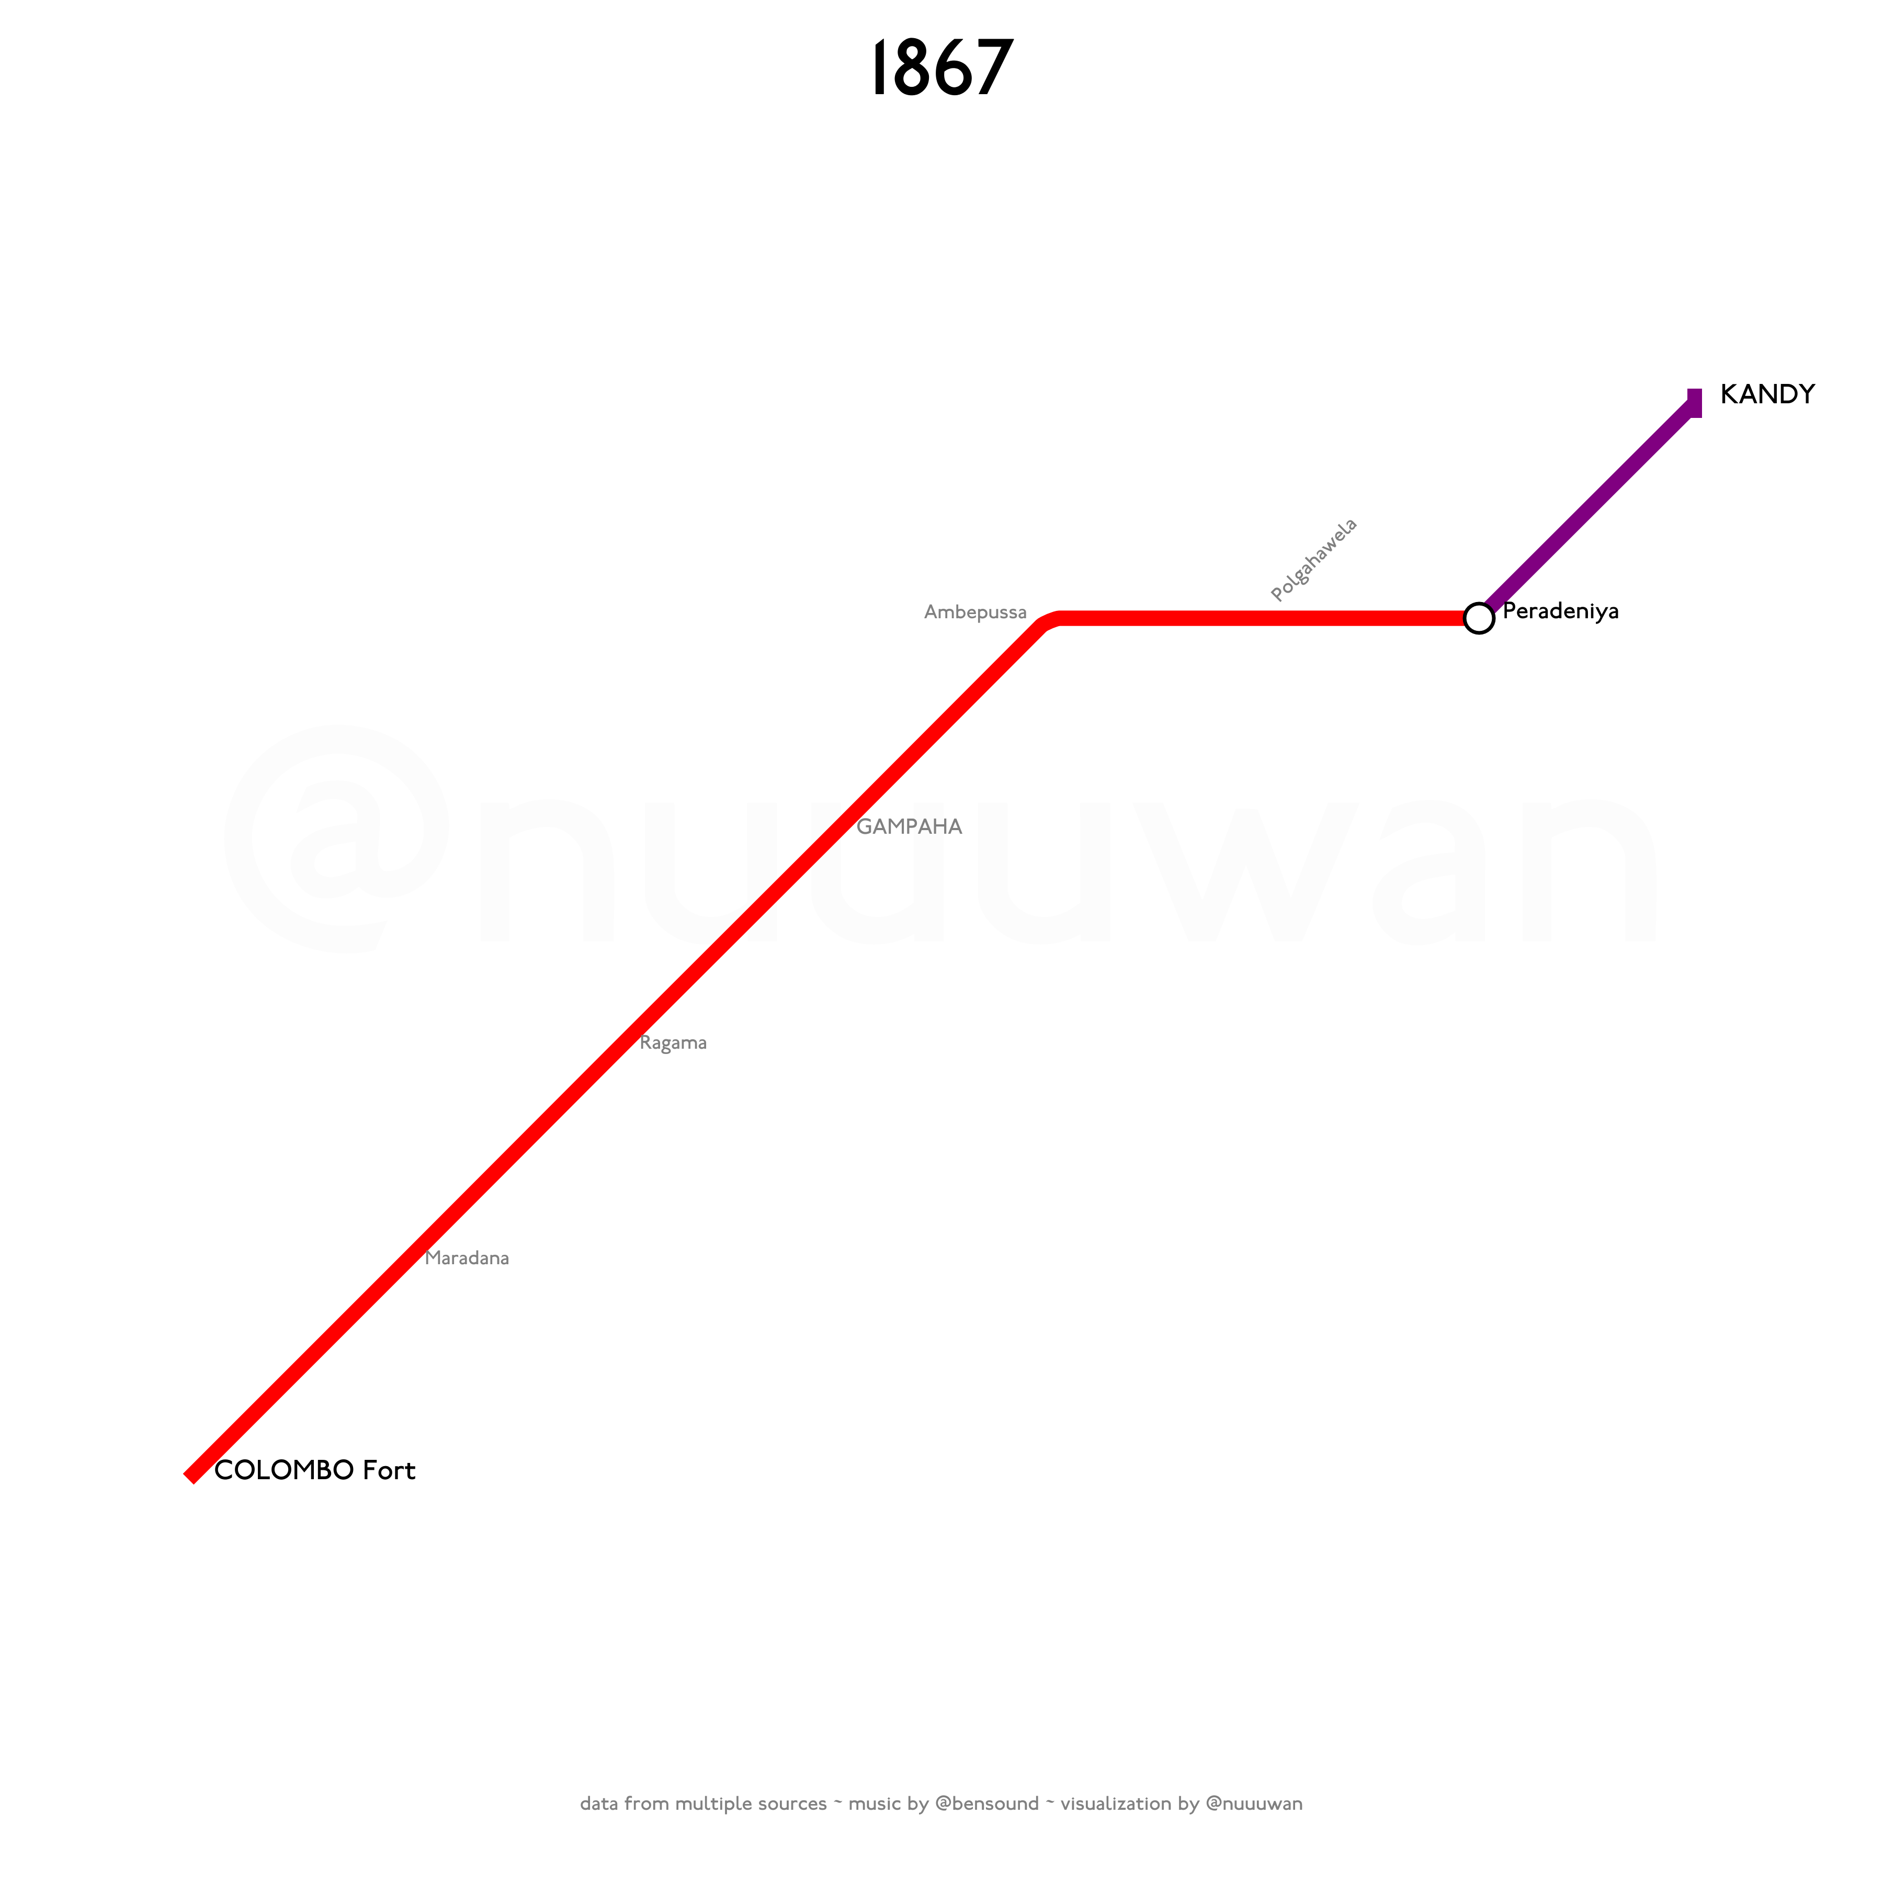
Notes:
The Main Line was extended in stages with service to the hill capital Kandy beginning in 1867 via Peradeniya.

Slide 6
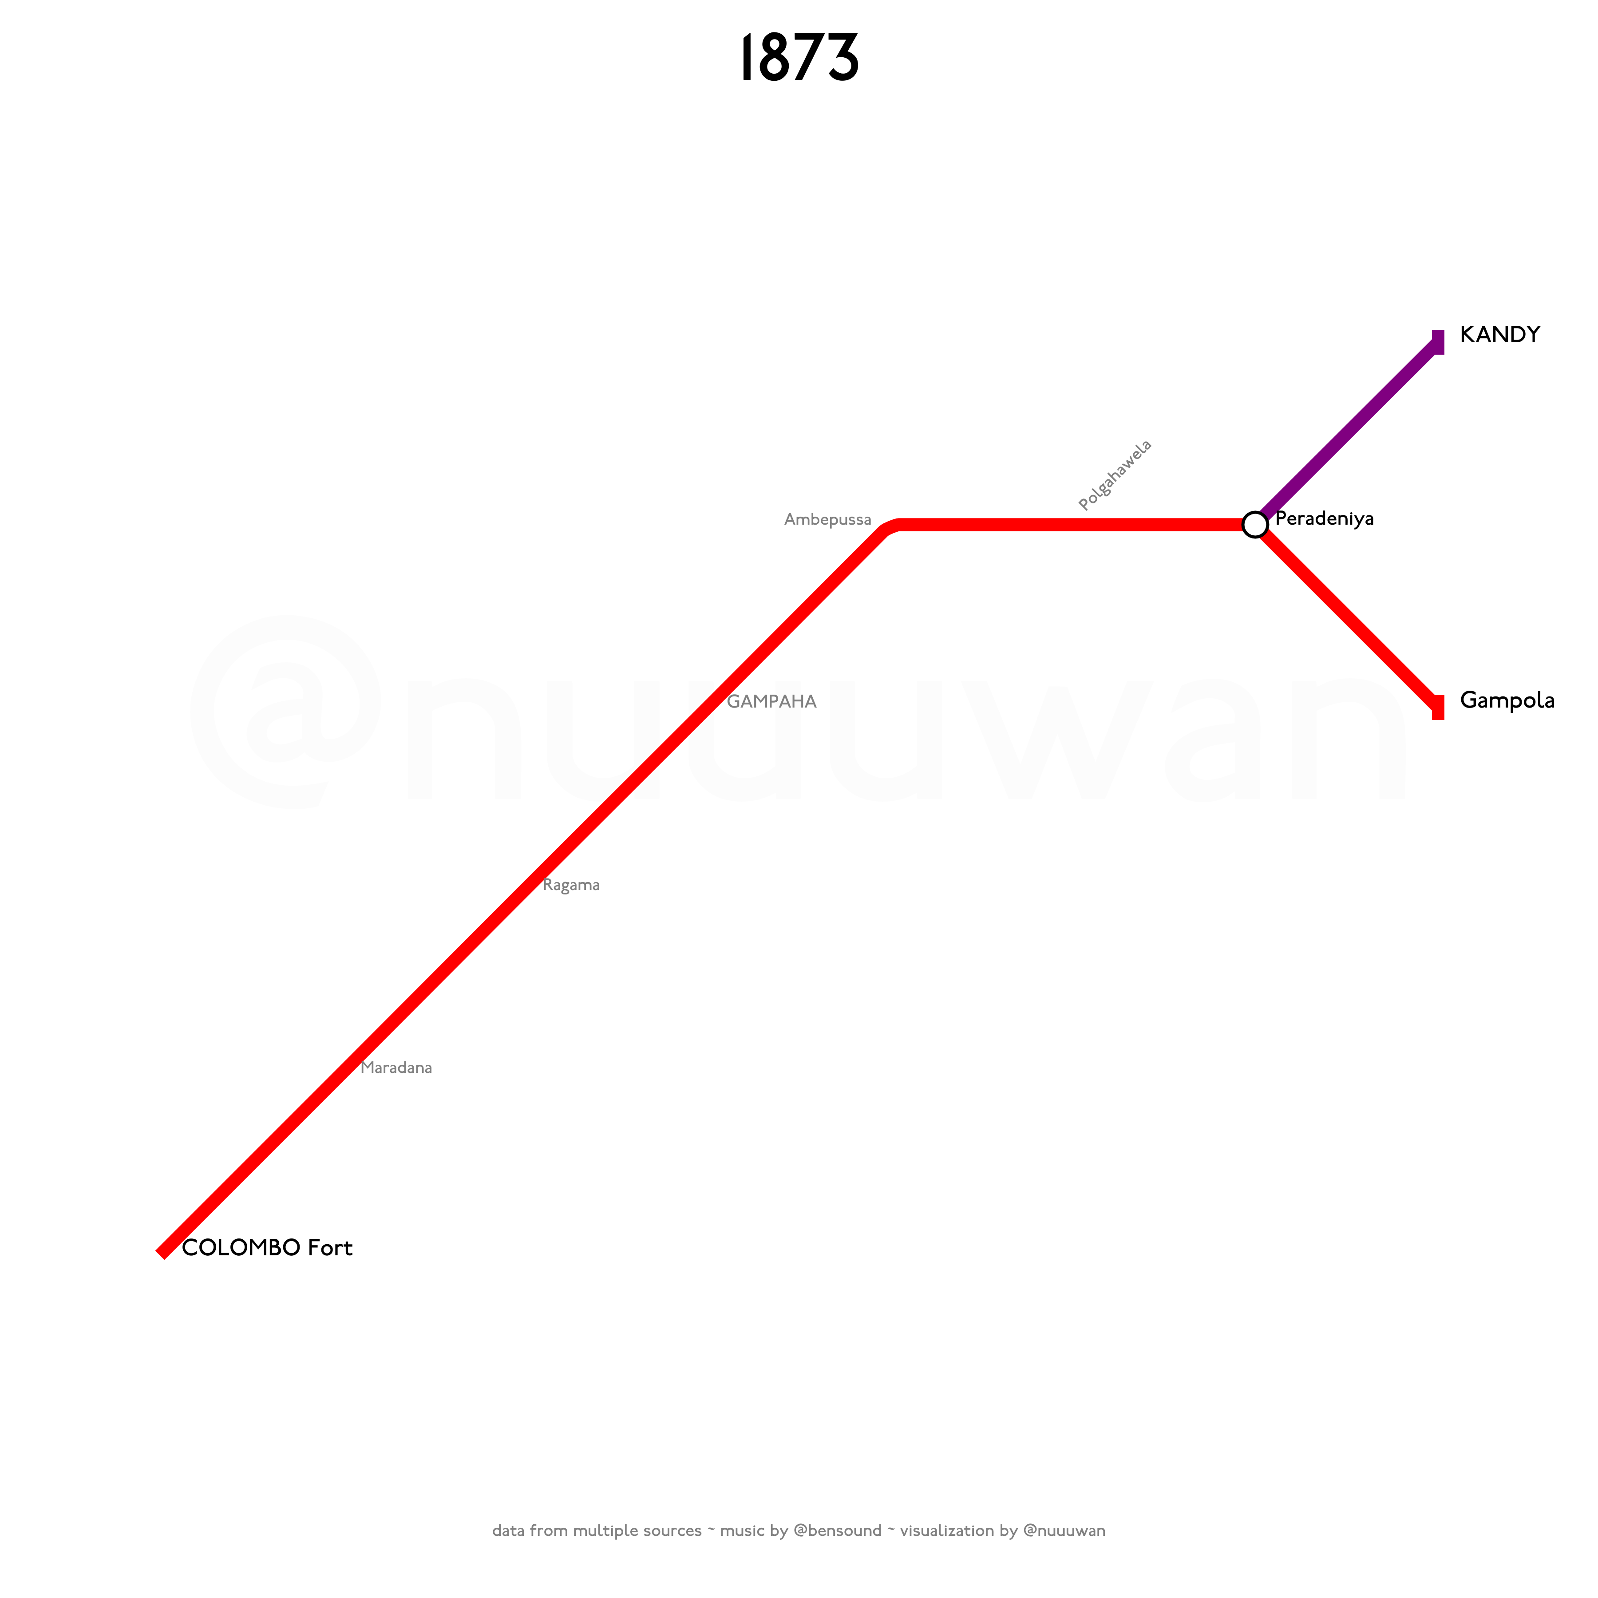
Notes:
From Peradeniya to Gampola in 1873.

Slide 7
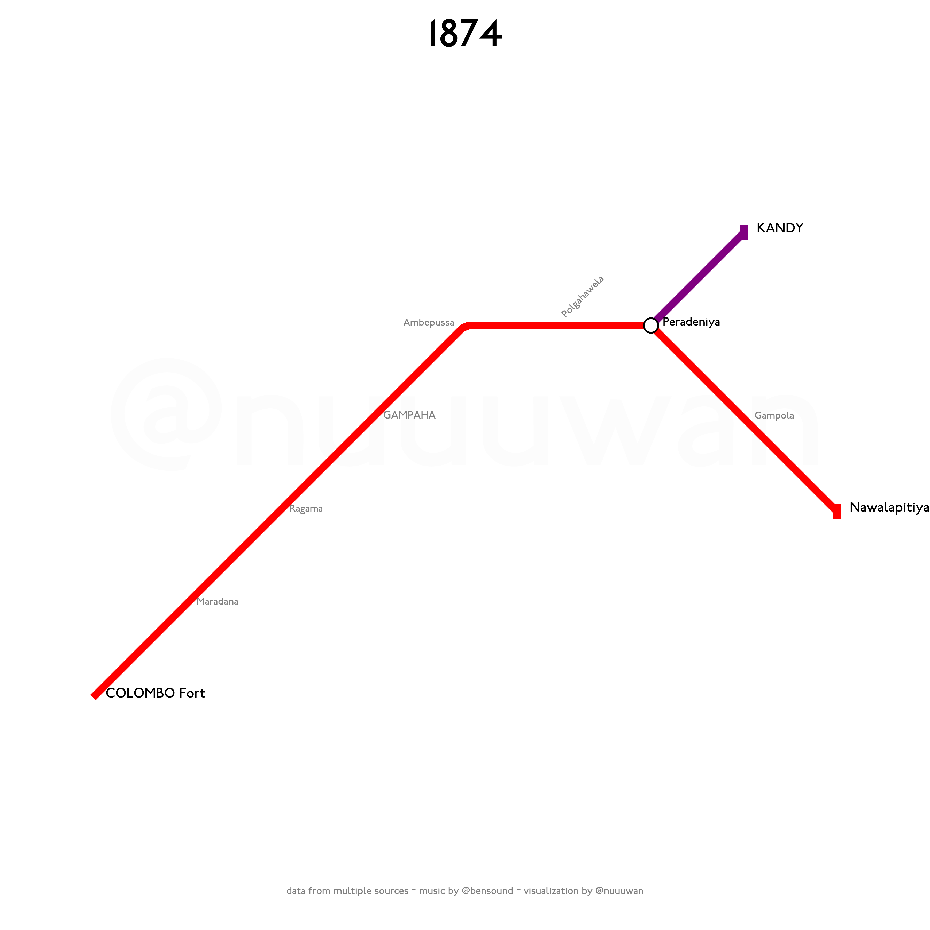
Notes:
From Gampola to Nawalapitiya in 1874.

Slide 8
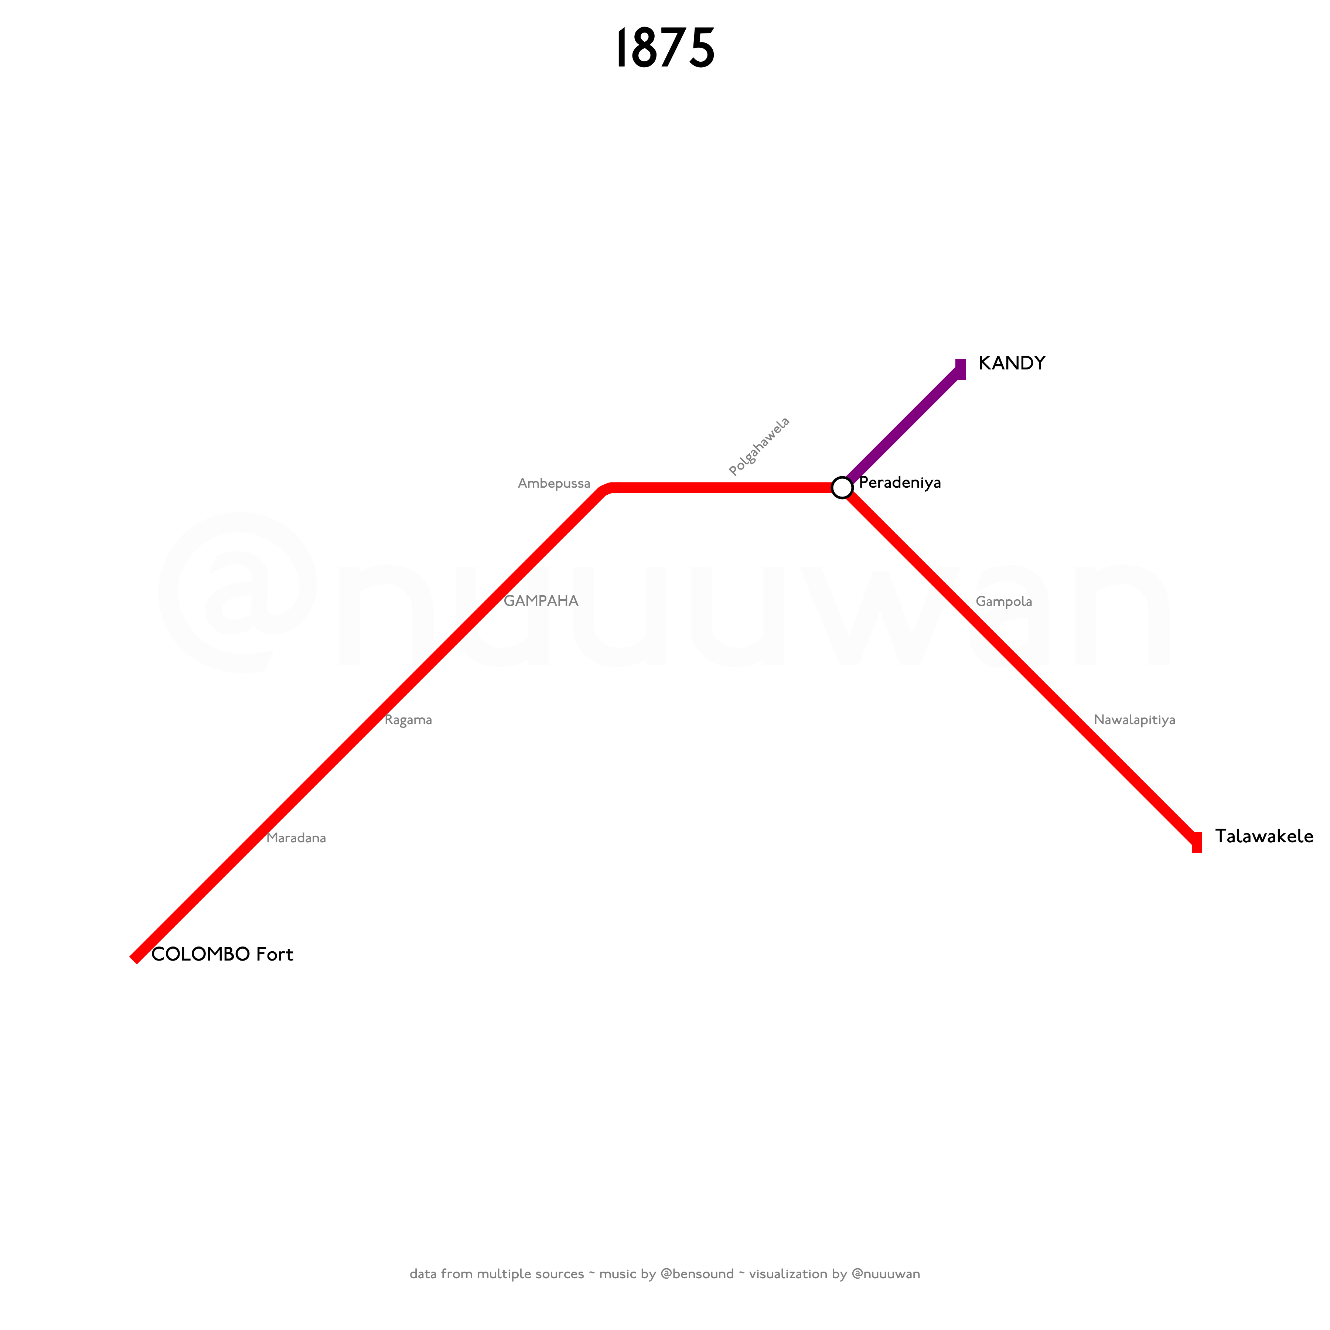
Notes:
And from Nawalapitiya to Talawakele in 1875.

Slide 9
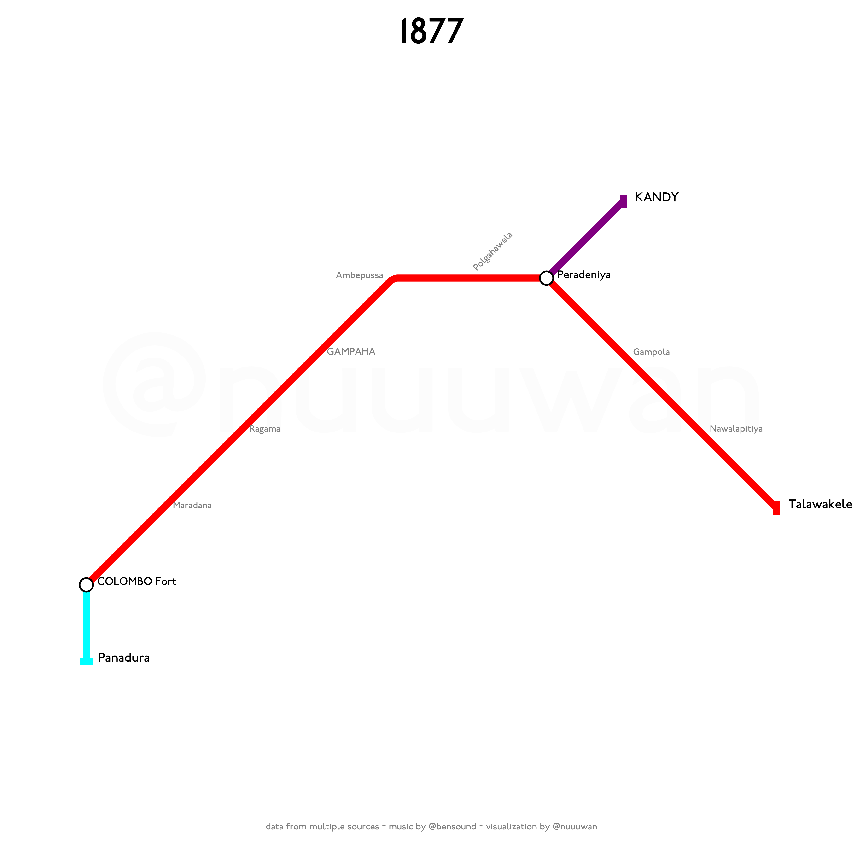
Notes:
The Coastal Line (sometimes referred to as the Coast Line or Southern Line) was the second railway line in Sri Lanka. On 1 March 1877, the first train up to Panadura commenced.

Slide 10
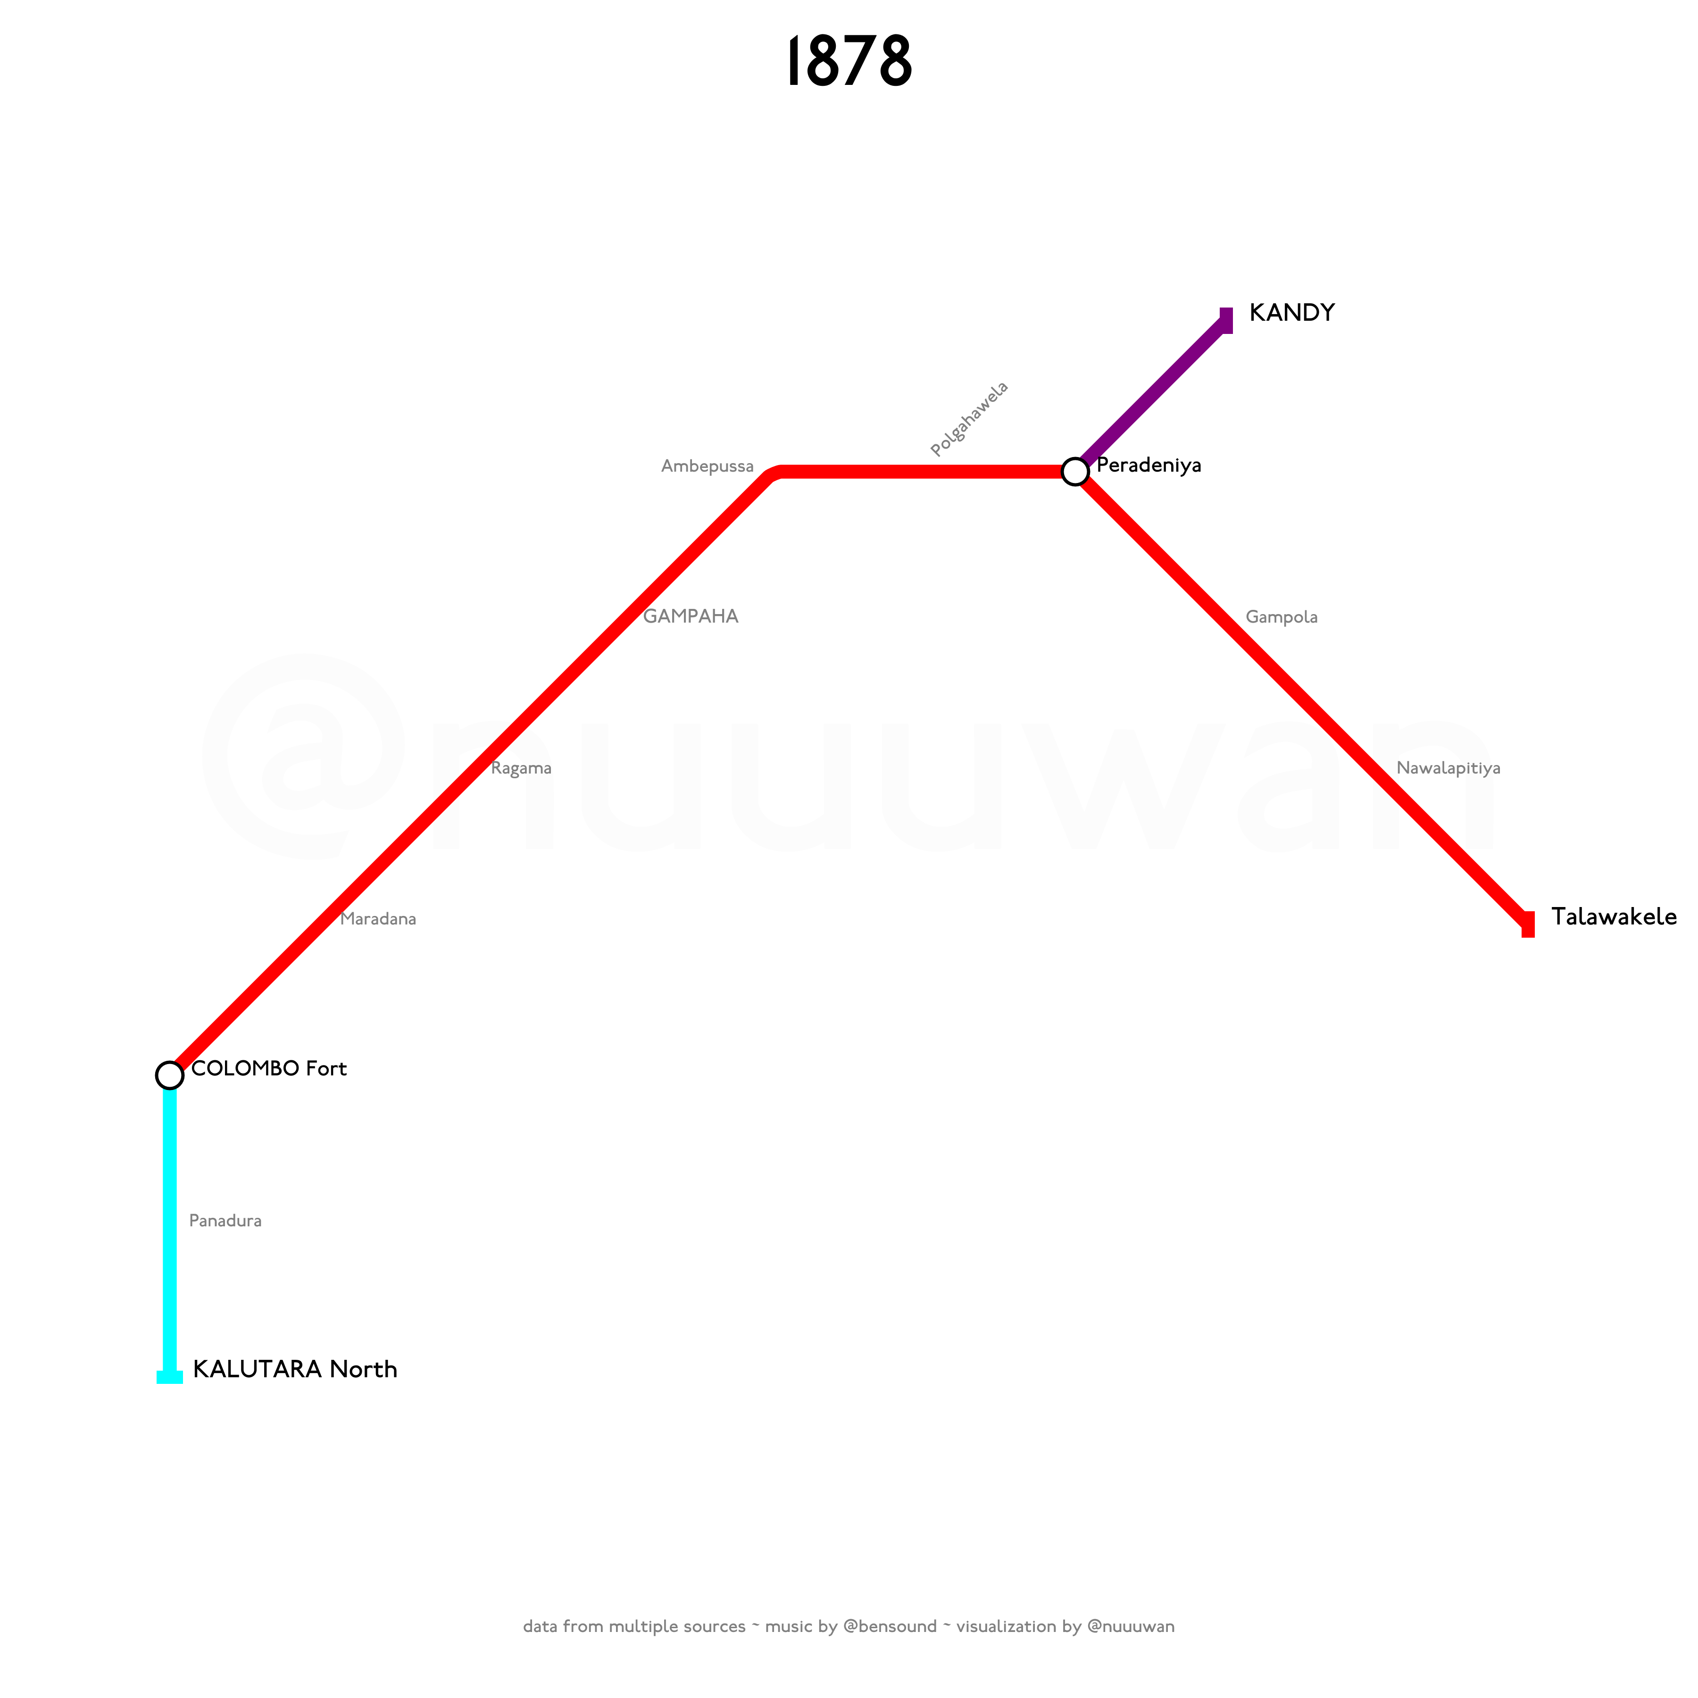
Notes:
By 1 February 1878, the line was extended from Panadura to Kalutara.

Slide 11
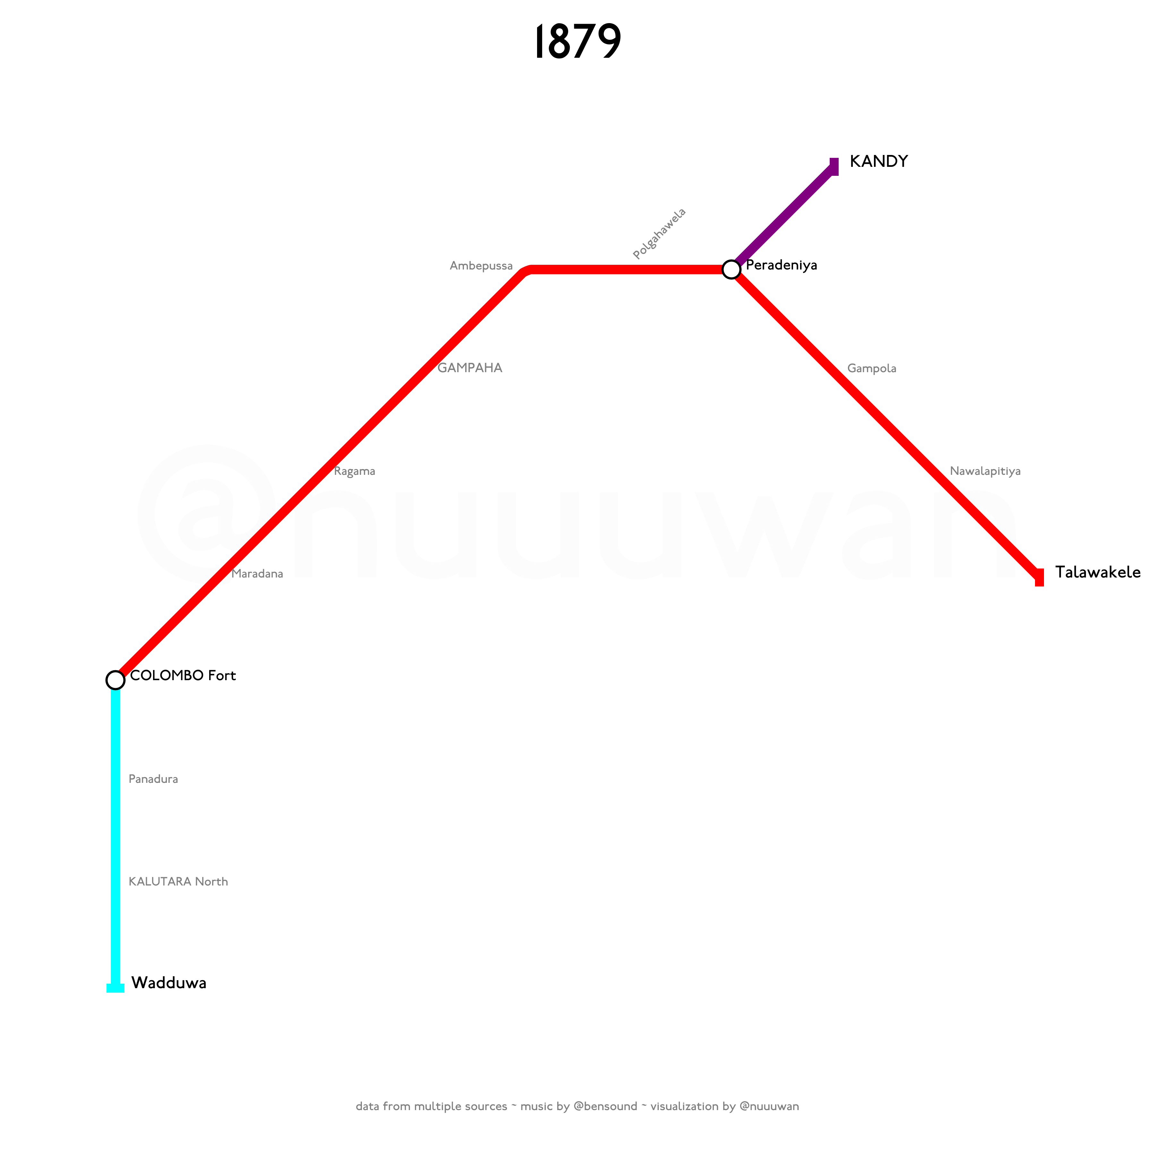
Notes:
On 1 February 1879, the Costal Line was extended from Kalutara to Wadduwa.

Slide 12
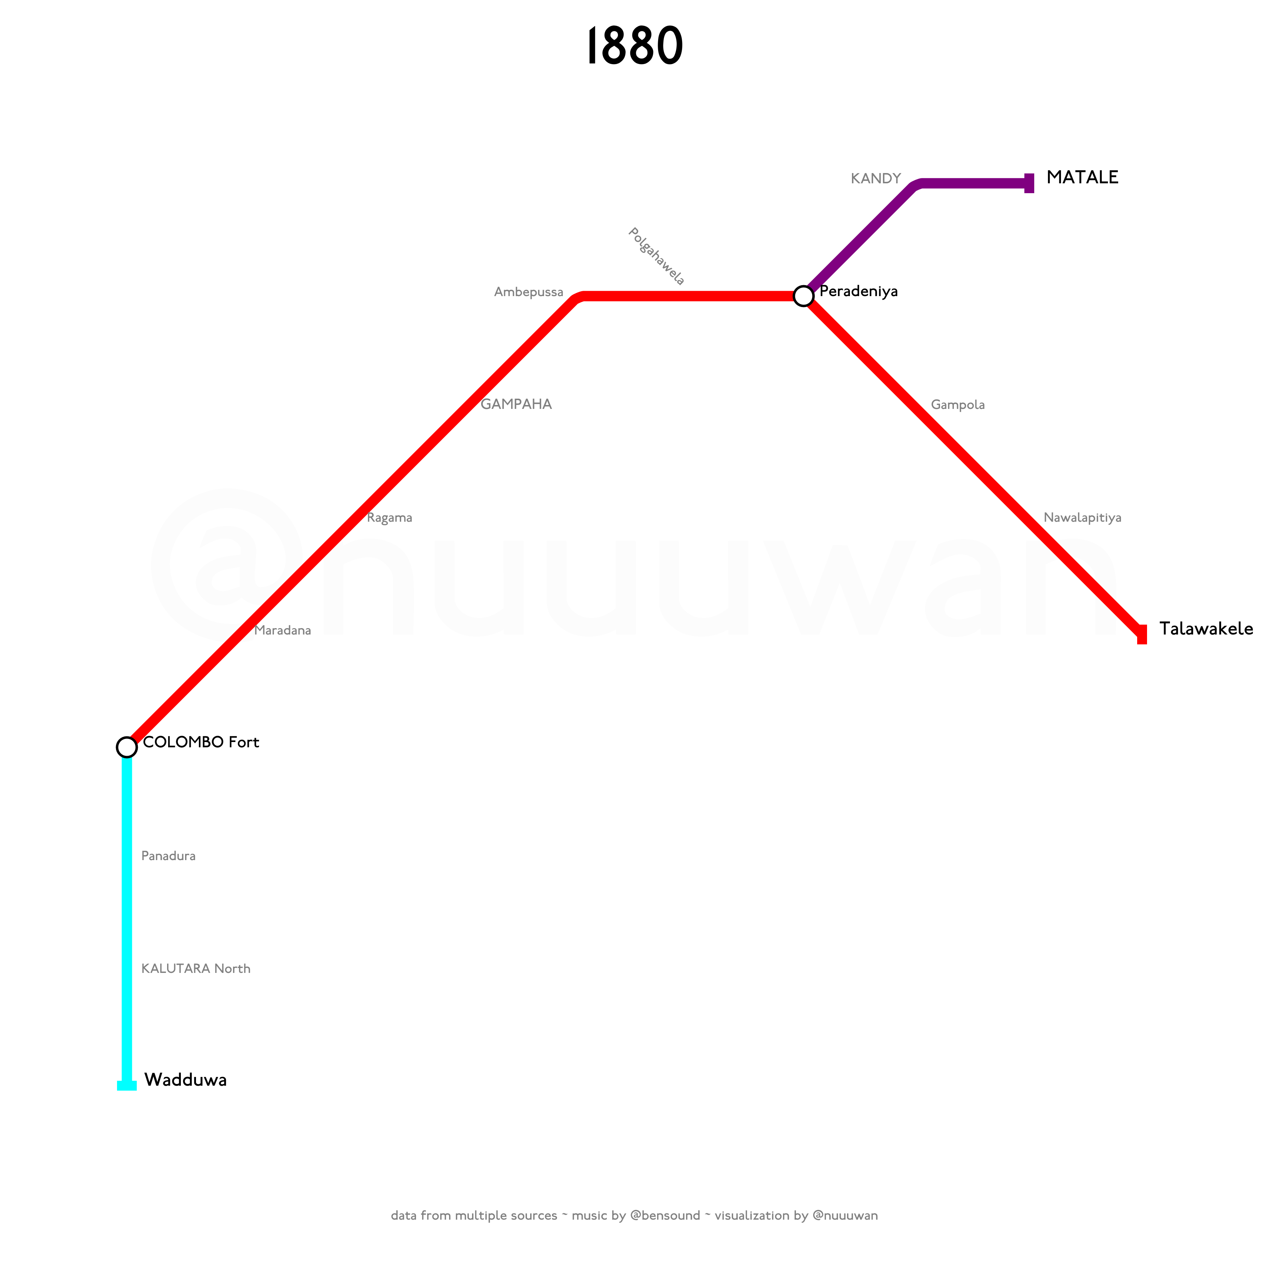
Notes:
The Matale line (sometimes referred to as the Kandy line) branches off the Main Line, and was inaugurated in 1880.
The 28.2 km route was surveyed between 1875 and 1877. In May 1878 the contract to construct the rail line was issued to David Reid for Rs. 1,782,408. The total estimated cost of the Matale extension amounted to Rs. 3,300,000, being a rate of Rs. 189,247 per mile.
The line was opened for traffic on 4 October 1880 by the Governor, Sir James Longden, eight months earlier than the contract date, for which Reid was given a Rs. 35,000 bonus.

Slide 13
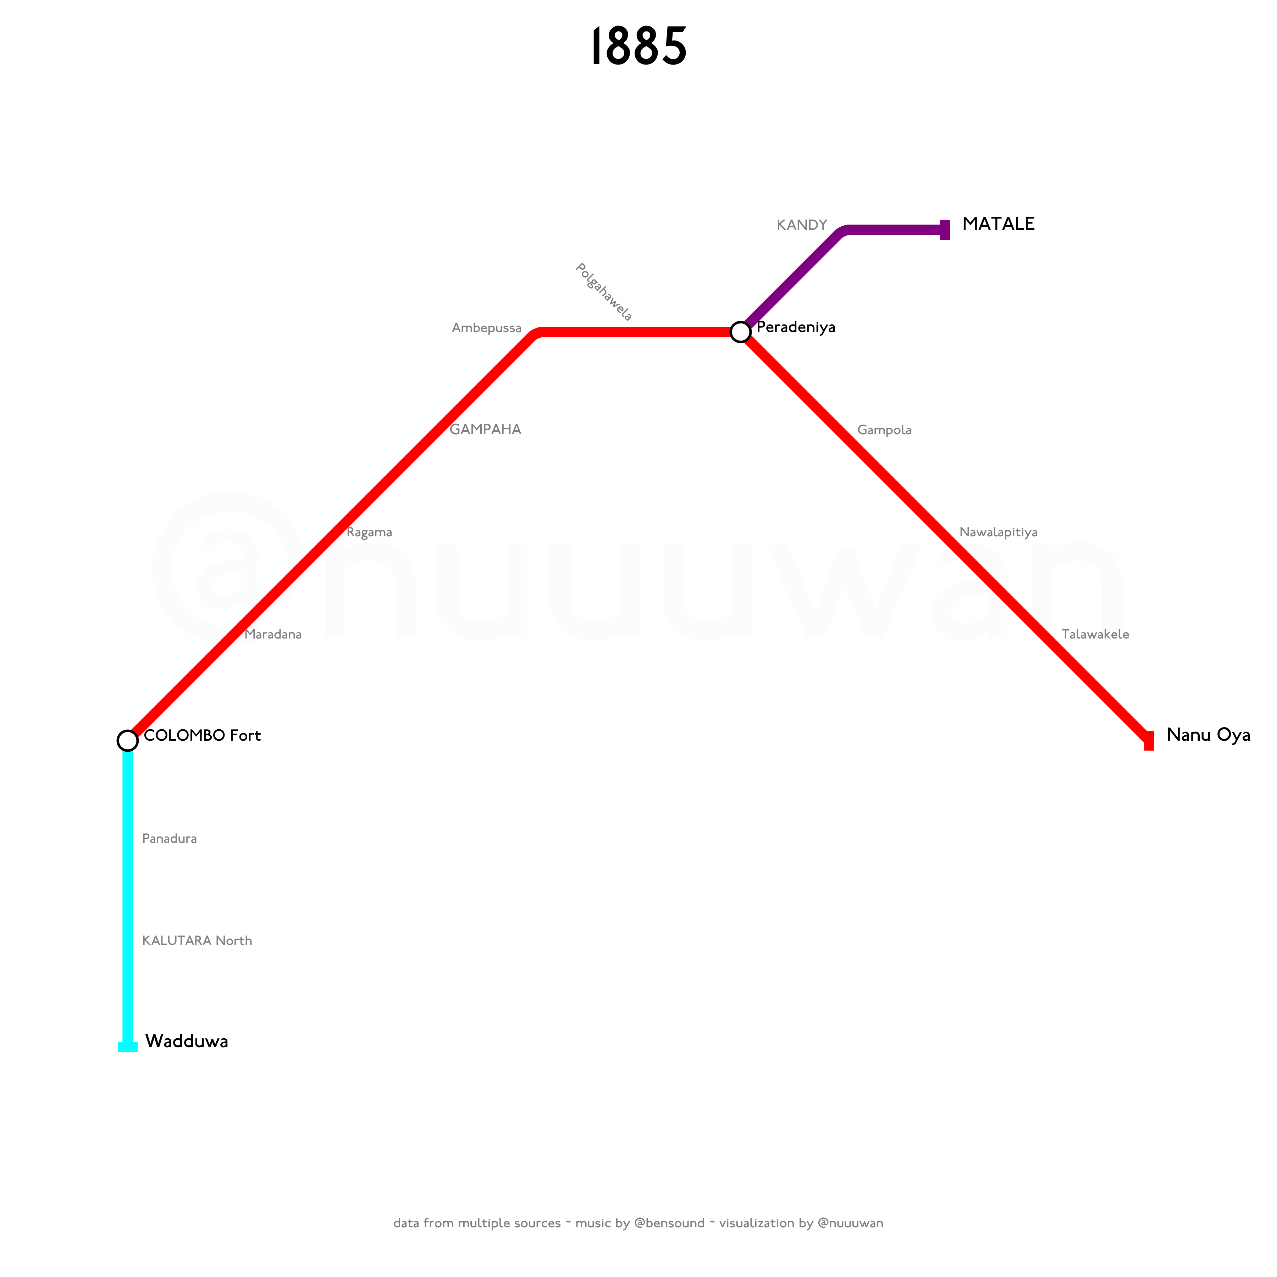
Notes:
In 1885, the Main Line was extended to Nanu Oya.

Slide 14
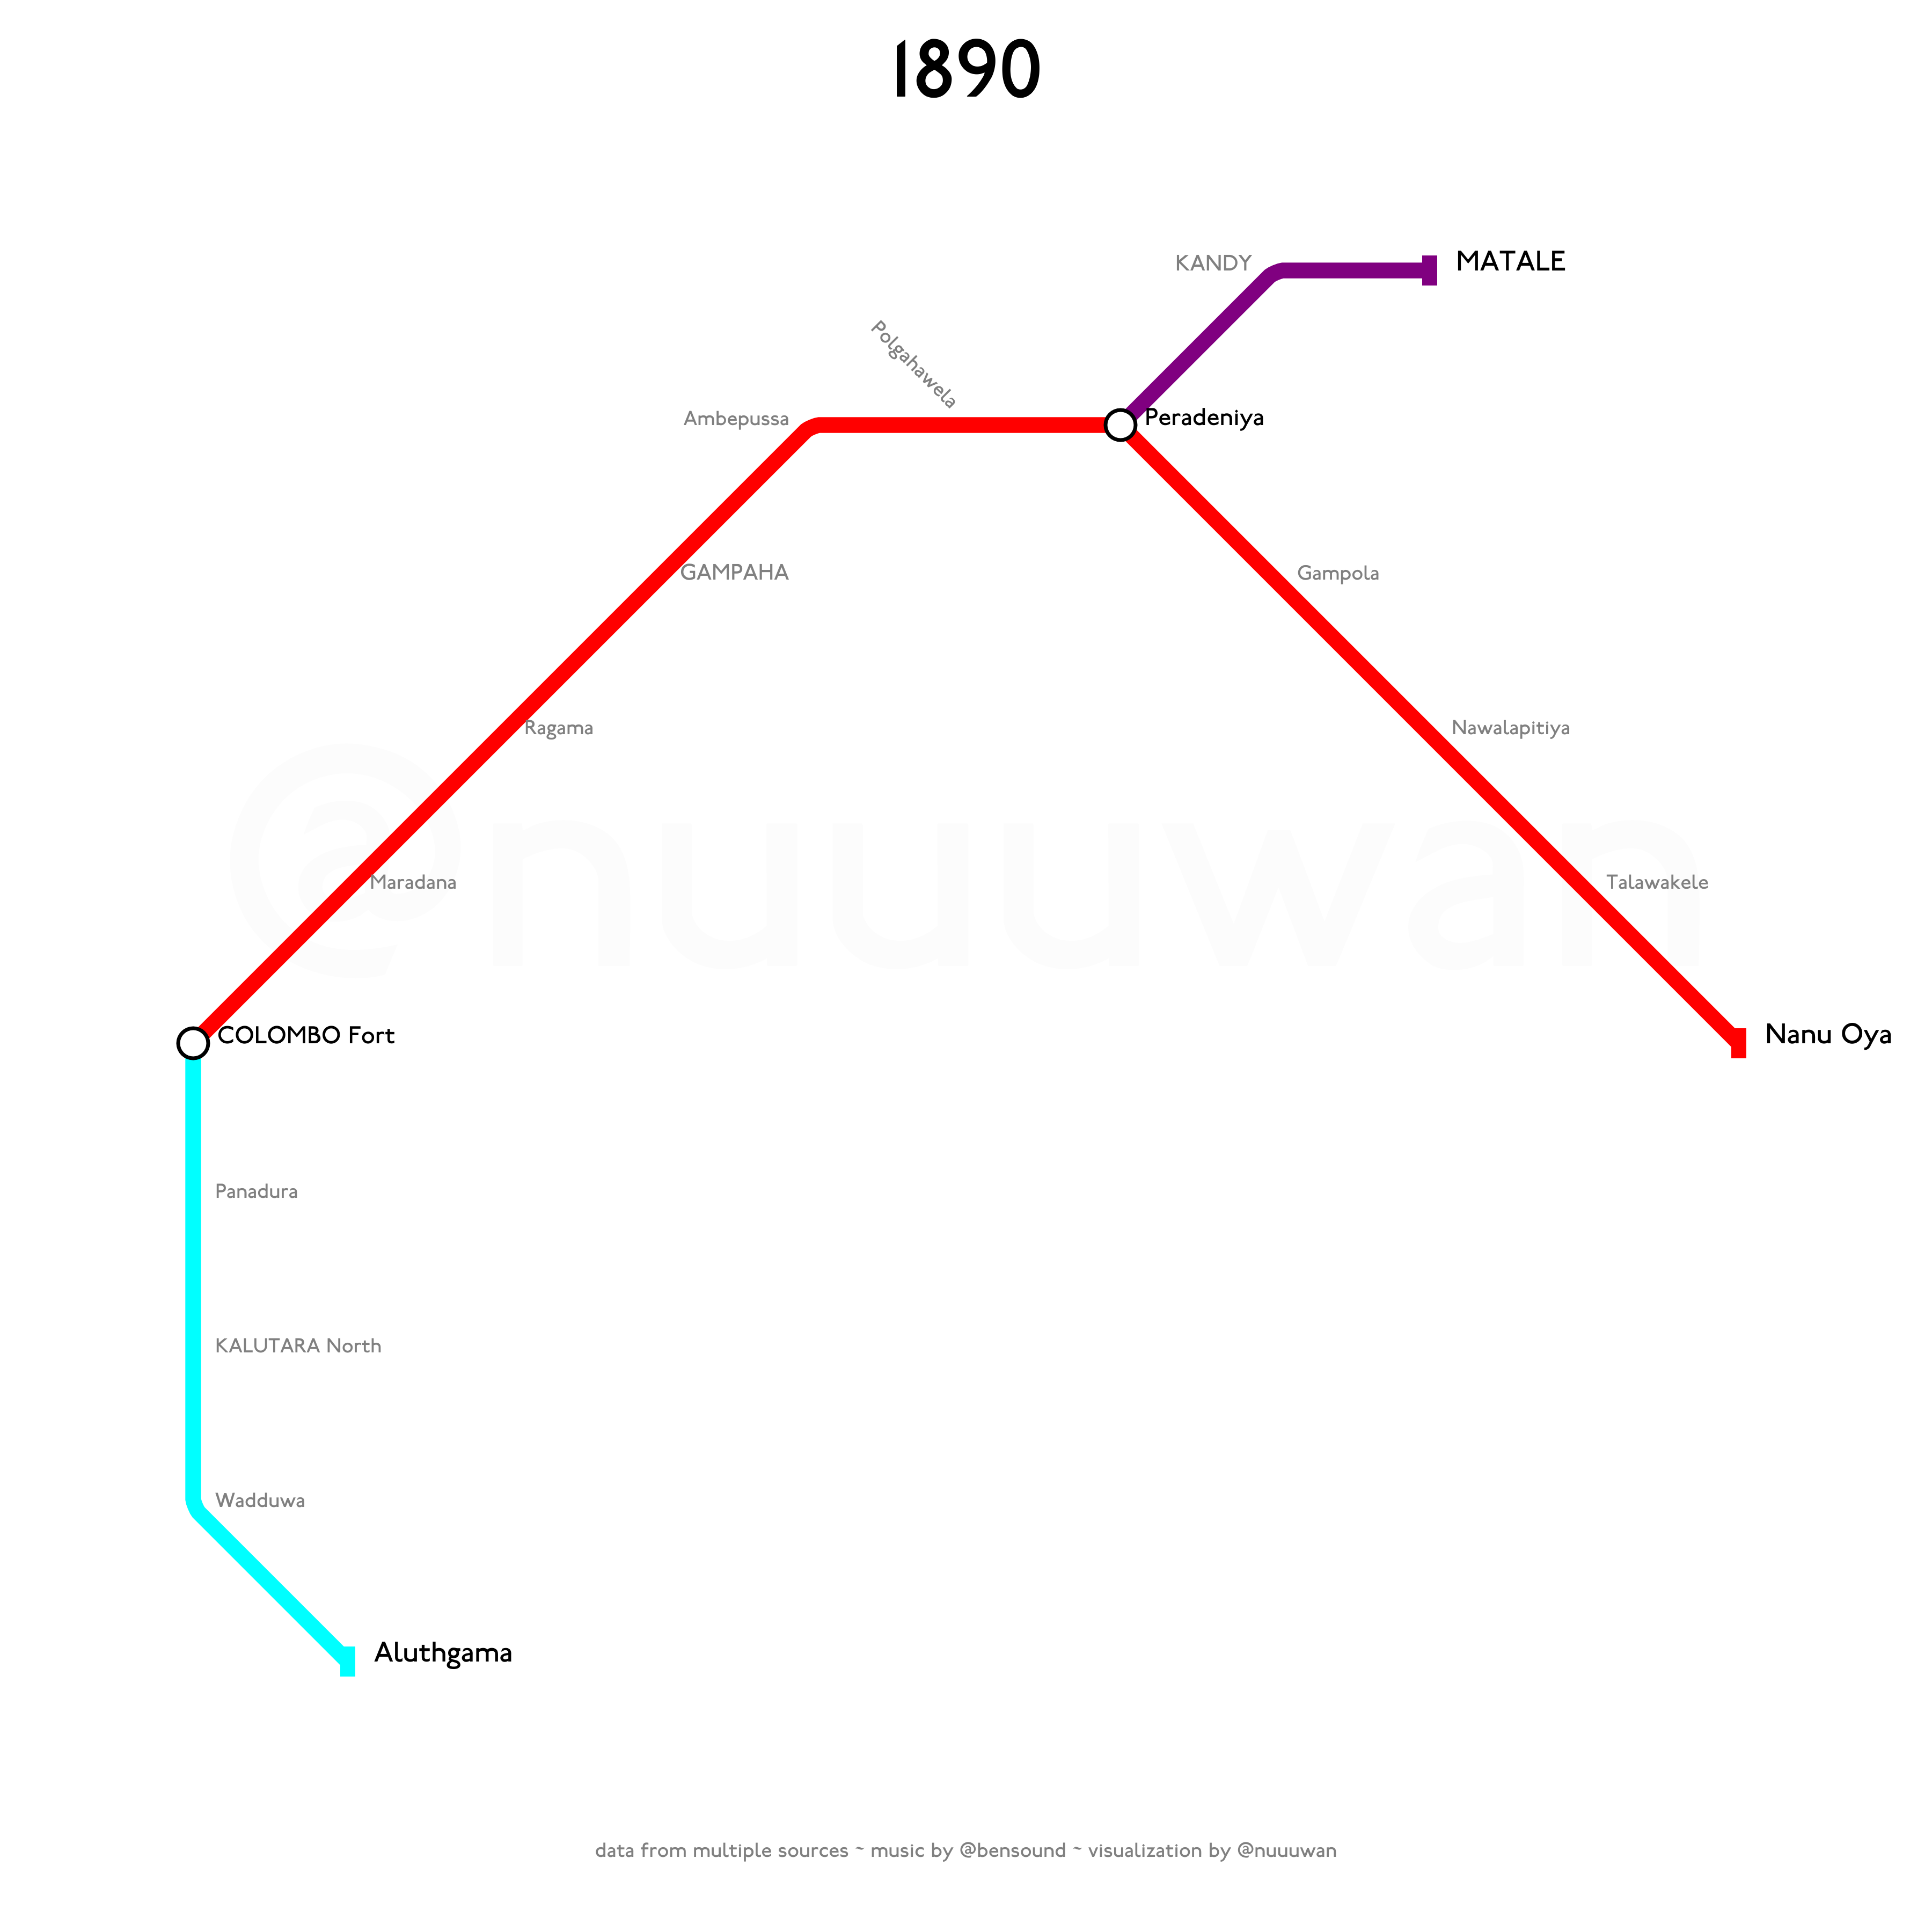
Notes:
On 31 March 1890, the Costal Line was extended from Wadduwa to Aluthgama.

Slide 15
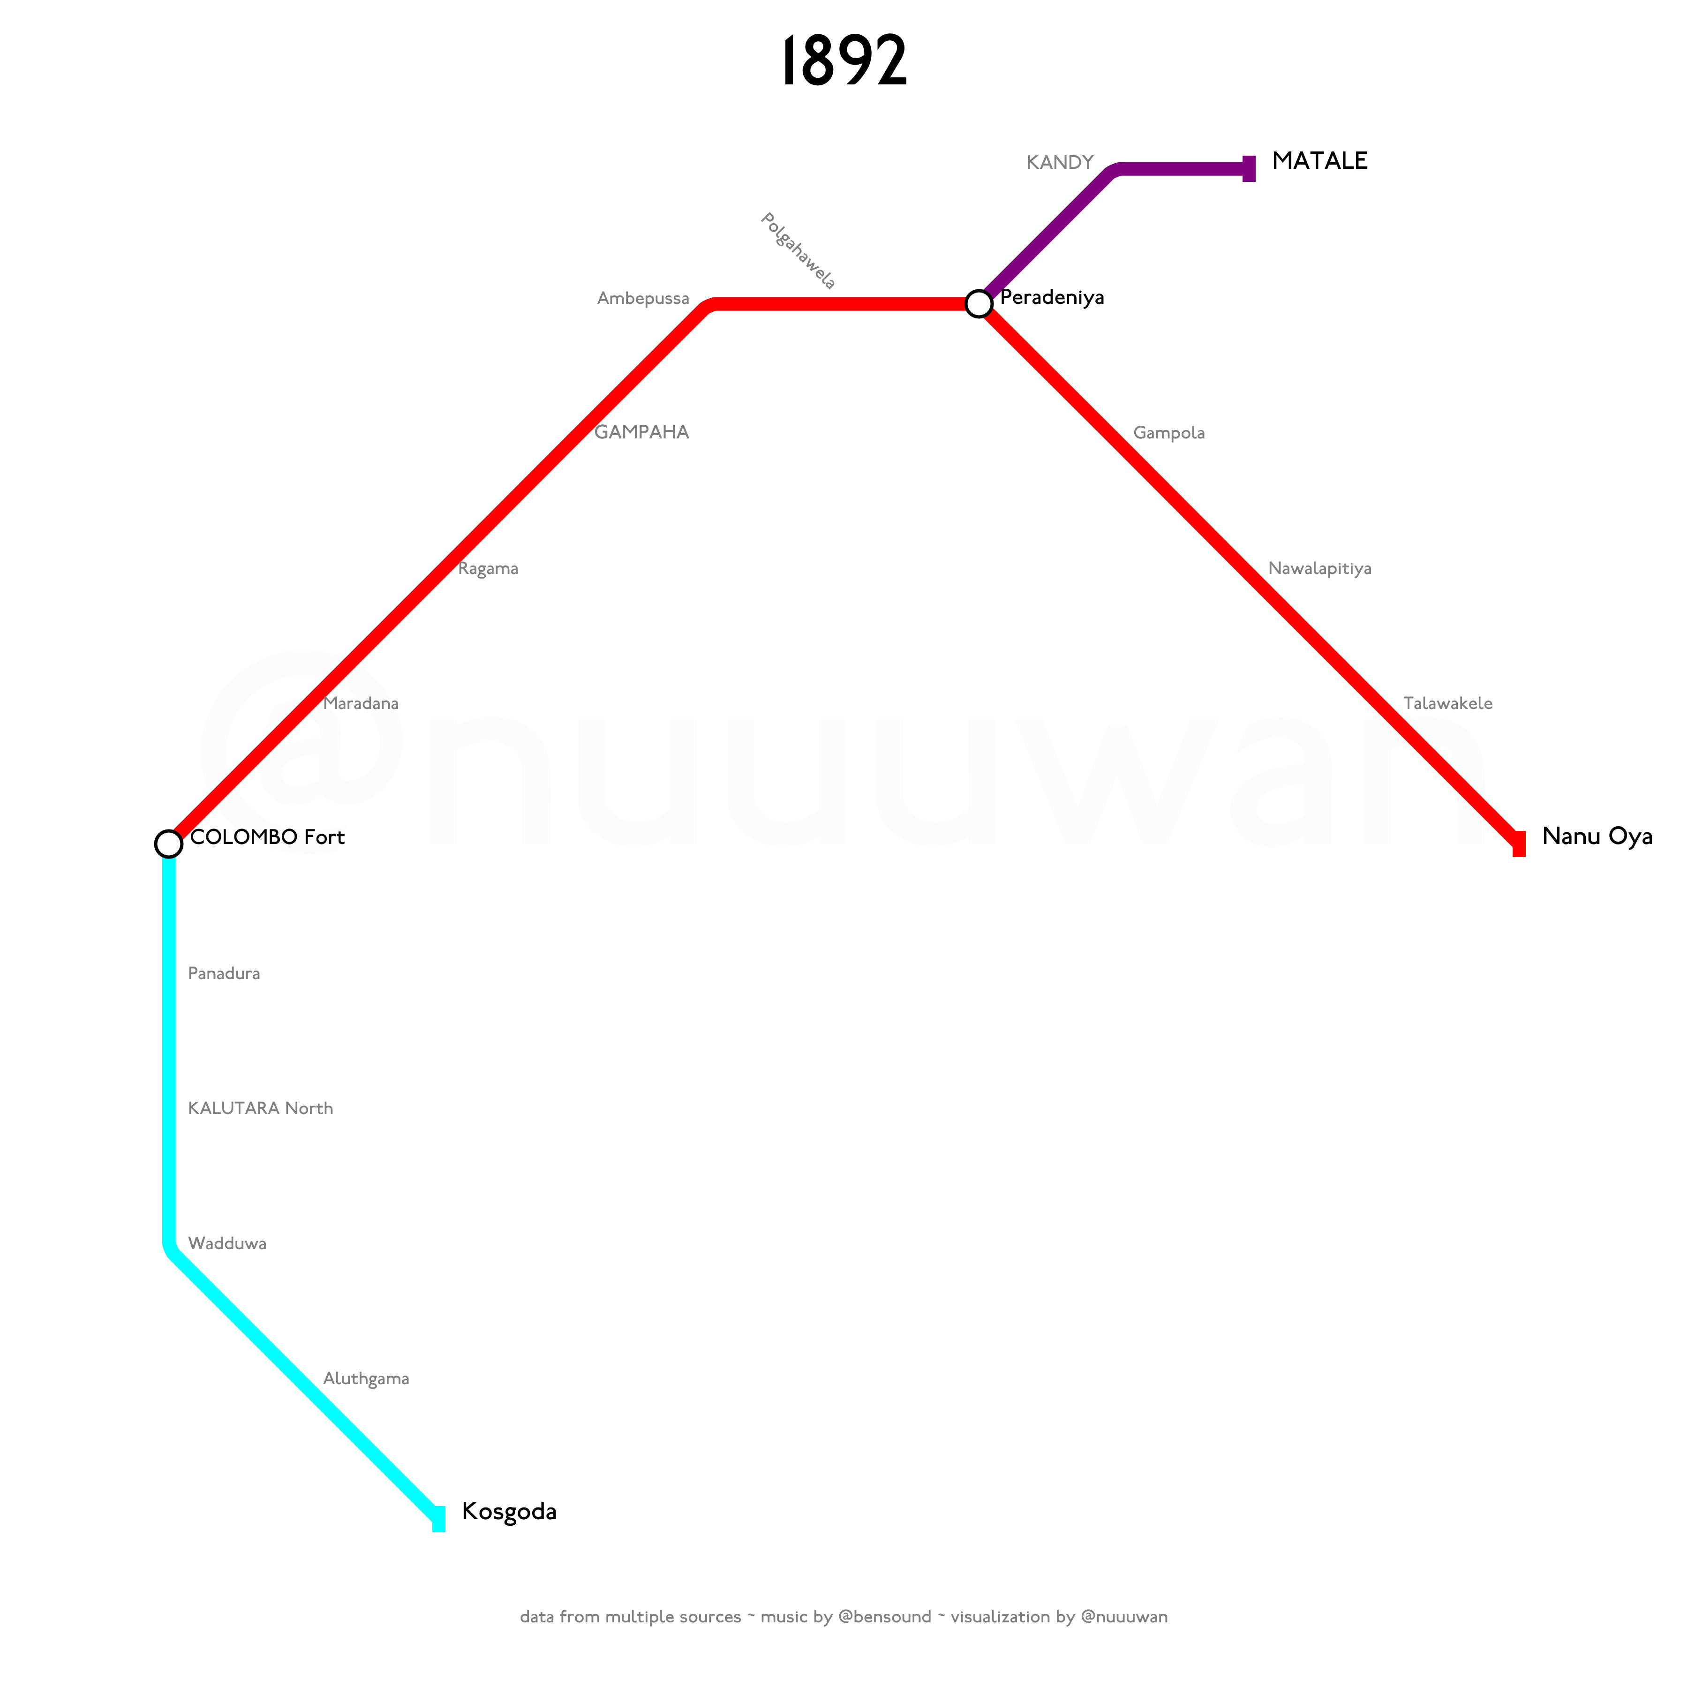
Notes:
Then from Wadduwa to Kosgoda on 8 September 1892.

Slide 16
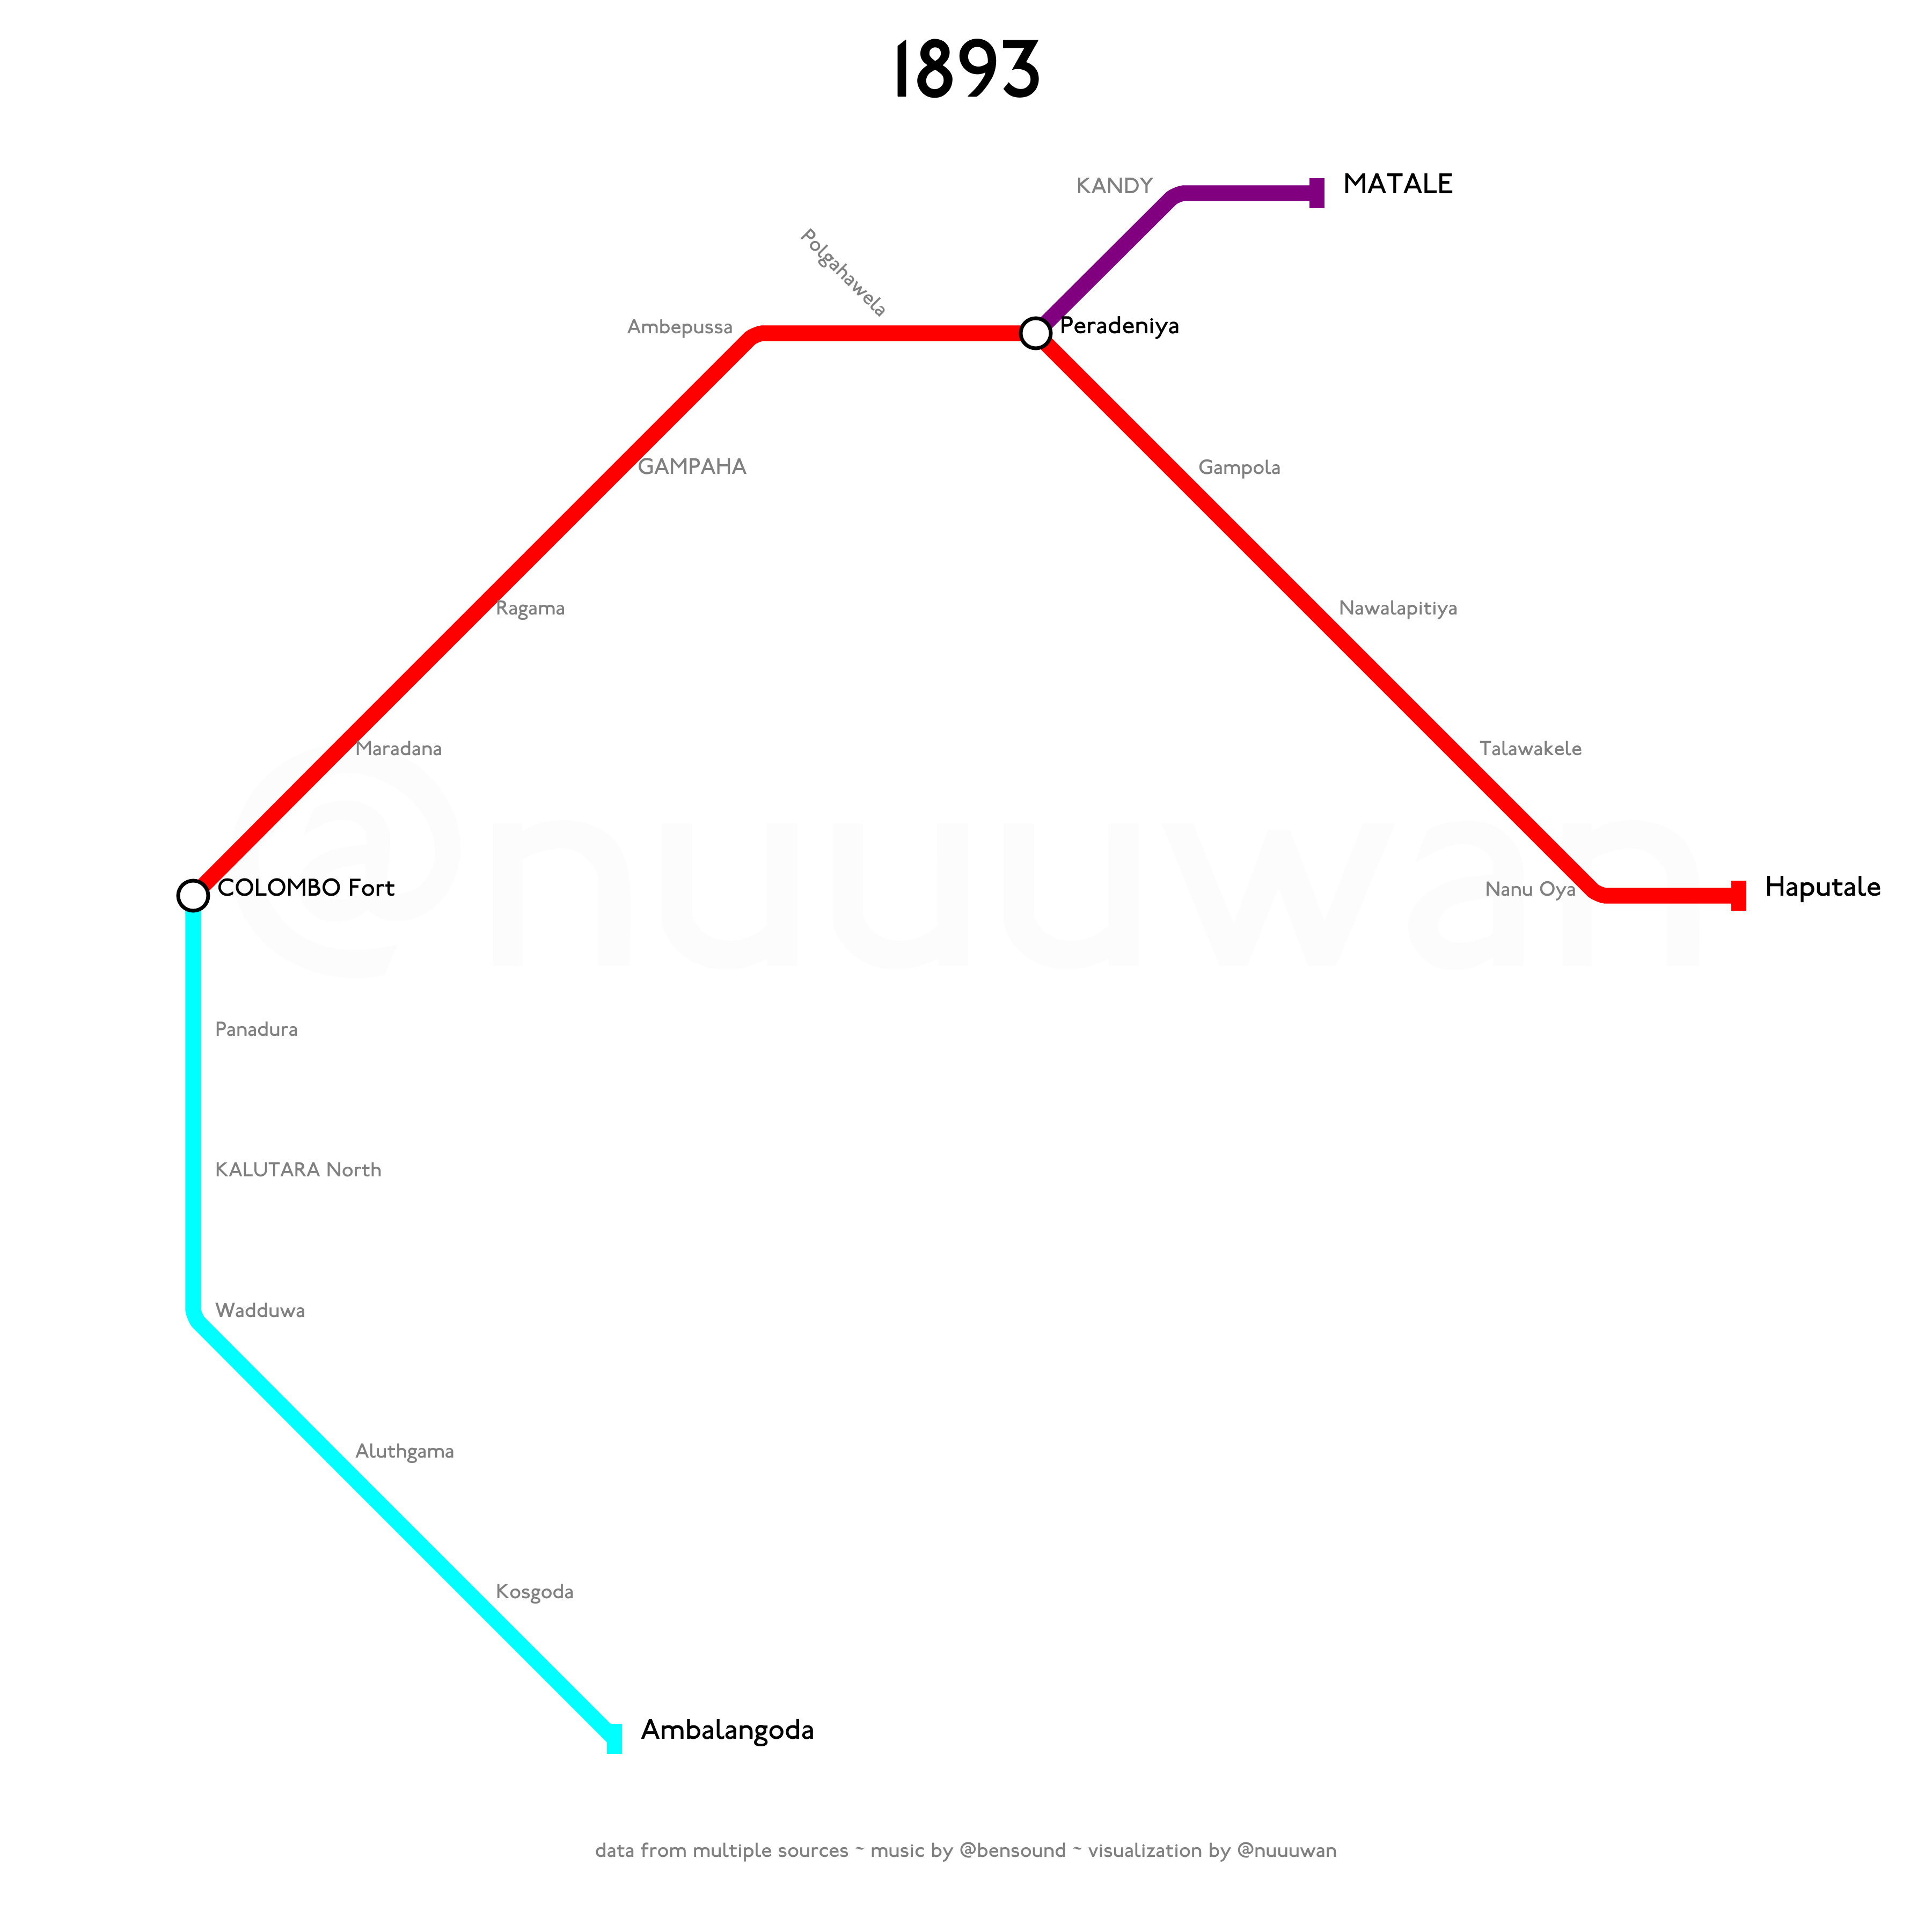
Notes:
And from Kosgoda to Ambalangoda on 15 November 1893.

Slide 17
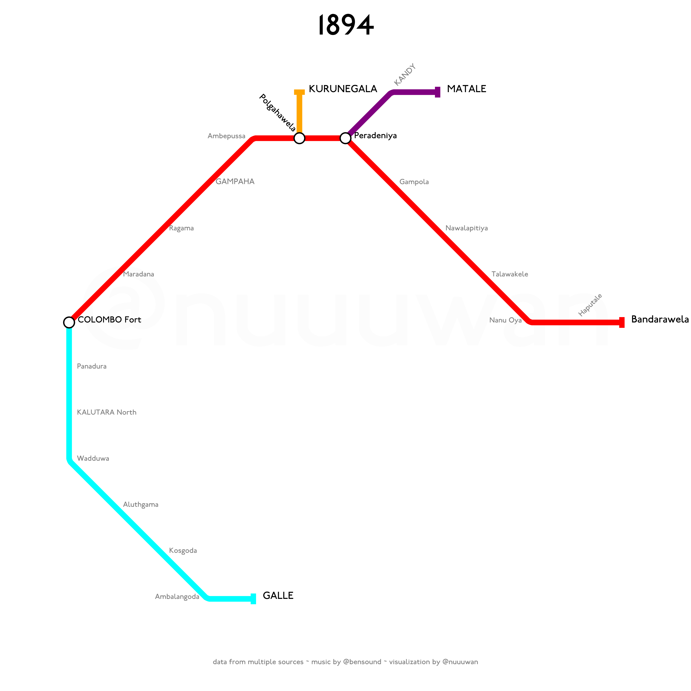
Notes:
There were three important developments to the Railway Network in 1894.
First, a new line connecting Polgahawela on the Main Line to Kurunegala opened on 14 February 1894. This new line would later become the Northern Line.
Second, on 7 May 1894 the Coastal Line was extended to Galle.
And finally, the Main Line was extended from Nanu Oya to Bandarawela.

Slide 18
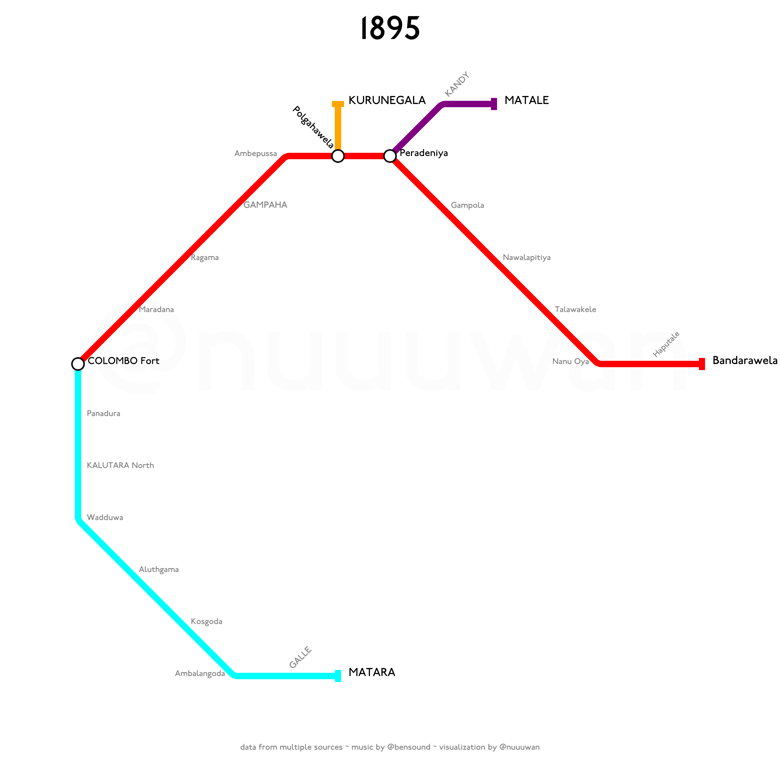
Notes:
On 17 December 1895, the Coastal Line was extended from Galle to Matara.

Slide 19
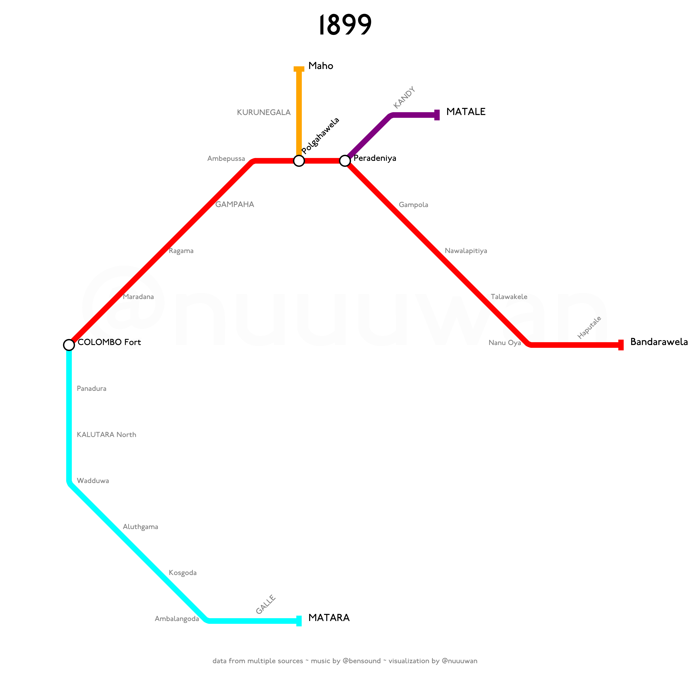
Notes:
In 1899, the Northern Line was extended from Kurunegala to Maho.
Tenders for the construction of railway line from Maho to Kankesanthurai were called in January 1900 and construction of the new line started in April of that year.
Construction of the Kankesanthurai-Pallai section, including Jaffna, began in July 1900.

Slide 20
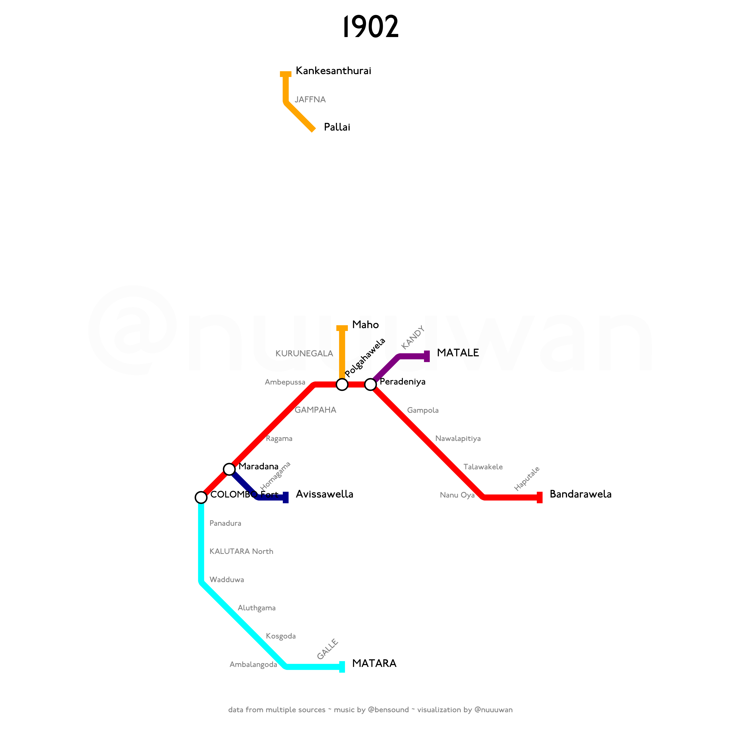
Notes:
This section was officially opened by Governor Sir J. W. Ridgeway on 11 March 1902.

Slide 21
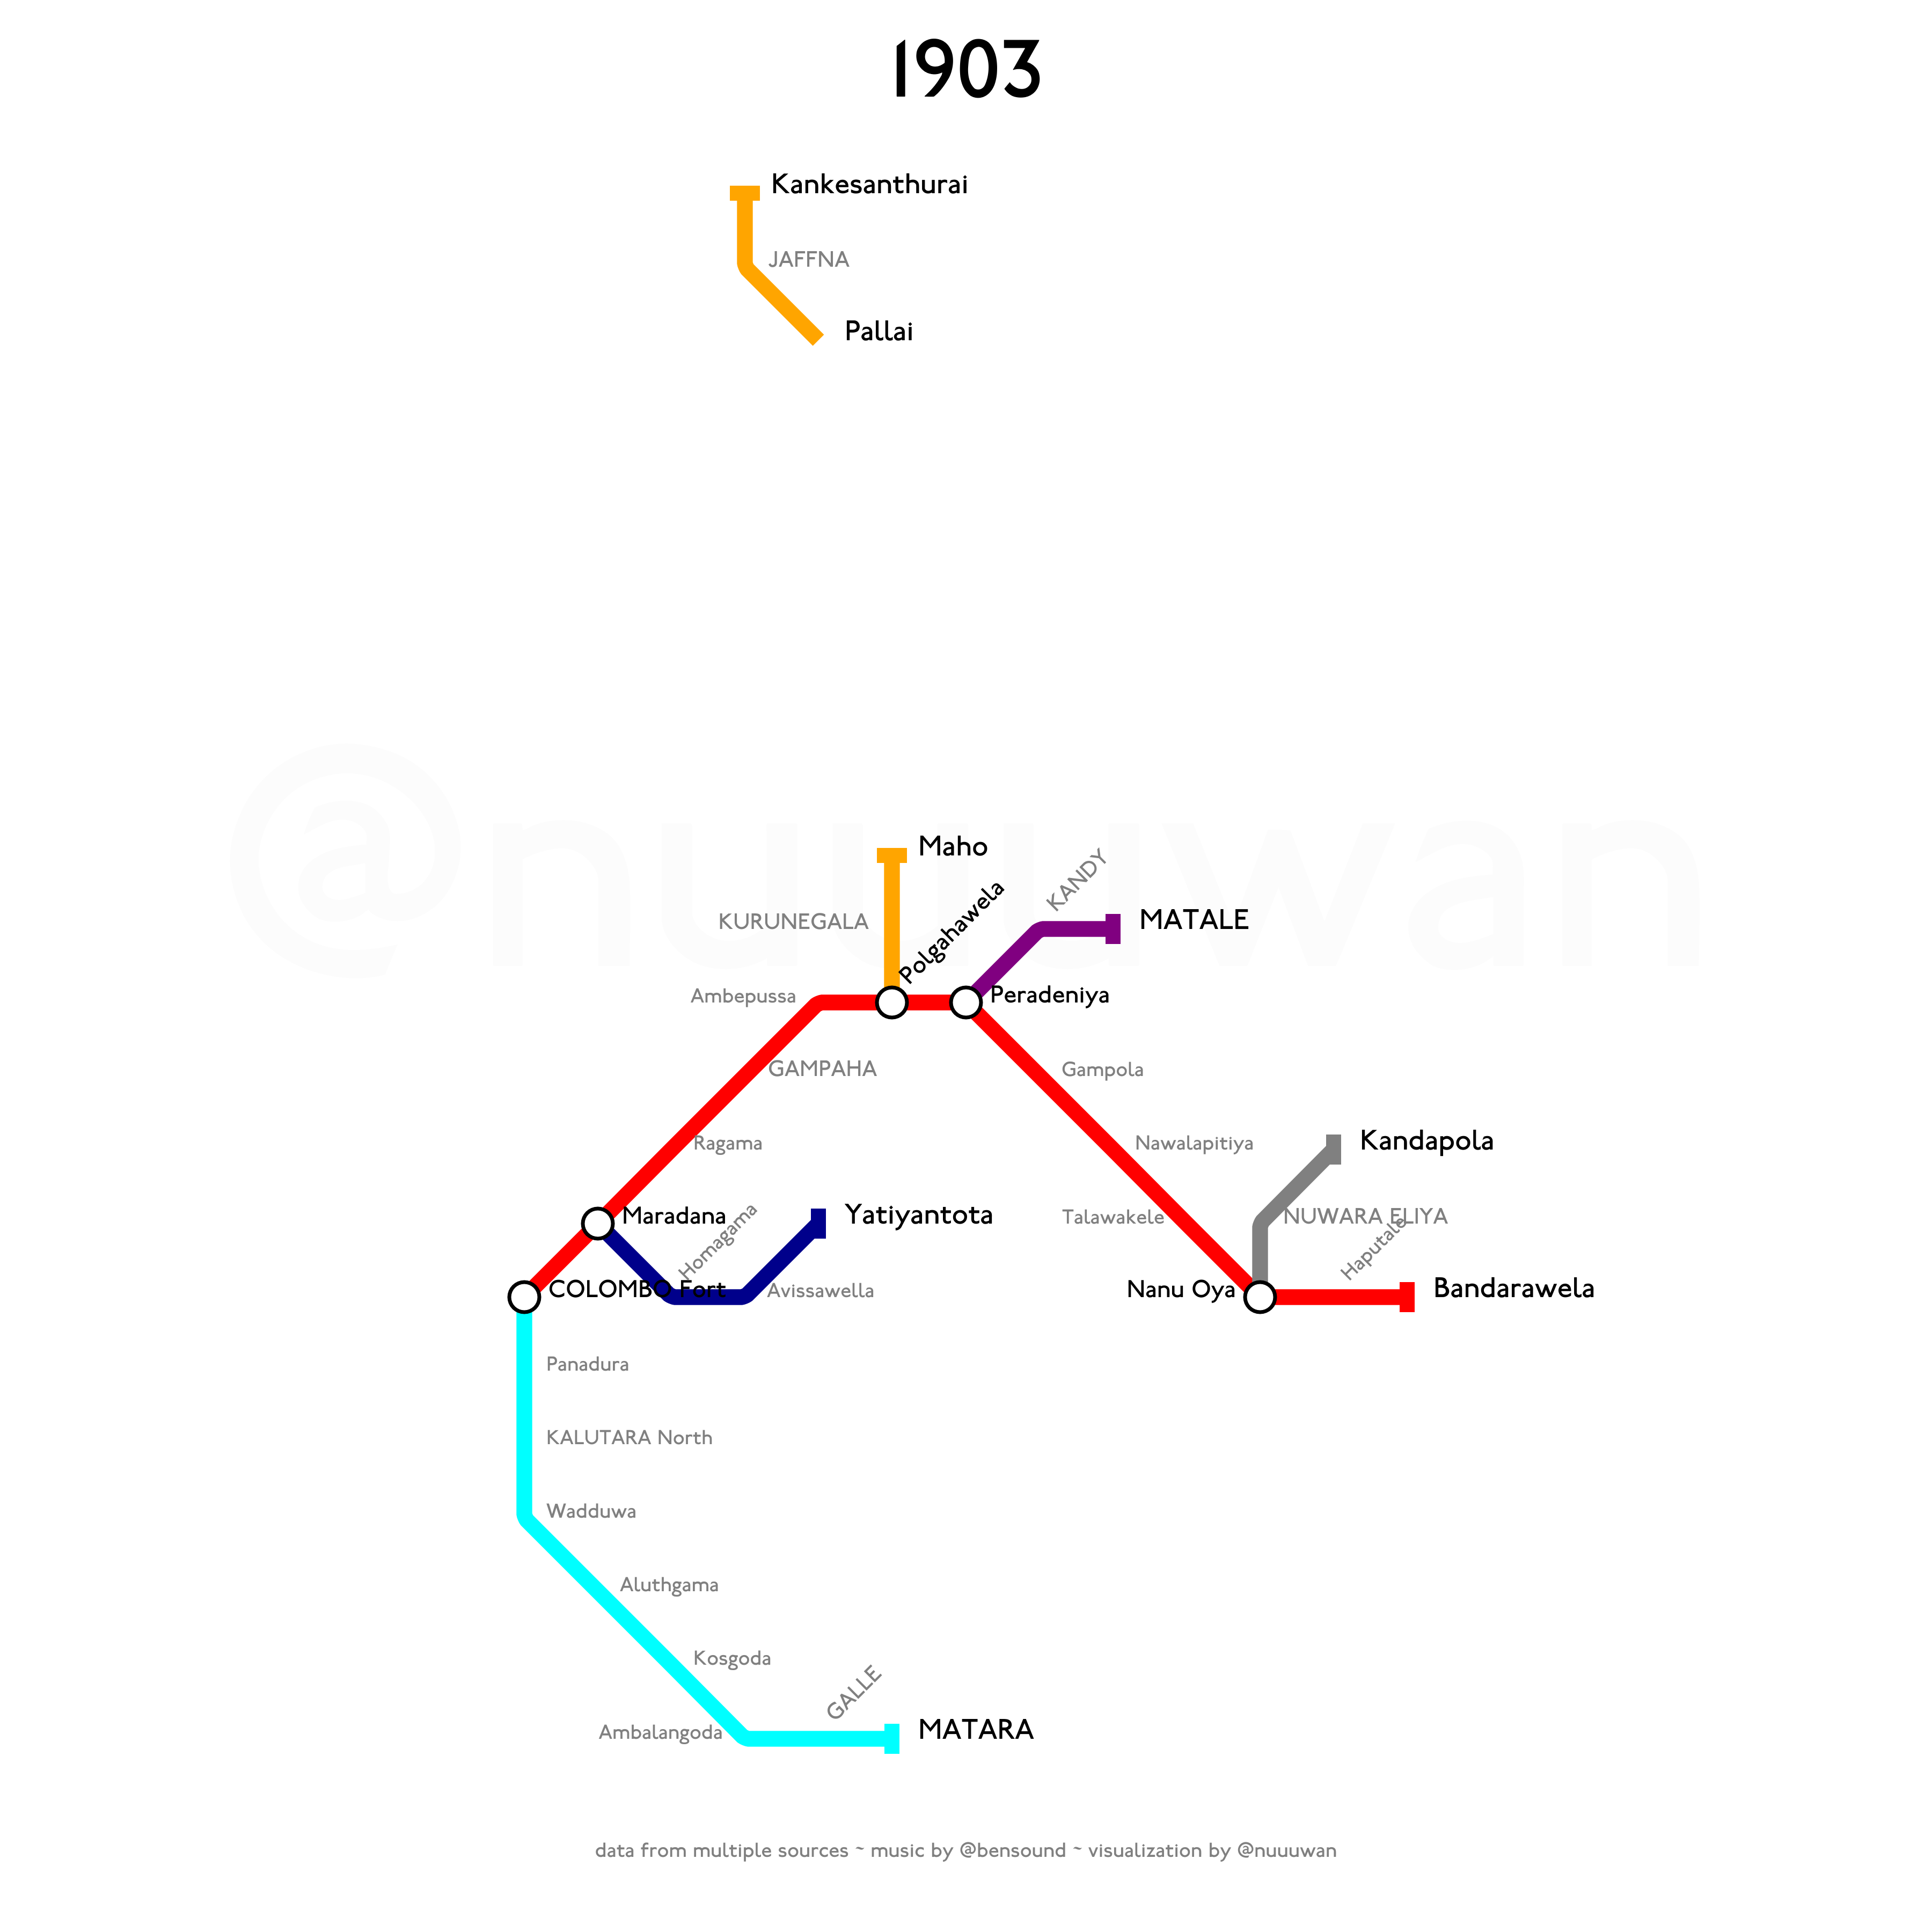
Notes:
1903 saw two new lines commencing service.
First, the Kelani Valley line, connecting Maradana on the Main line, and Yatiyantota commenced service. The line primarily served rubber plantations in the area.
Then on 14 December 1903, the Uda Pussellawa Railway (or UPR), connecting Nanu Oya on the Main Line and Nuwara Eliya, also commenced service.
By 21 December 1903, the UPR was extended from Nuwara Eliya to Kandapola.

Slide 22
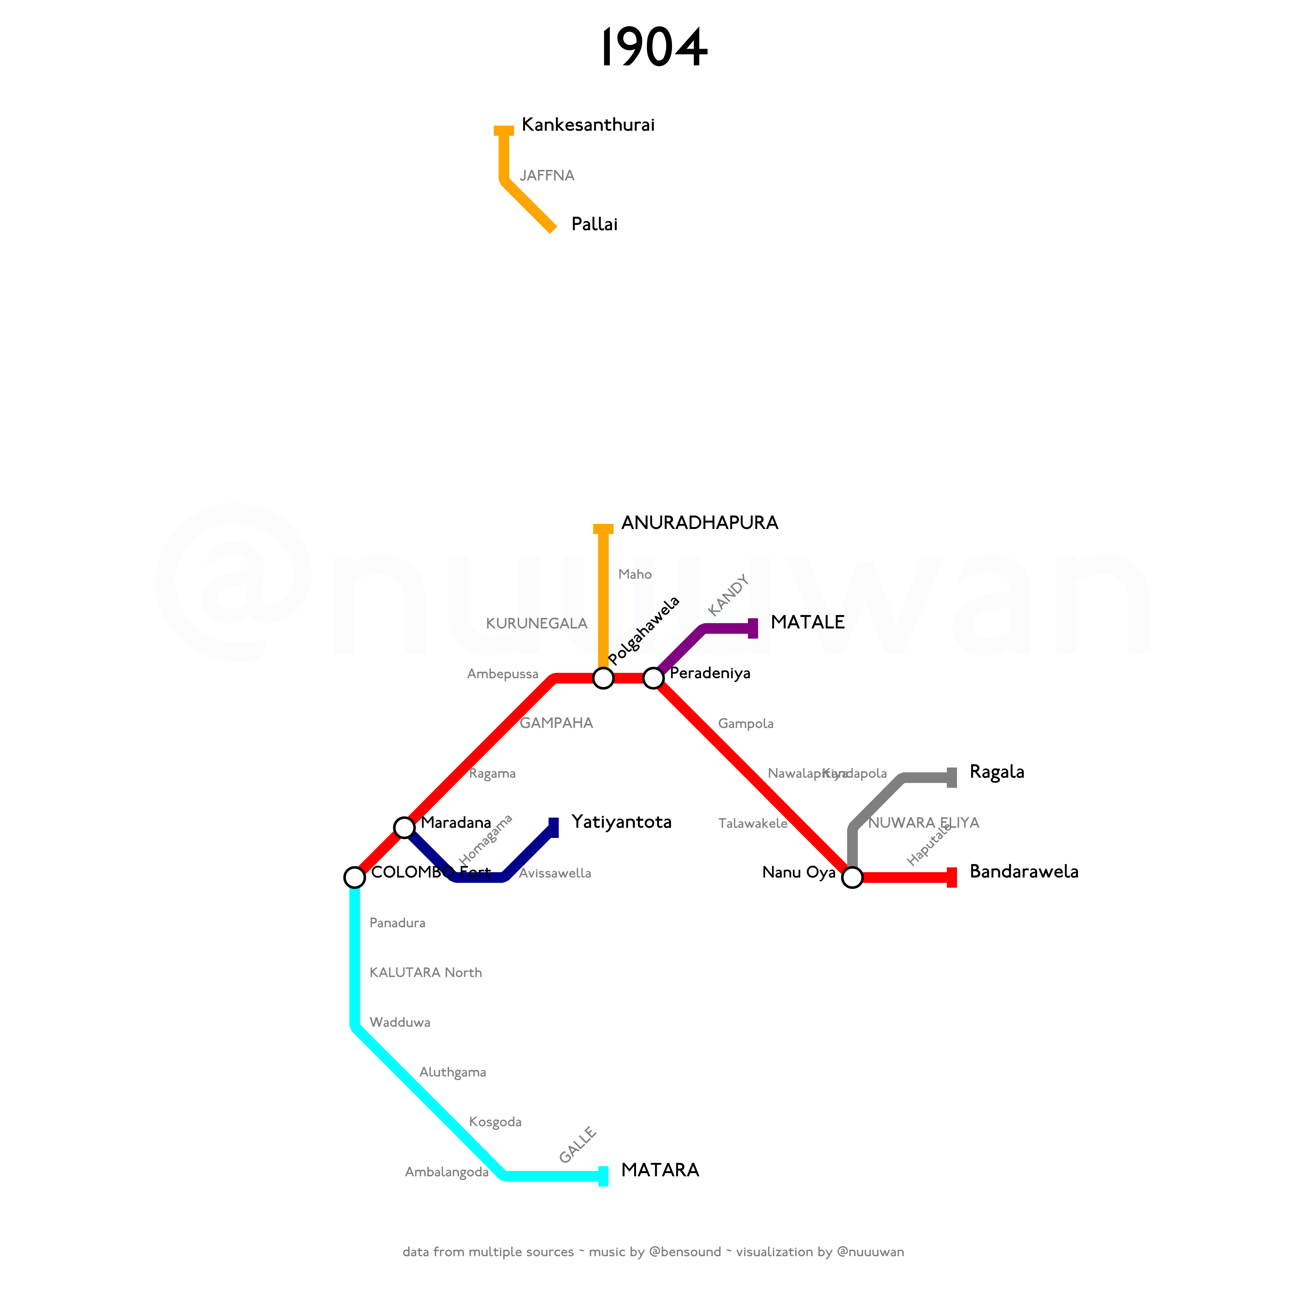
Notes:
In July 1904, the Uda Pussellawa Railway was extended from Kandapola to Ragala.
Then on 1 November 1904, the Northern Line was extended from Maho to Anuradhapura.

Slide 23
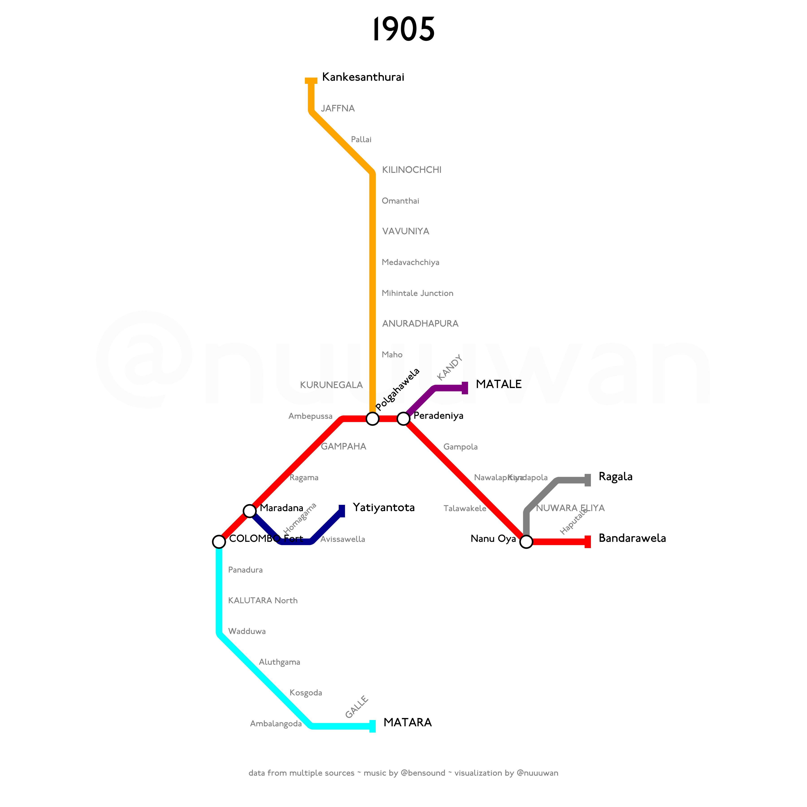
Notes:
On 11 March 1905, the Northern Line was extended from Anuradhapura to Medawachchiya, and on 1 August 1905 from Medawachchiya to Pallai, finally connecting the national capital Colombo with Jaffna, the capital of the Northern Province.
Construction of a new line to Puttalam commenced on 3 July 1907.

Slide 24
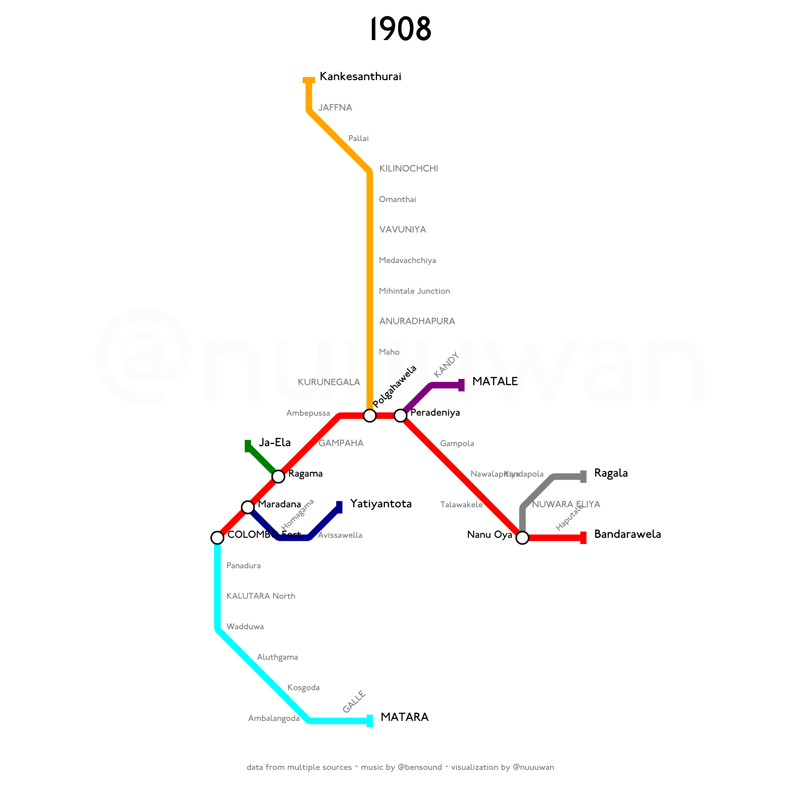
Notes:
The first segment, connecting Ragama on the Main Line, with Ja-Ela, commenced on 9 November 1908.
This new line was originally called the North-Western Line, but was later referred to as the Puttalam Line.

Slide 25
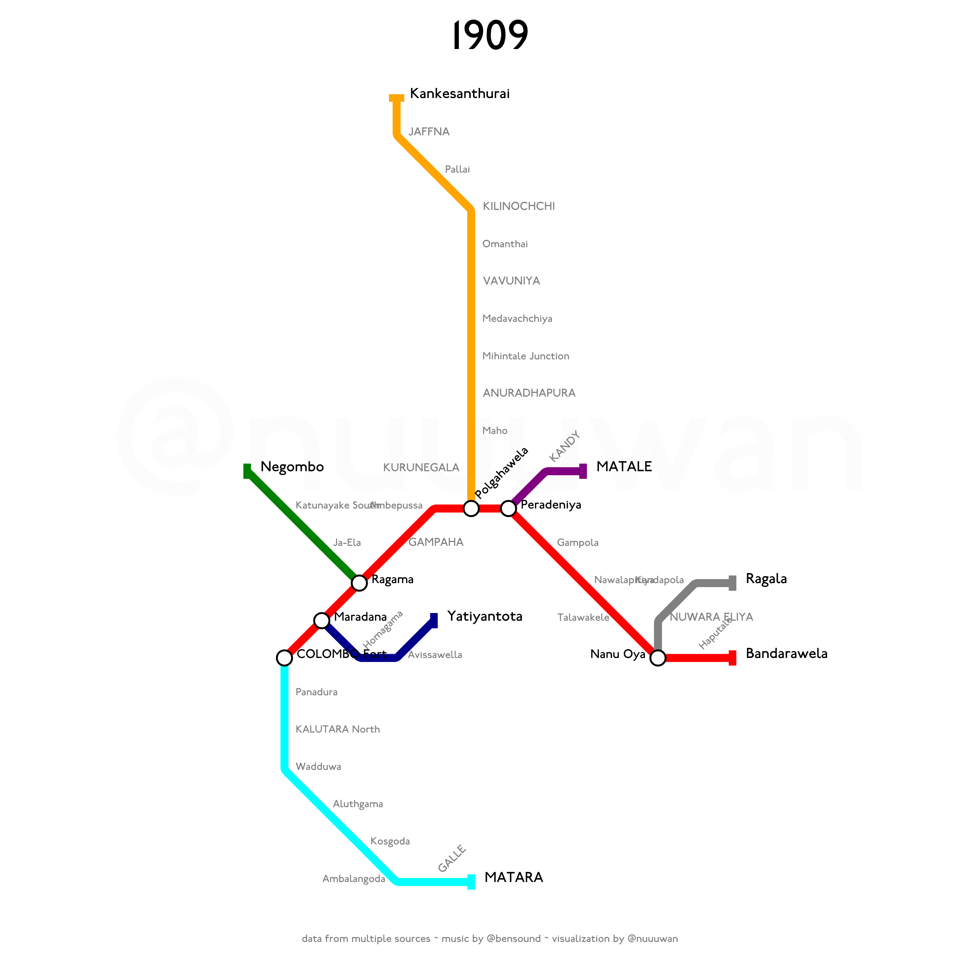
Notes:
On 1 December 1909, the Puttalam Line was extended from Ja-Ela to Negombo.

Slide 26

Notes:
A new branch line off the Kelani Valley line, from Avissawella to Opanayaka via Ratnapura, commenced service in 1912.

Slide 27
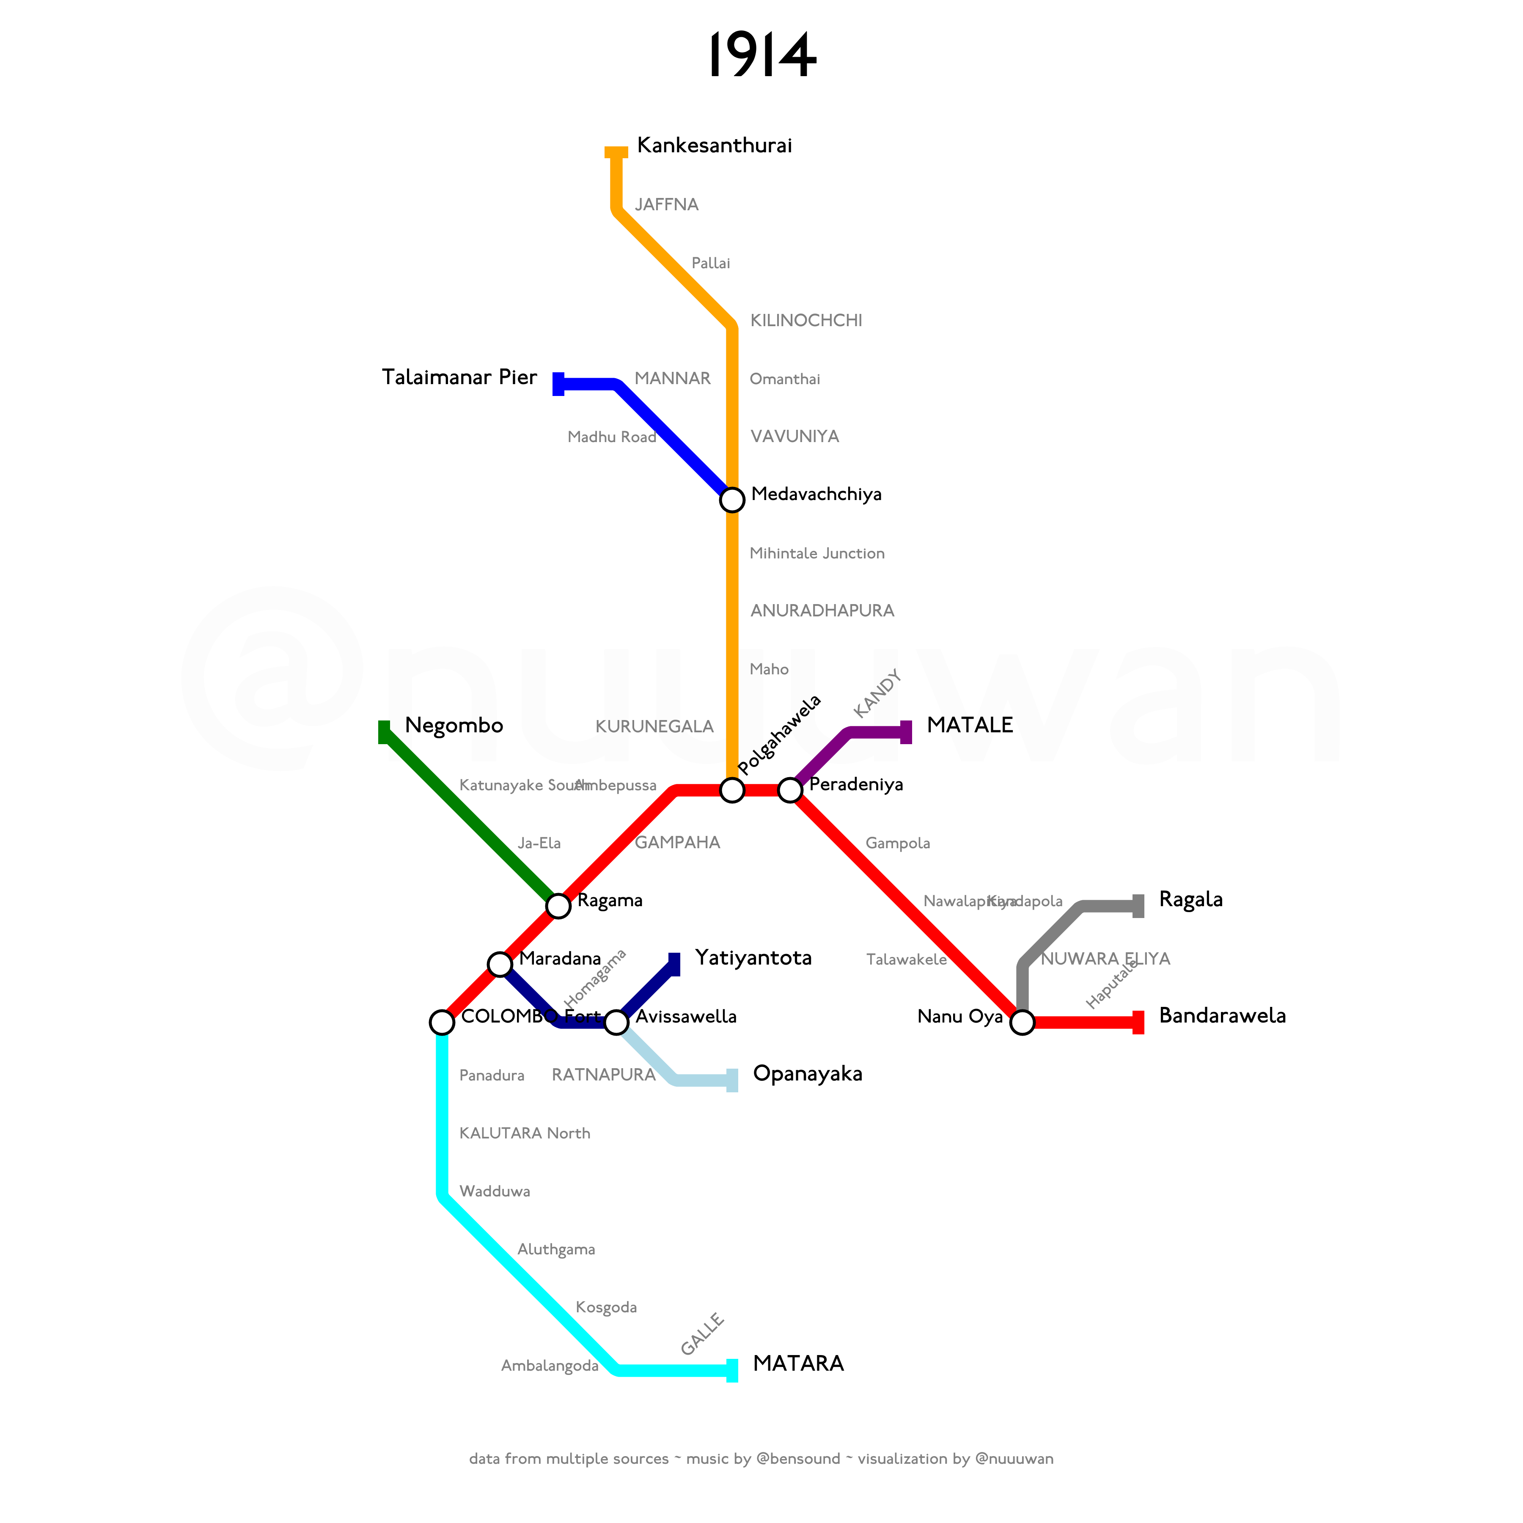
Notes:
The Mannar Line, a new line branching off Medawachchiya on the Northern Line, and connecting to Talaimannar Pier, opened in 1914.

Slide 28
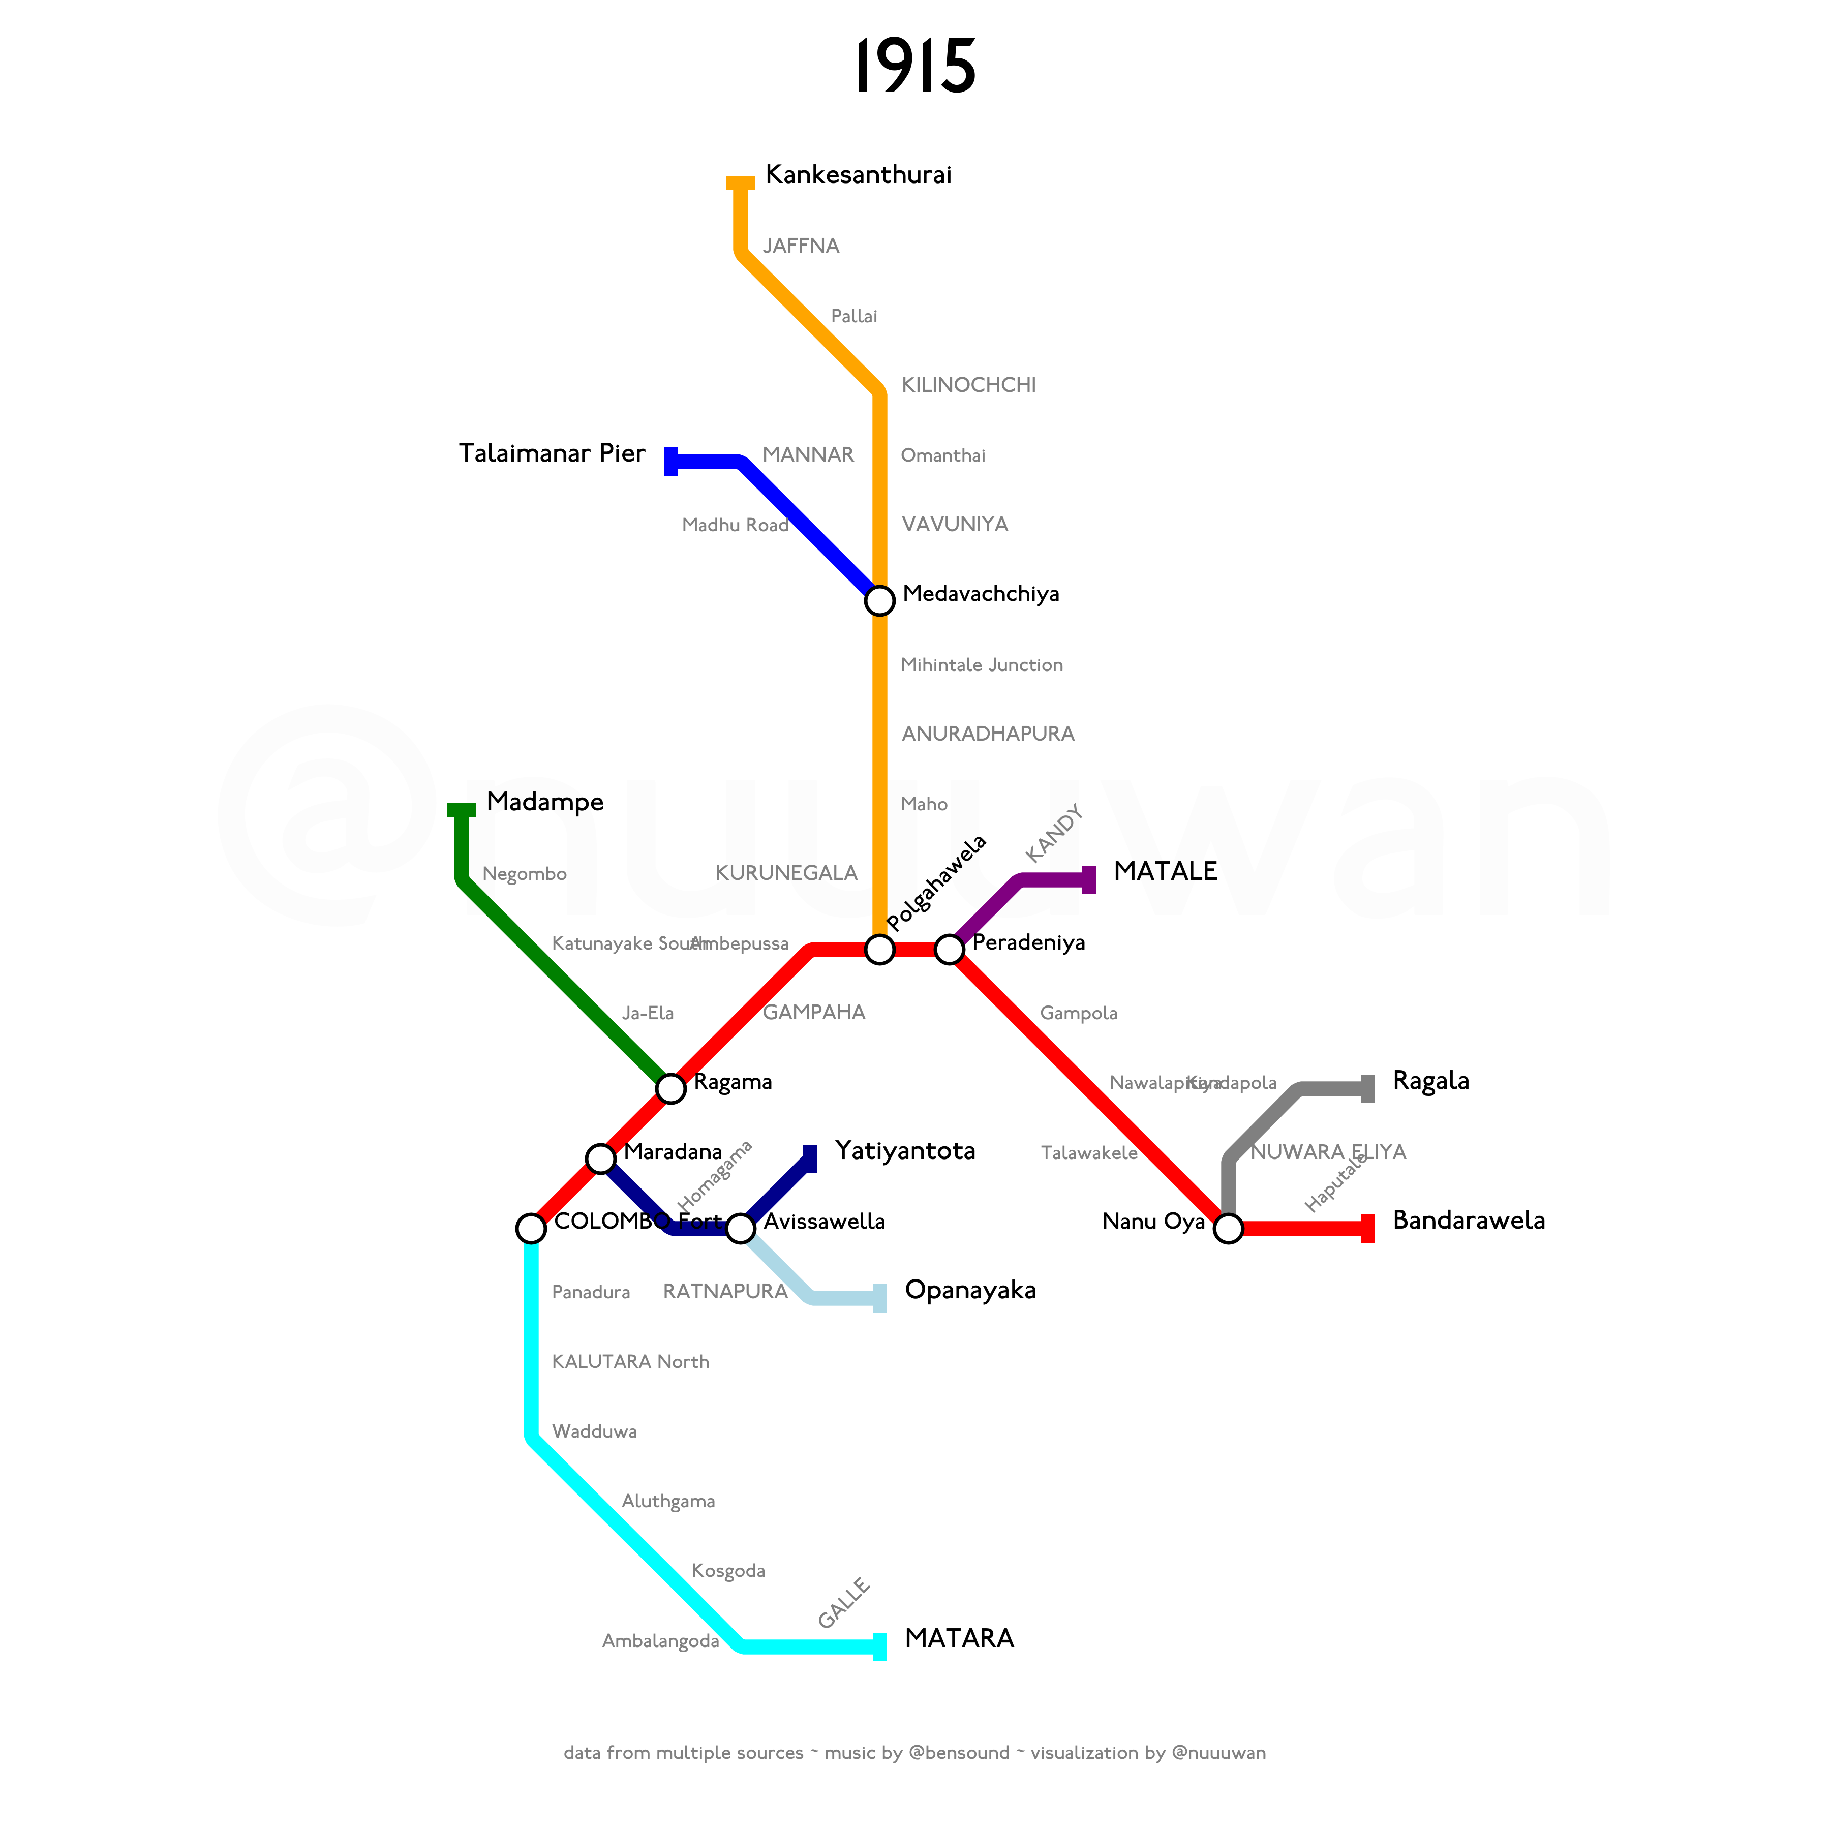
Notes:
The Puttalam Line was extended from Negombo to Madampe in 1915.

Slide 29
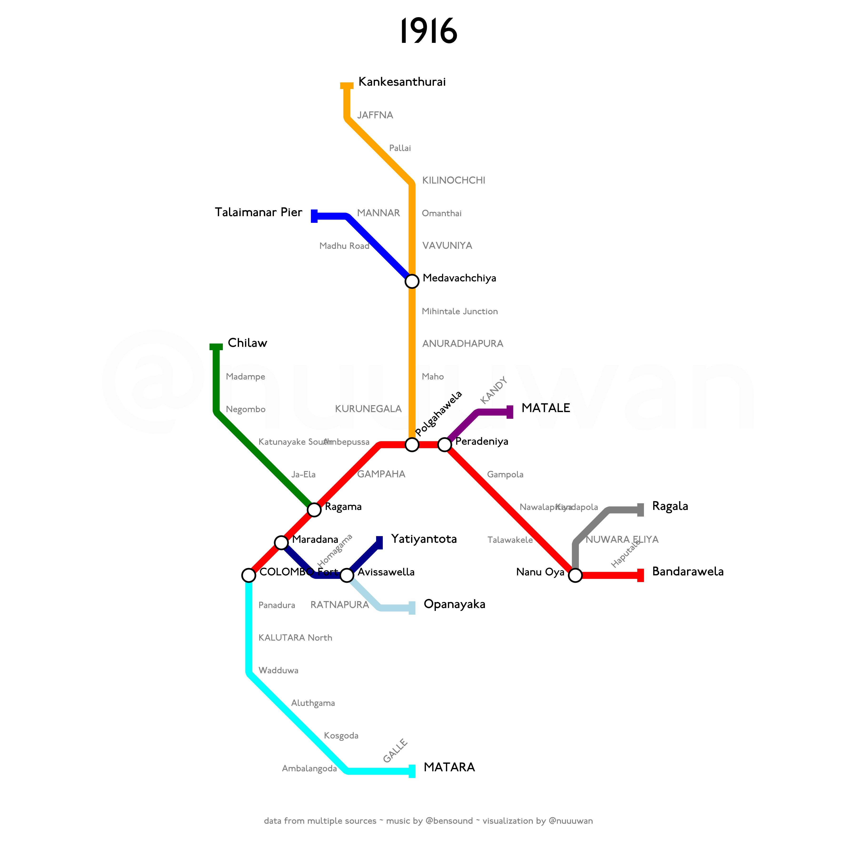
Notes:
And then from Madampe to Chilaw in 1916.

Slide 30
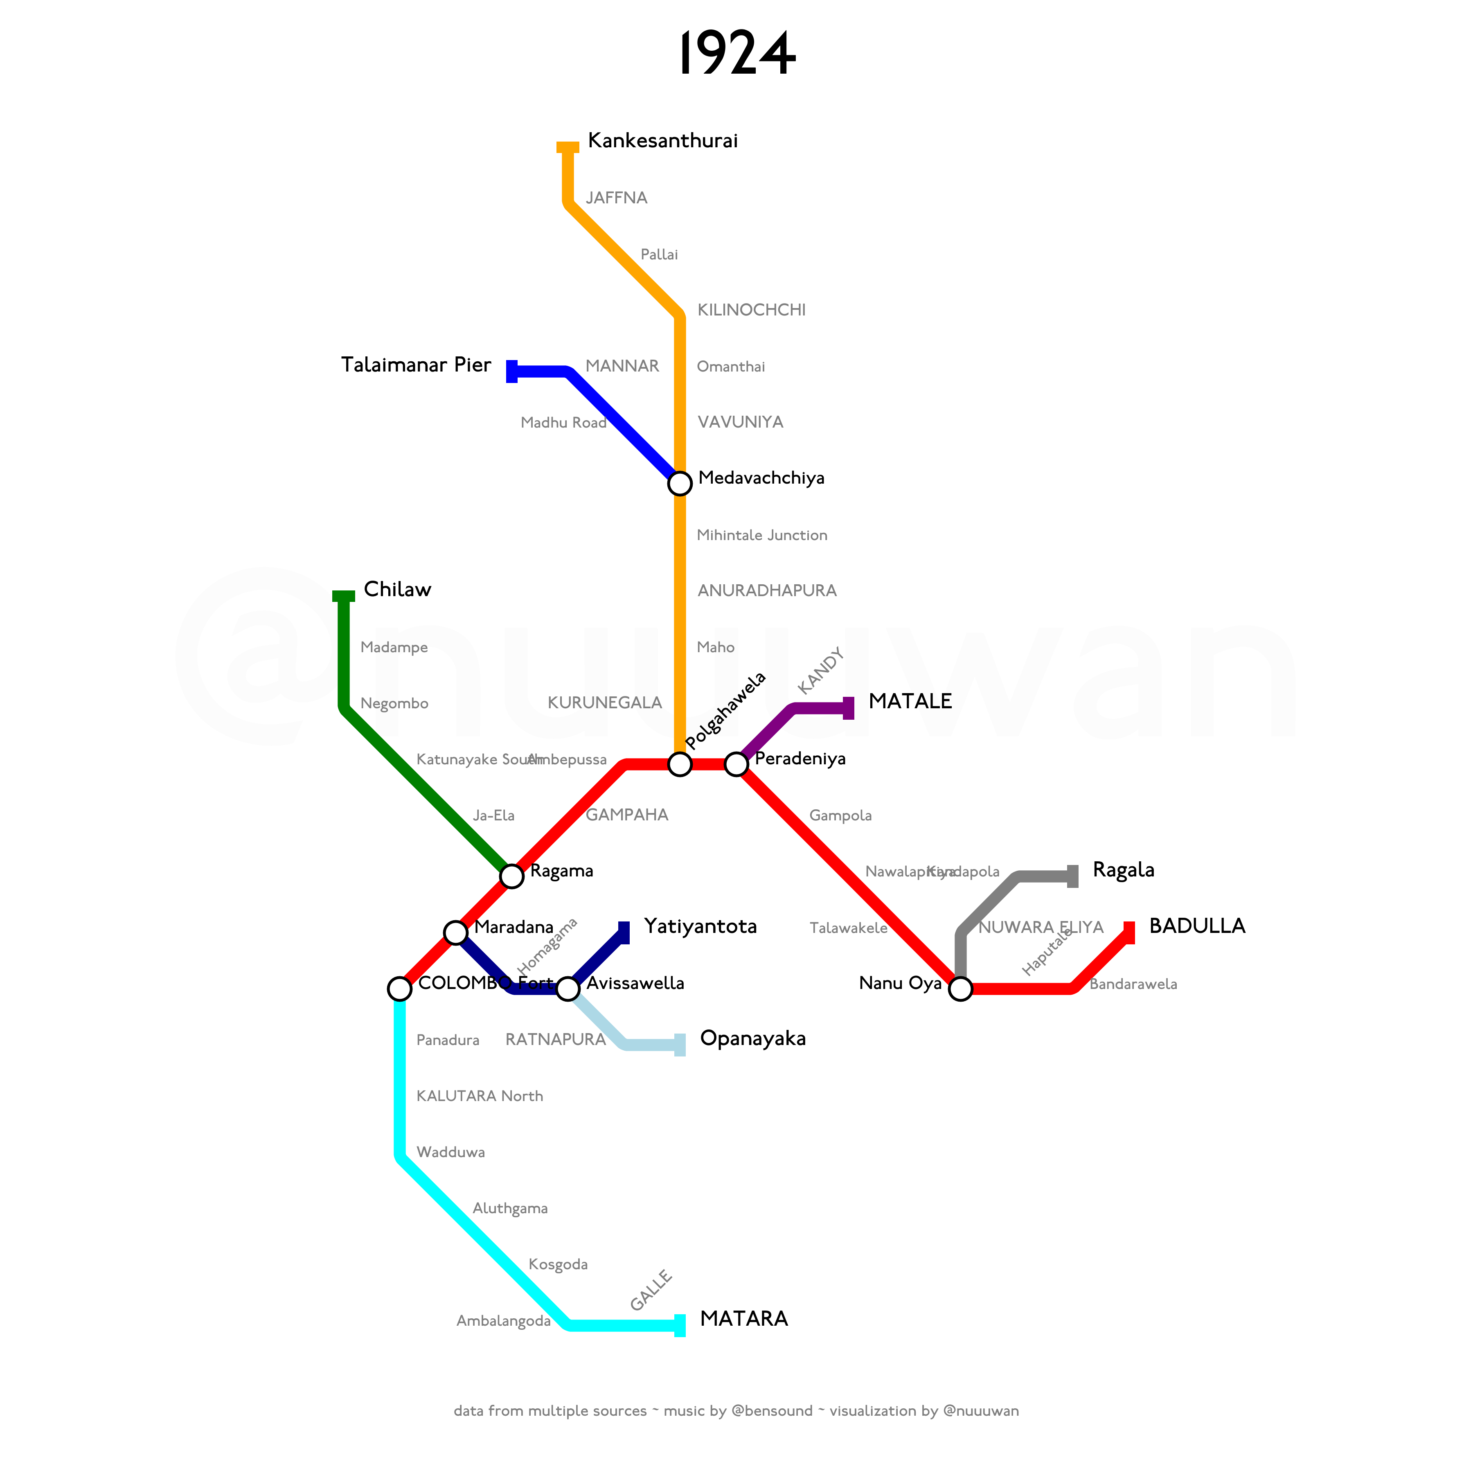
Notes:
In 1924, the Main line was extended from Bandarawela to Badulla.

Slide 31
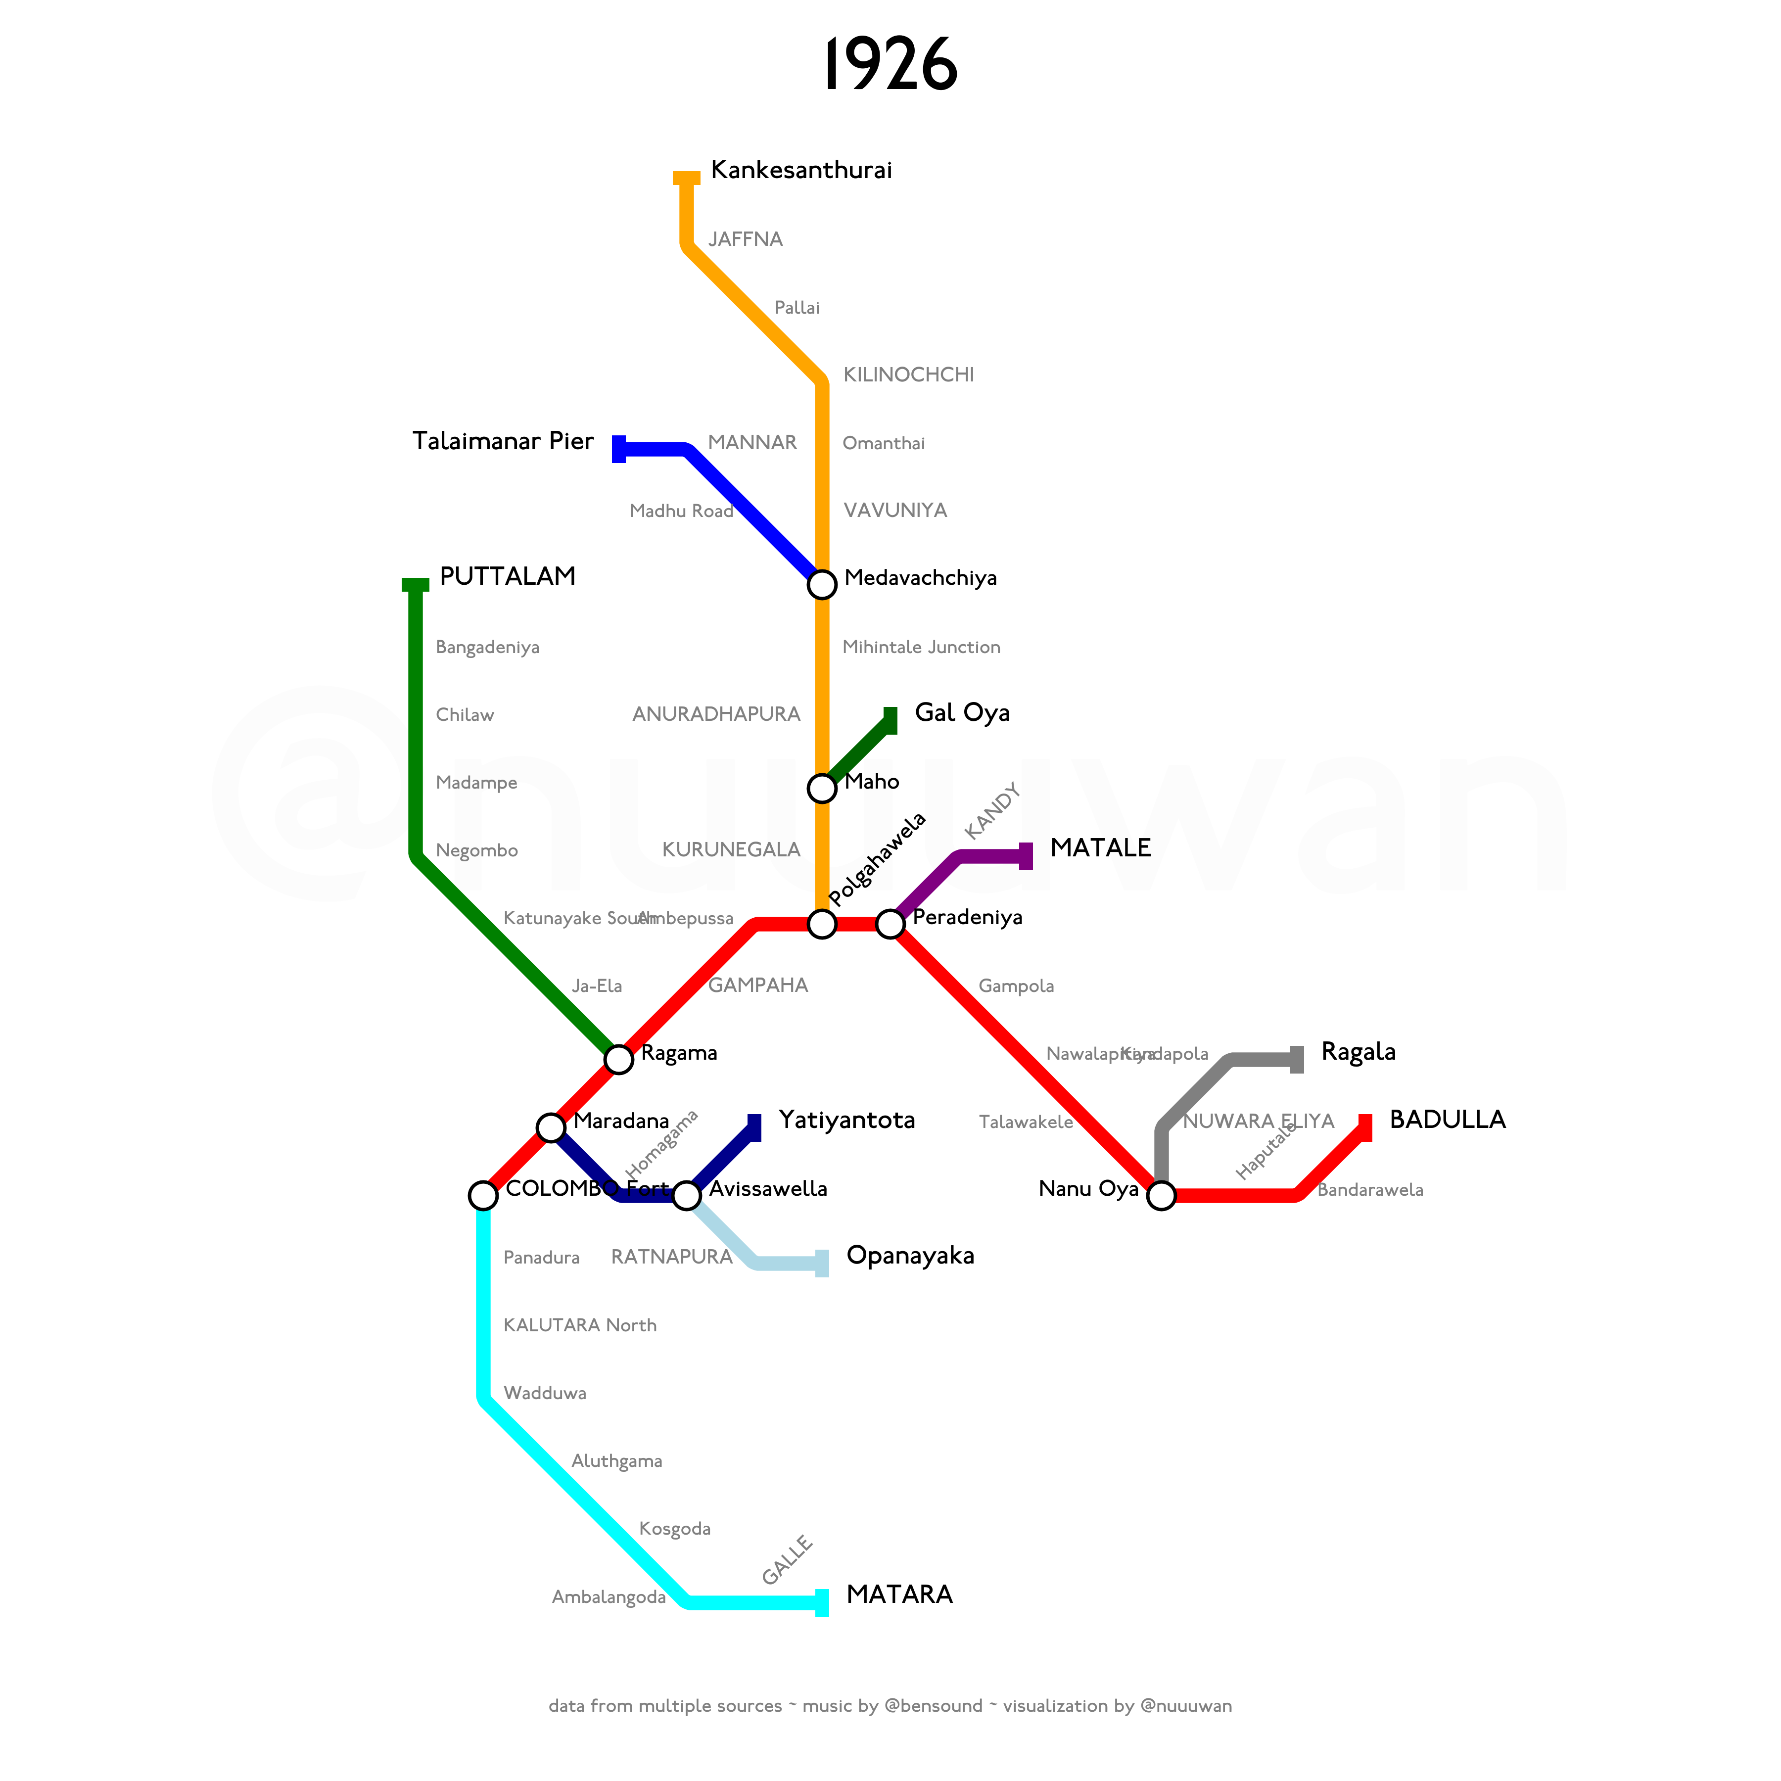
Notes:
The Puttalam Line was extended from Chilaw to Puttalam, and officially opened on 12 May 1926.
Also, the first segment of a new line to Trincomalee, connecting Maho on the Northern Line, to Gal Oya, opened the same year.

Slide 32
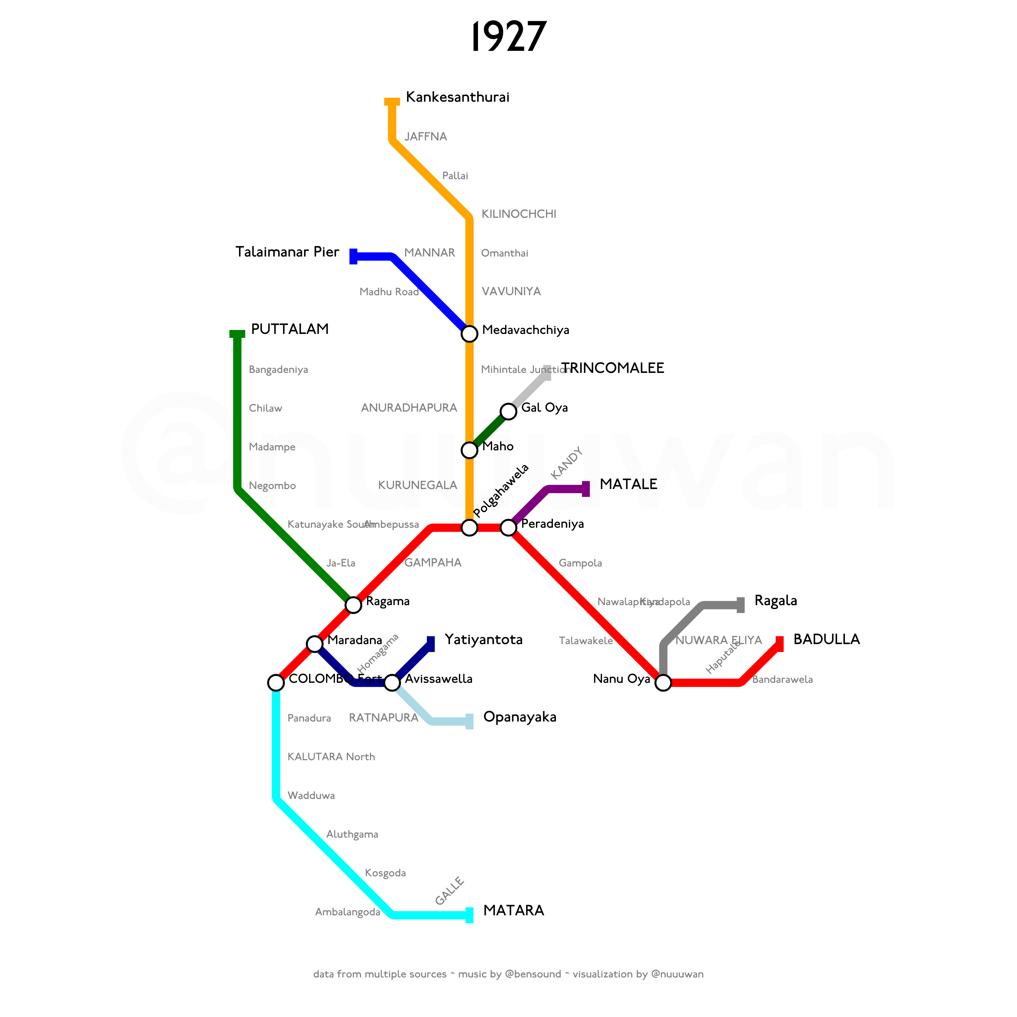
Notes:
The Trincomalee Line was extended from Gal Oya to Trincomalee in 1927.

Slide 33
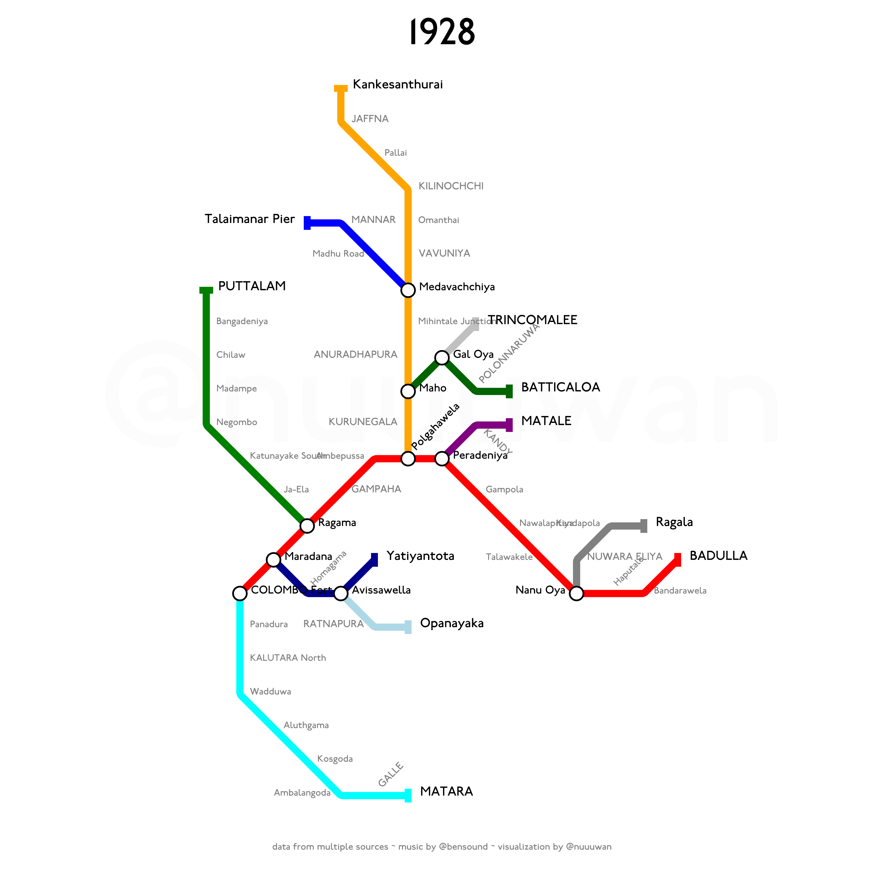
Notes:
A new branch off the Trincomalee Line, connecting Gal Oya to Batticaloa, commenced service in 1928.

Slide 34
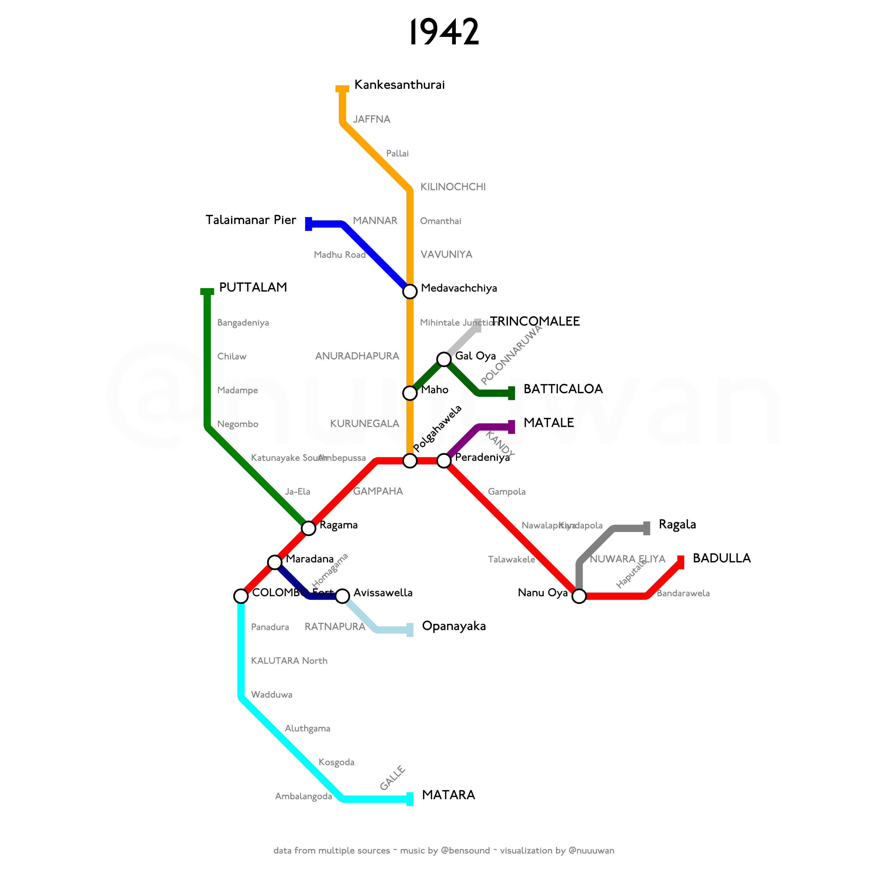
Notes:
The line between Avissawella and Yatiyanthota was removed in 1942.

Slide 35
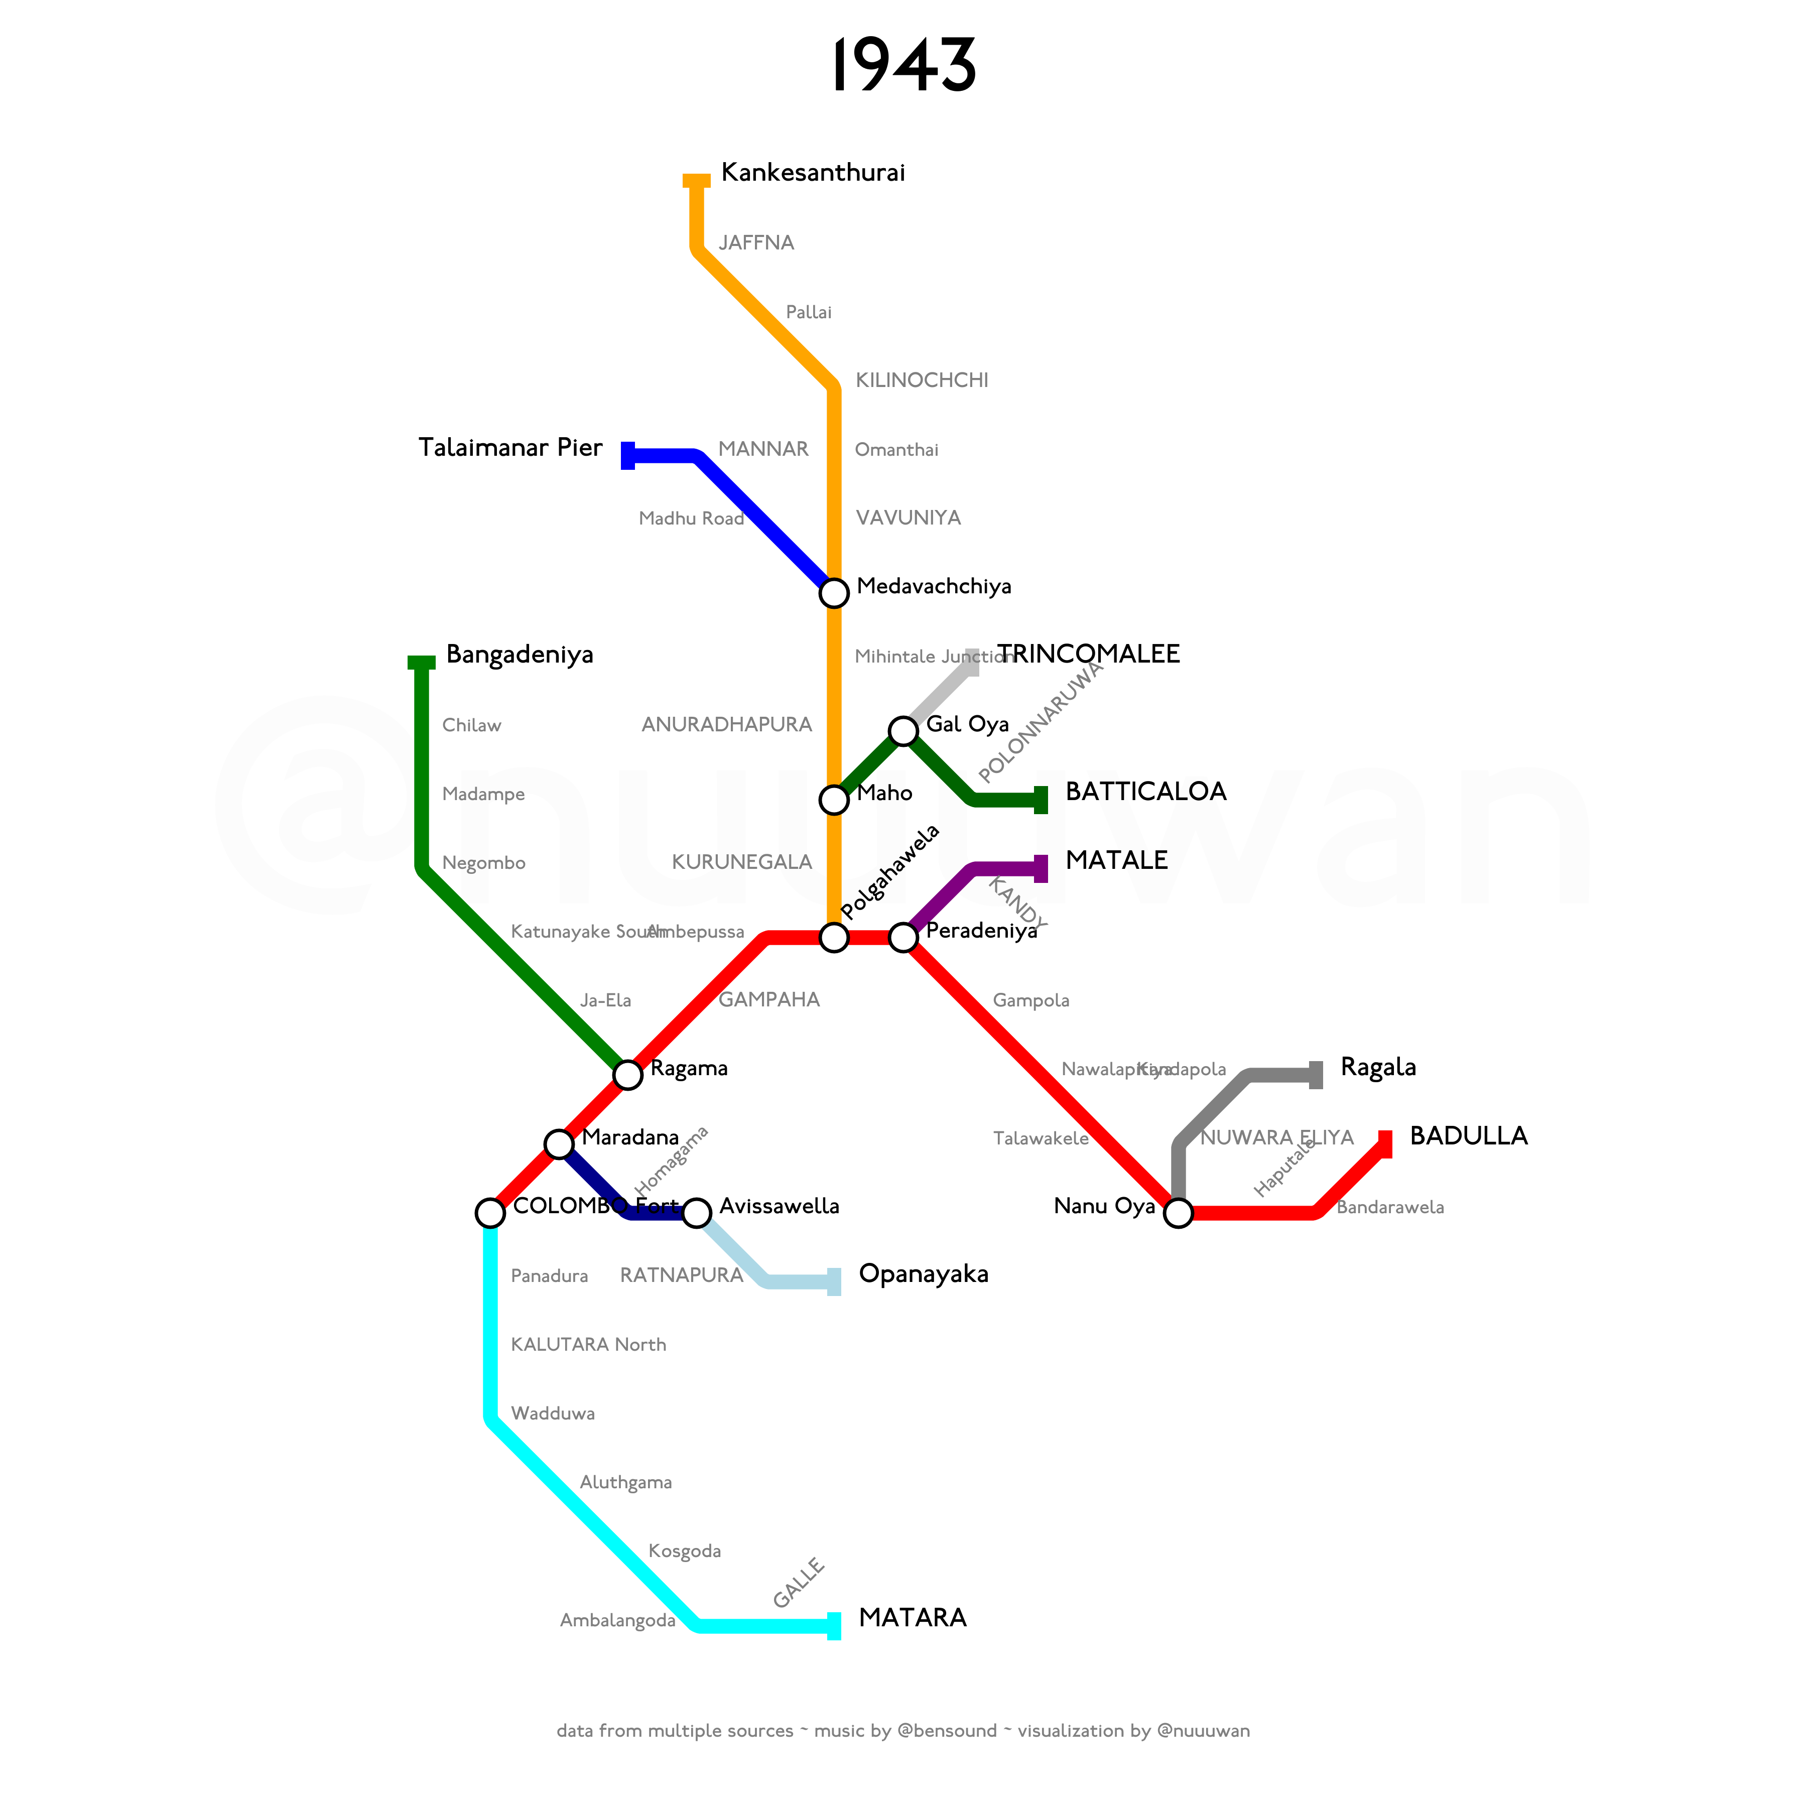
Notes:
In 1943 the track from Bangadeniya to Puttalam was removed, as the rails were required on other strategically important routes due to shortages caused by World War II.

Slide 36
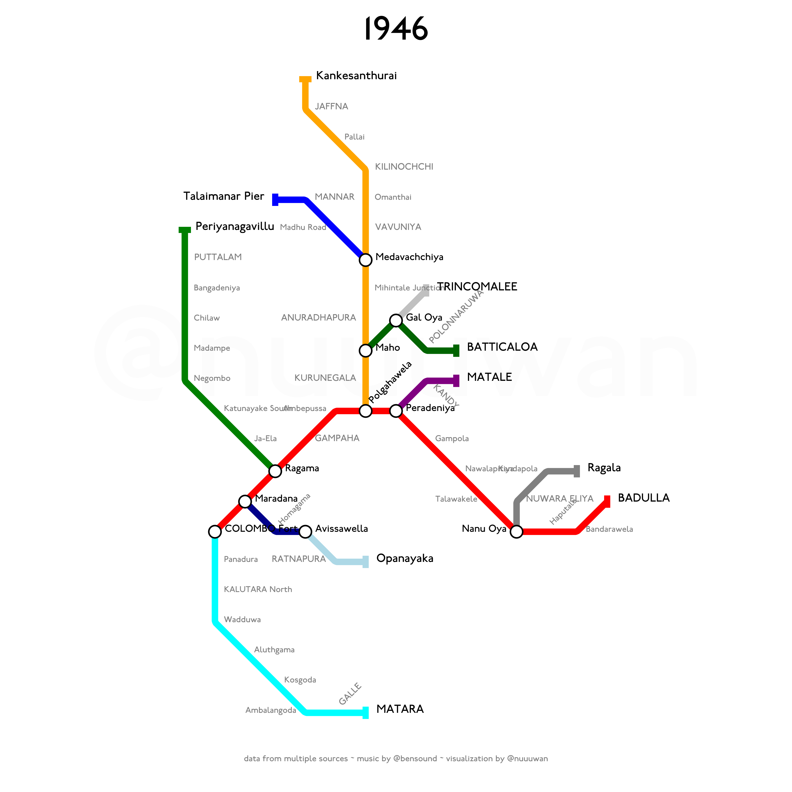
Notes:
It was re-laid in 1946 with a number of new stations added to the line. The line was also extended beyond Puttalam to Periyanagavillu.
By January 1940, all passenger services on the Uda Pussellawa Line were withdrawn and only two freight trains were in operation between Nanu Oya and Ragala.

Slide 37
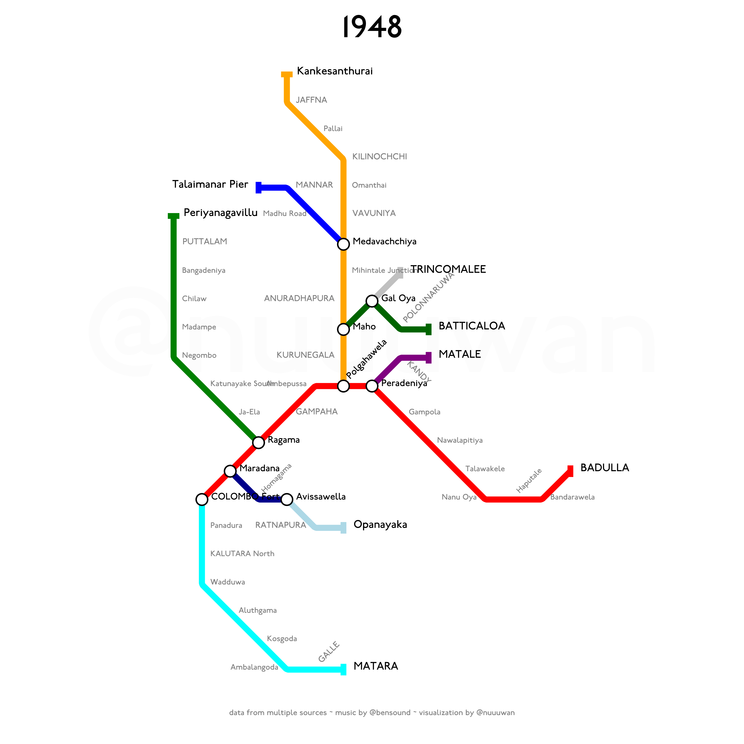
Notes:
On 2 August 1948 all services were withdrawn and the line was completely removed.

Slide 38

Notes:
In 1970, a short branch line connecting Katunayake South on the Puttalam Line and Katunayake International Airport commenced service.

Slide 39
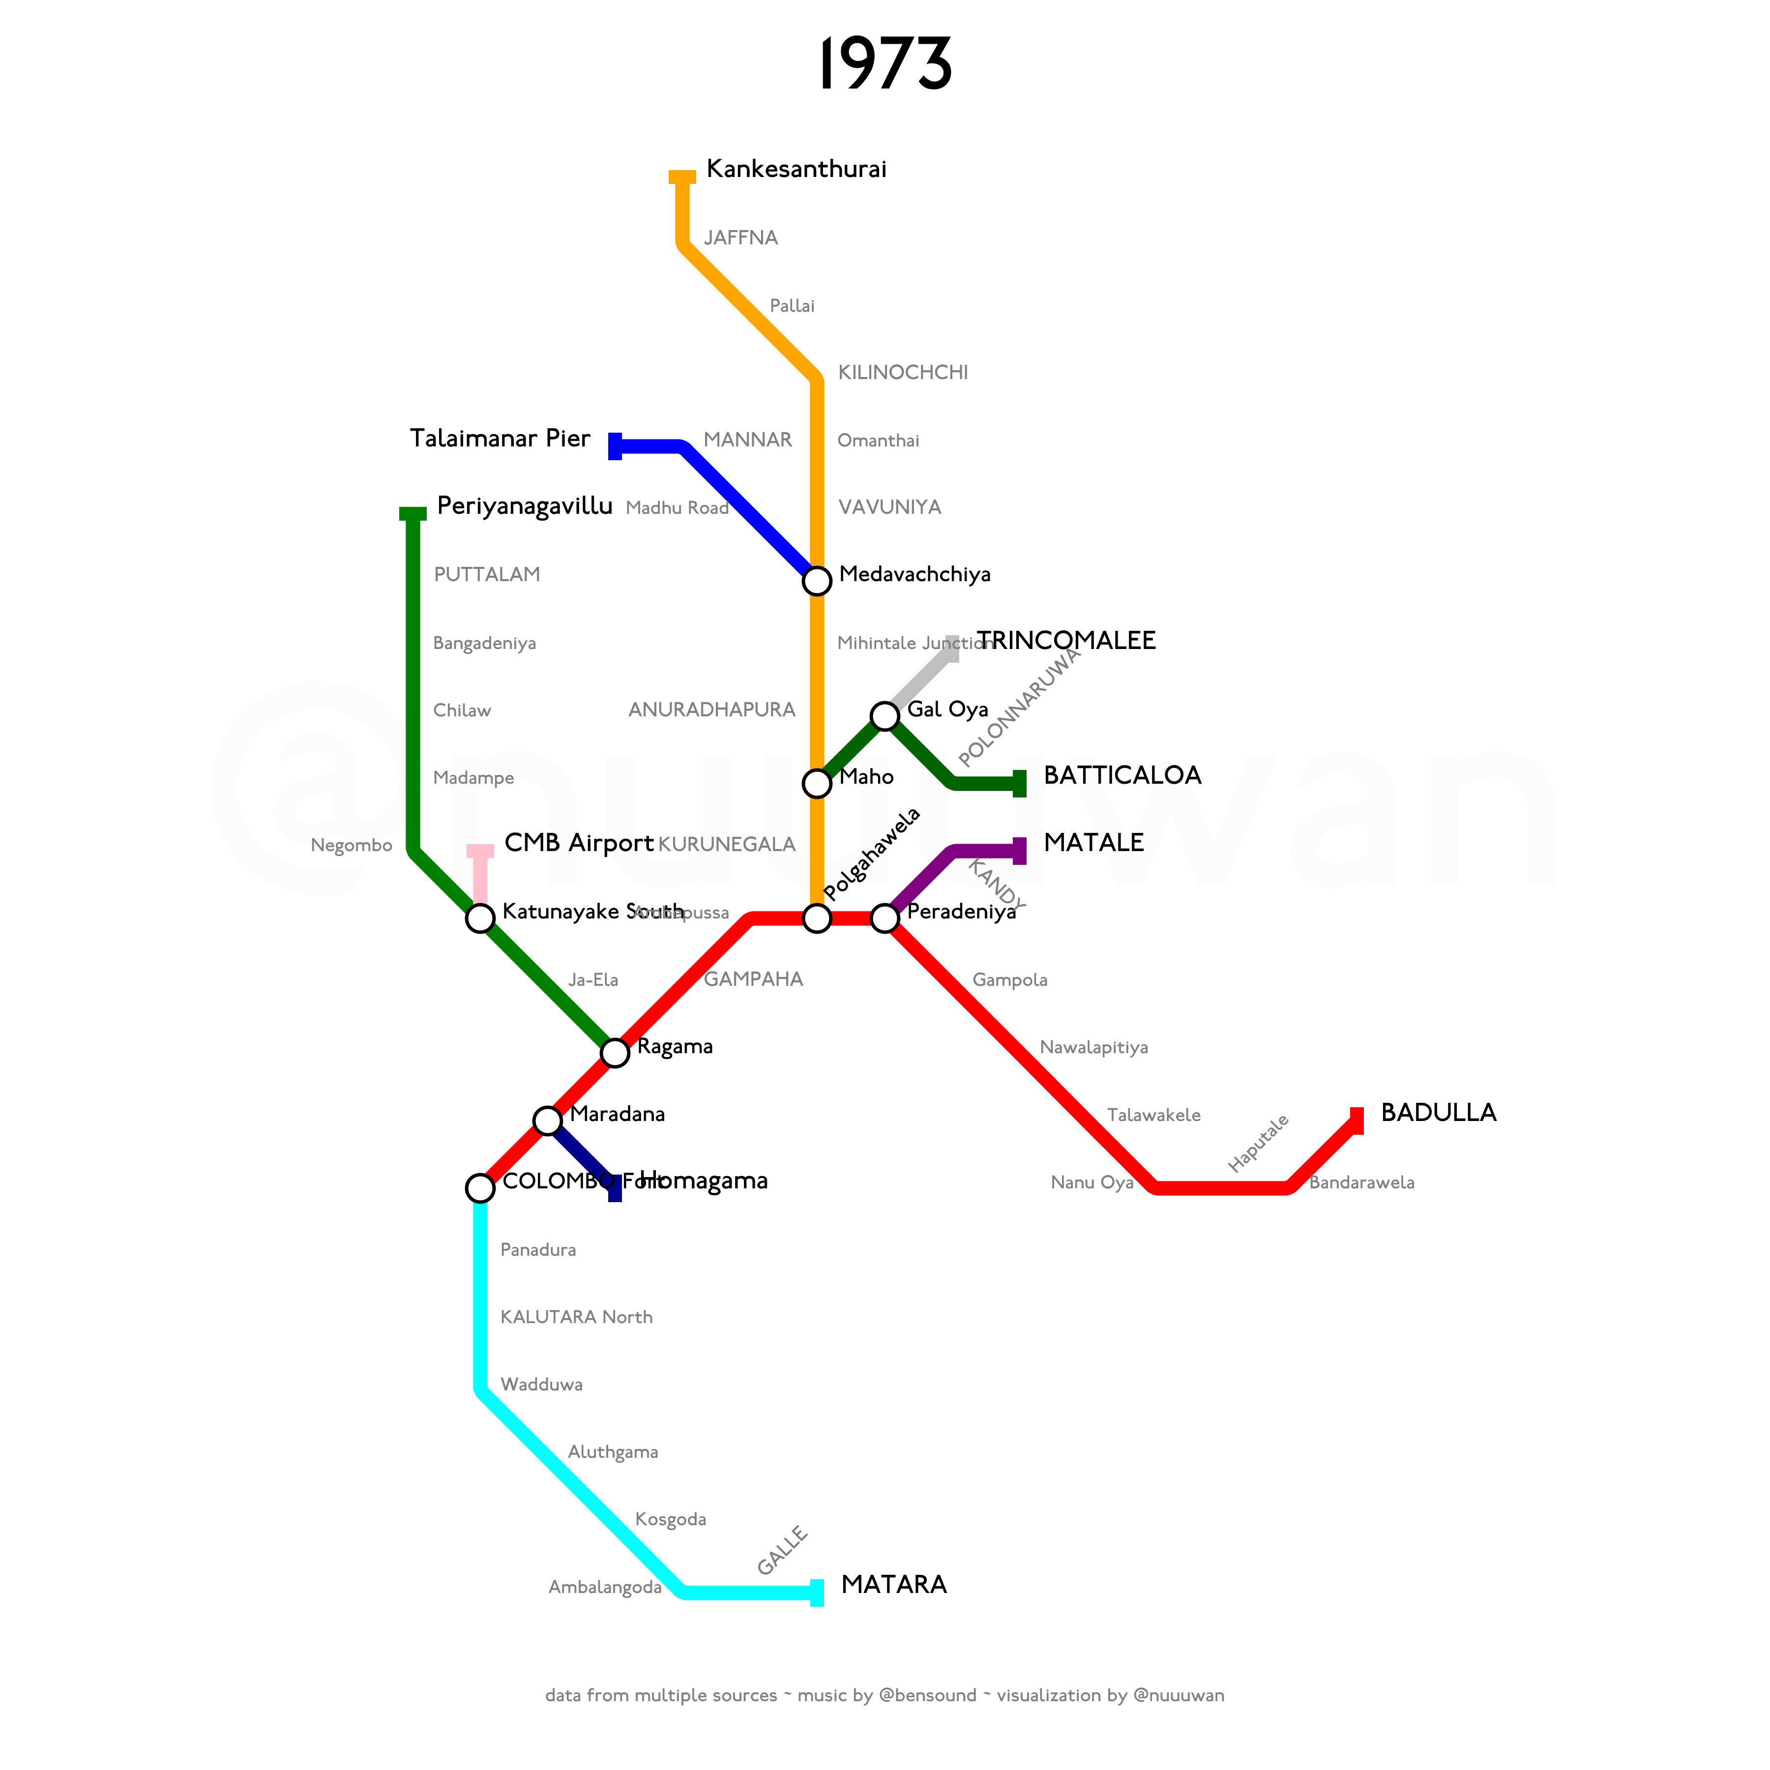
Notes:
The Kelani Valley line segment from Homagama to Opanayaka was closed in 1973.

Slide 40
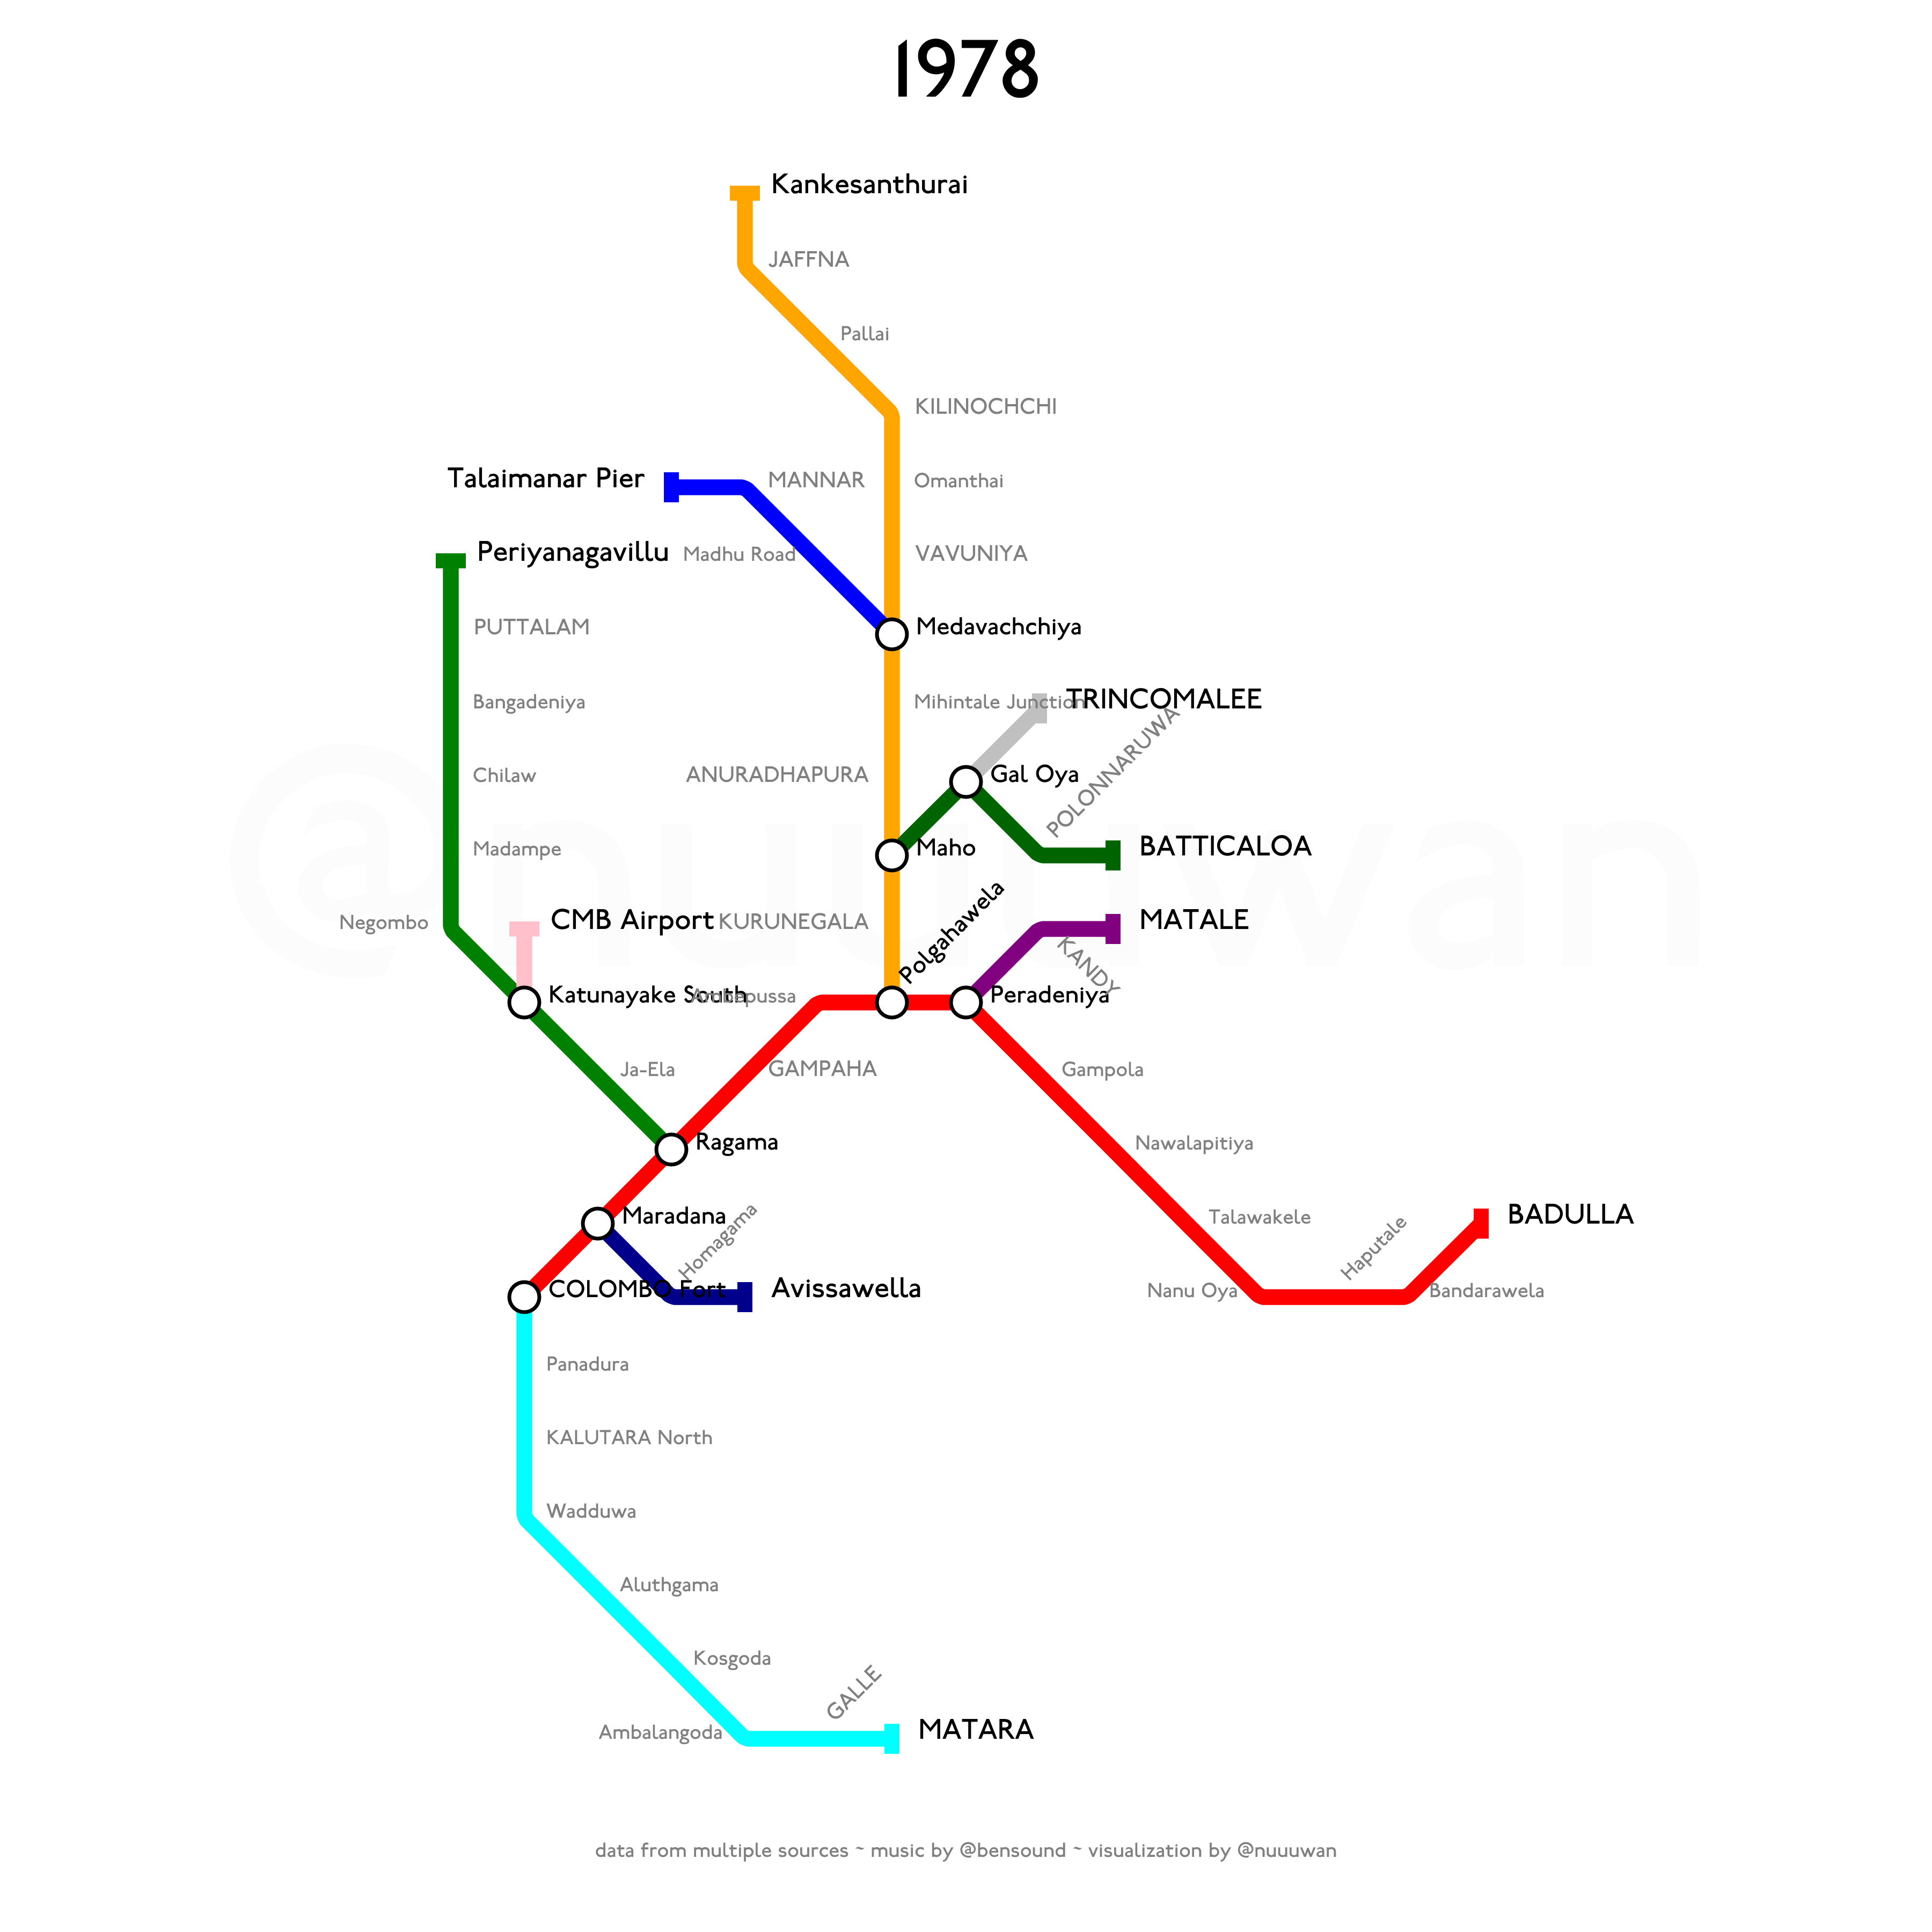
Notes:
The services were restarted from Homagama to Avissawella in 1978.

Slide 41
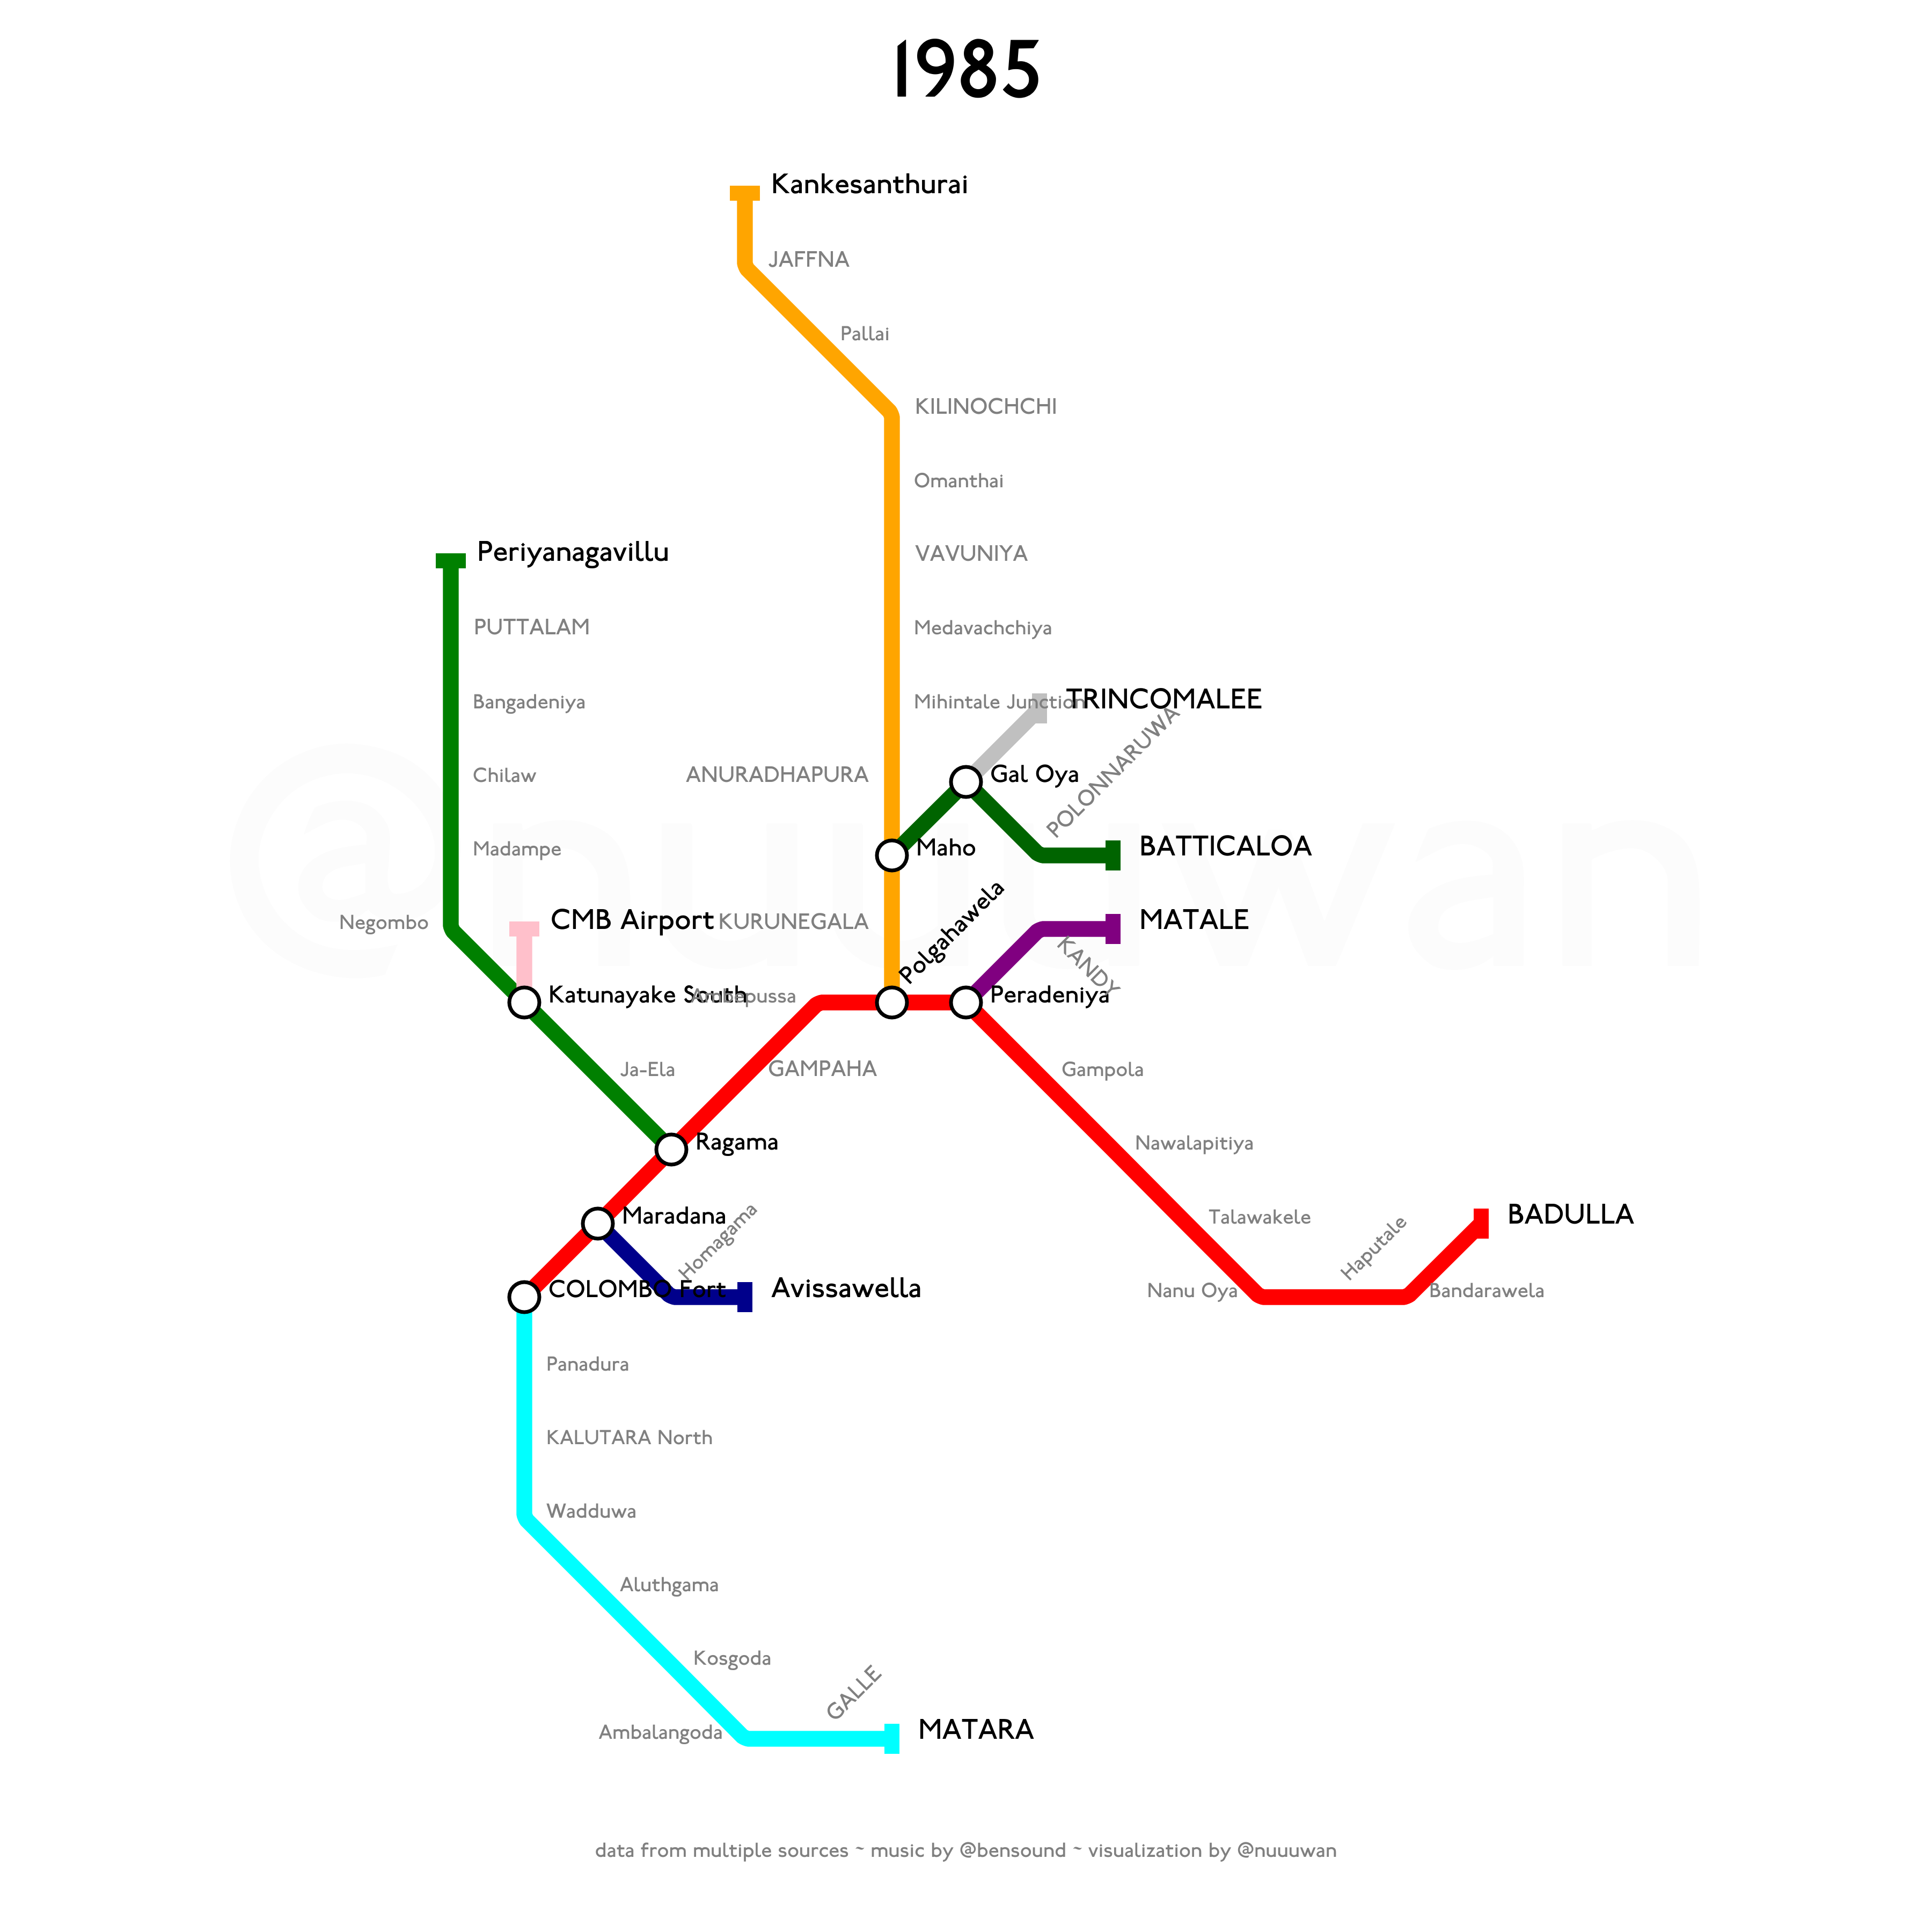
Notes:
Due to the Civil war, the Mannar line was closed in 1985.
With further escalation of the Civil War, trains, especially the Yaal Devi service (from Colombo to Kankesanturai), became the target of frequent LTTE attacks.

Slide 42
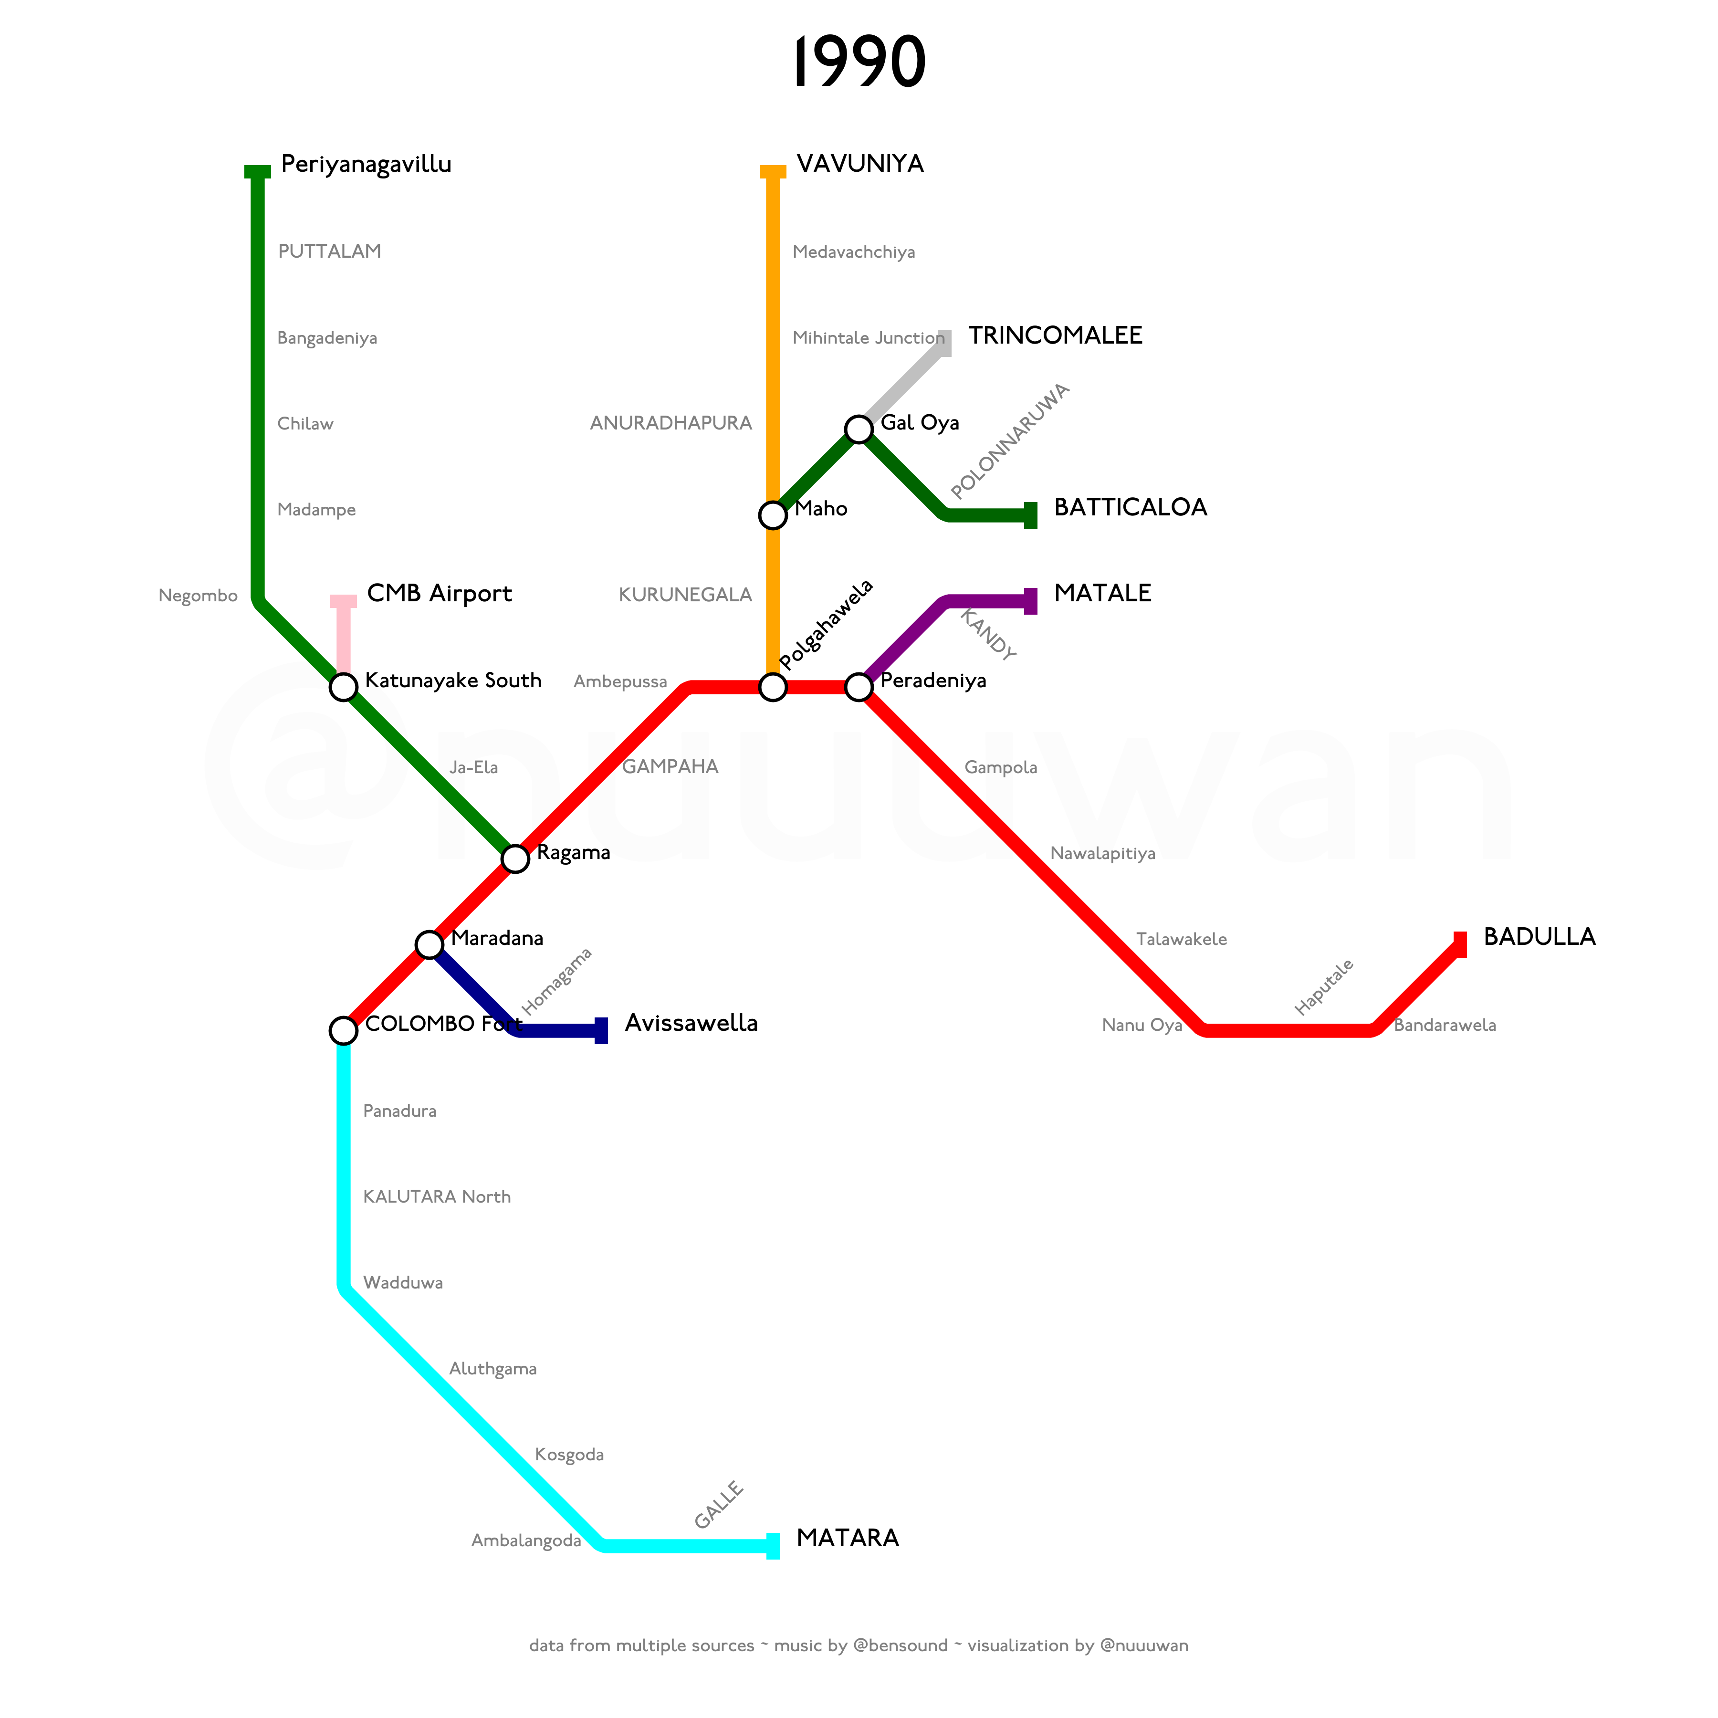
Notes:
After multiple attacks, service between Vavuniya and Kankesanturai was suspended in 1990.

Slide 43

Notes:
A new, 11 km branch line from Anuradhapura on the Northern Line, to Mihintale was opened in 1993. The line primarily transported Buddhist pilgrims traveling to the sacred sites at Mihintale

Slide 44
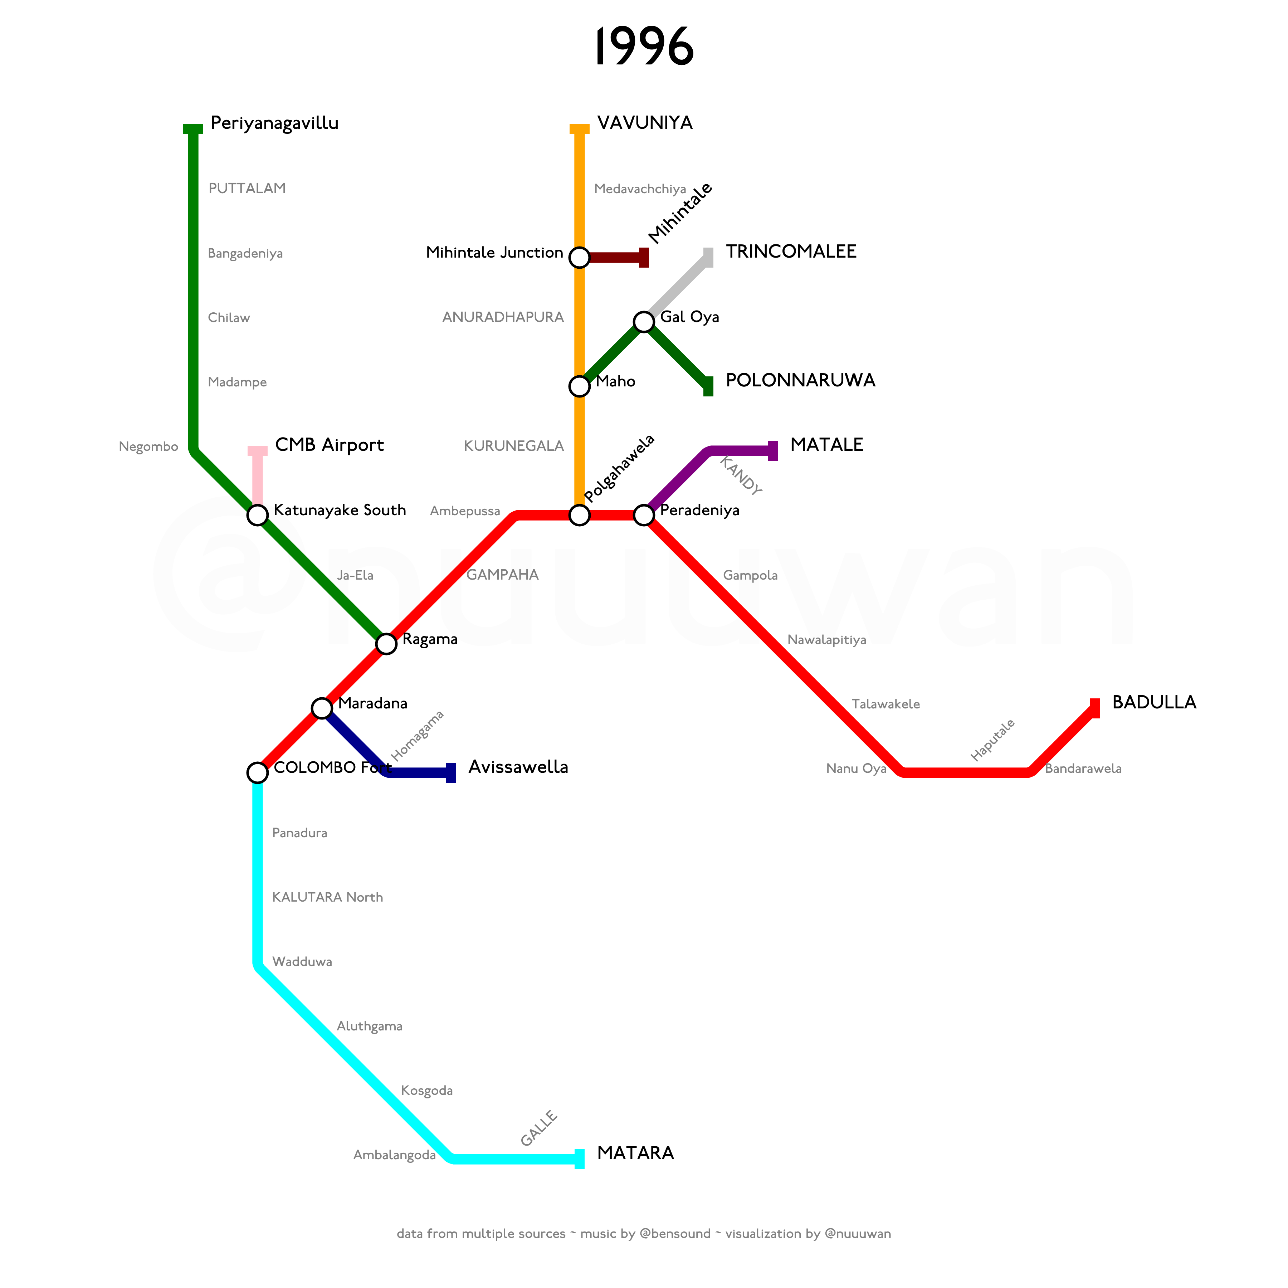
Notes:
With continued escalation of the Civil War in the Eastern Province, the segment from Polonnaruwa to Batticaloa on the Batticaloa Line was closed on 31 October 1996.

Slide 45

Notes:
It was reopened on 12 April 2003.

Slide 46
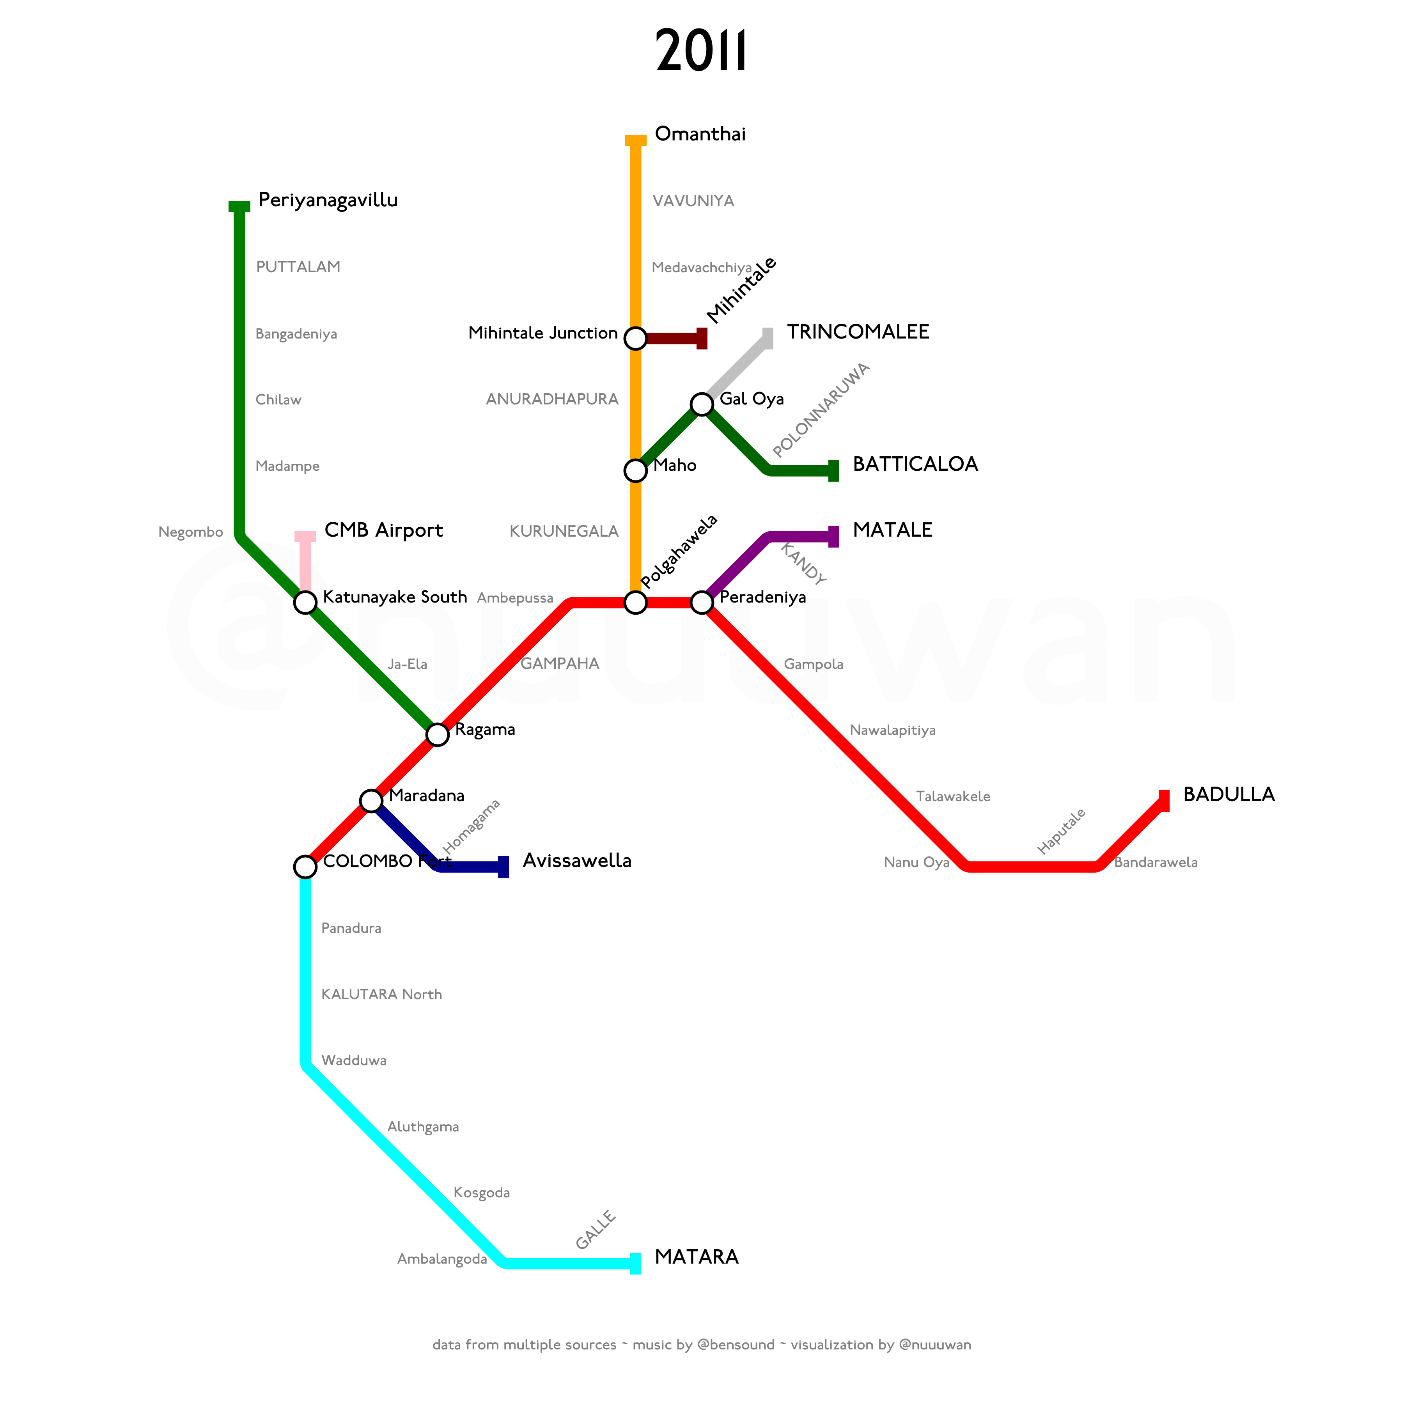
Notes:
After the end of the Civil War in 2009, the Northern Line was reopened in stages. The segment from Vavuniya to Omanthai was reopened on 27 May 2011.

Slide 47
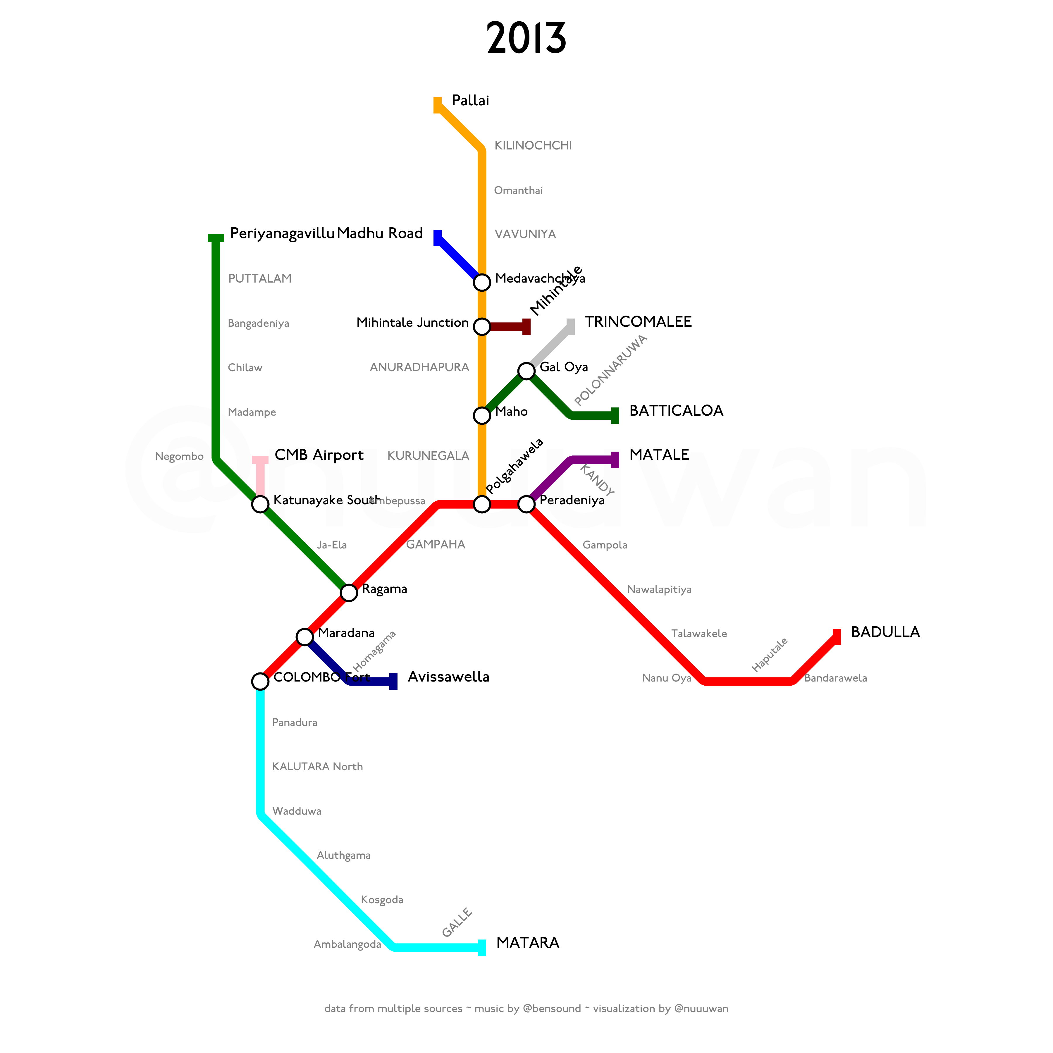
Notes:
The segment from Omanthai to Pallai opened in 2013.
Also, the segment of the Mannar line, from Medawachchiya to Madhu Road, was reopened in 2013.

Slide 48
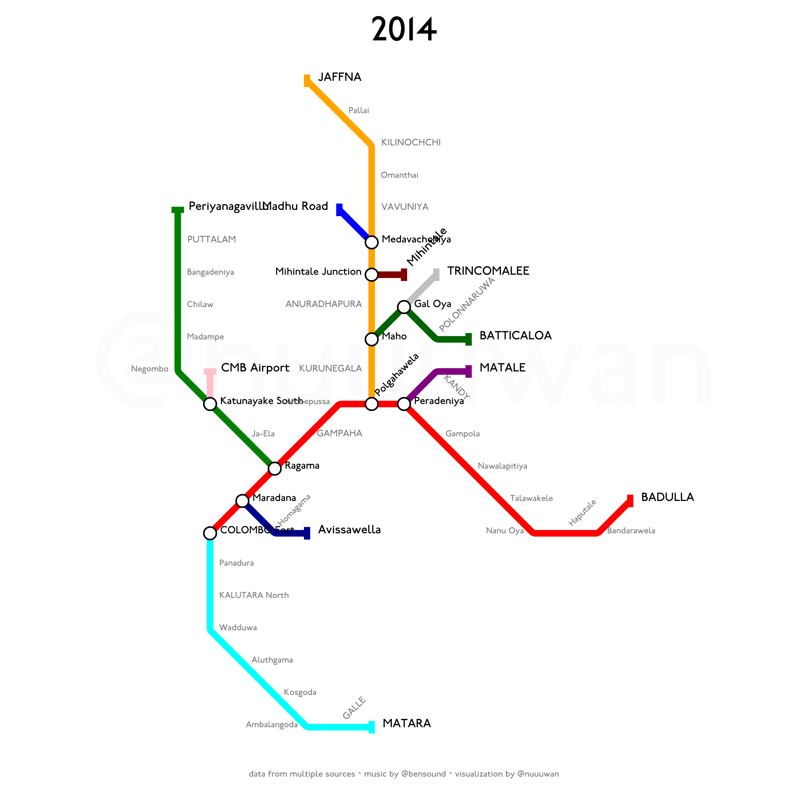
Notes:
The Northern Line from Pallai to Jaffna was reopened on 13 October 2014.

Slide 49
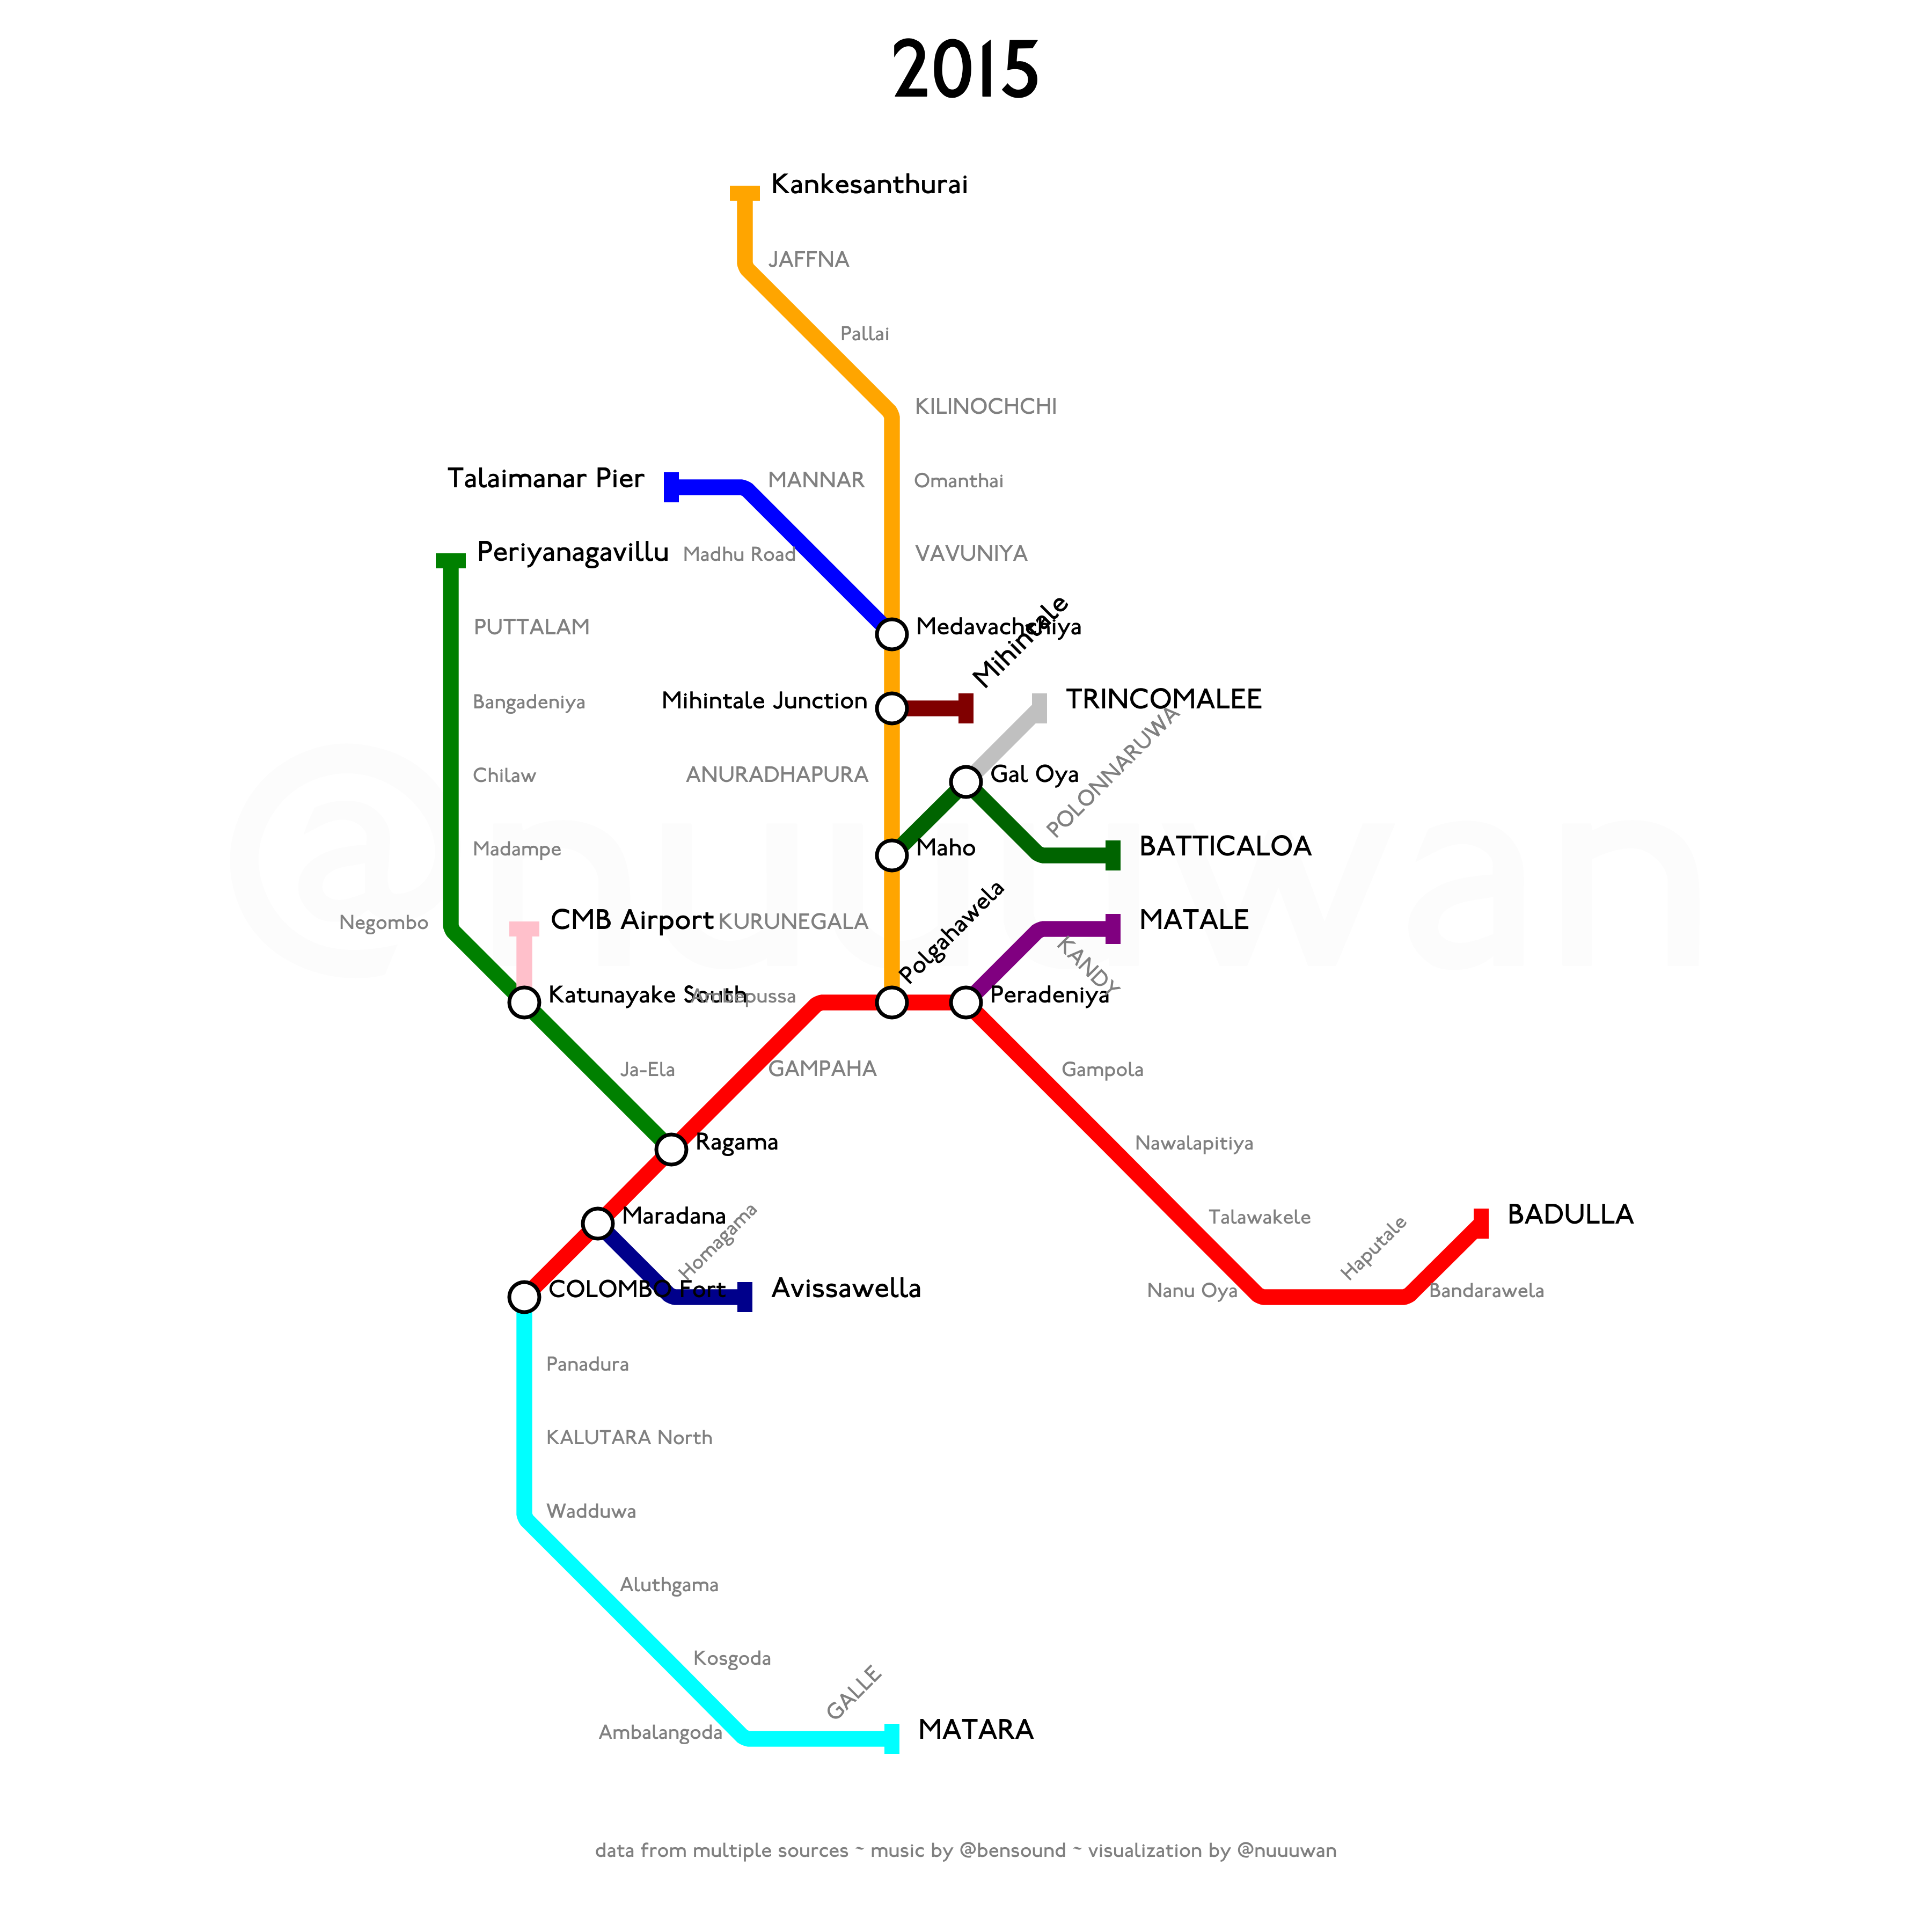
Notes:
And finally from Jaffna to Kankesanthurai on 2 January 2015.
The remainder of the Mannar Line was also reopened from Madhu Road to Talaimannar Pier on 14 September 2015.

Slide 50
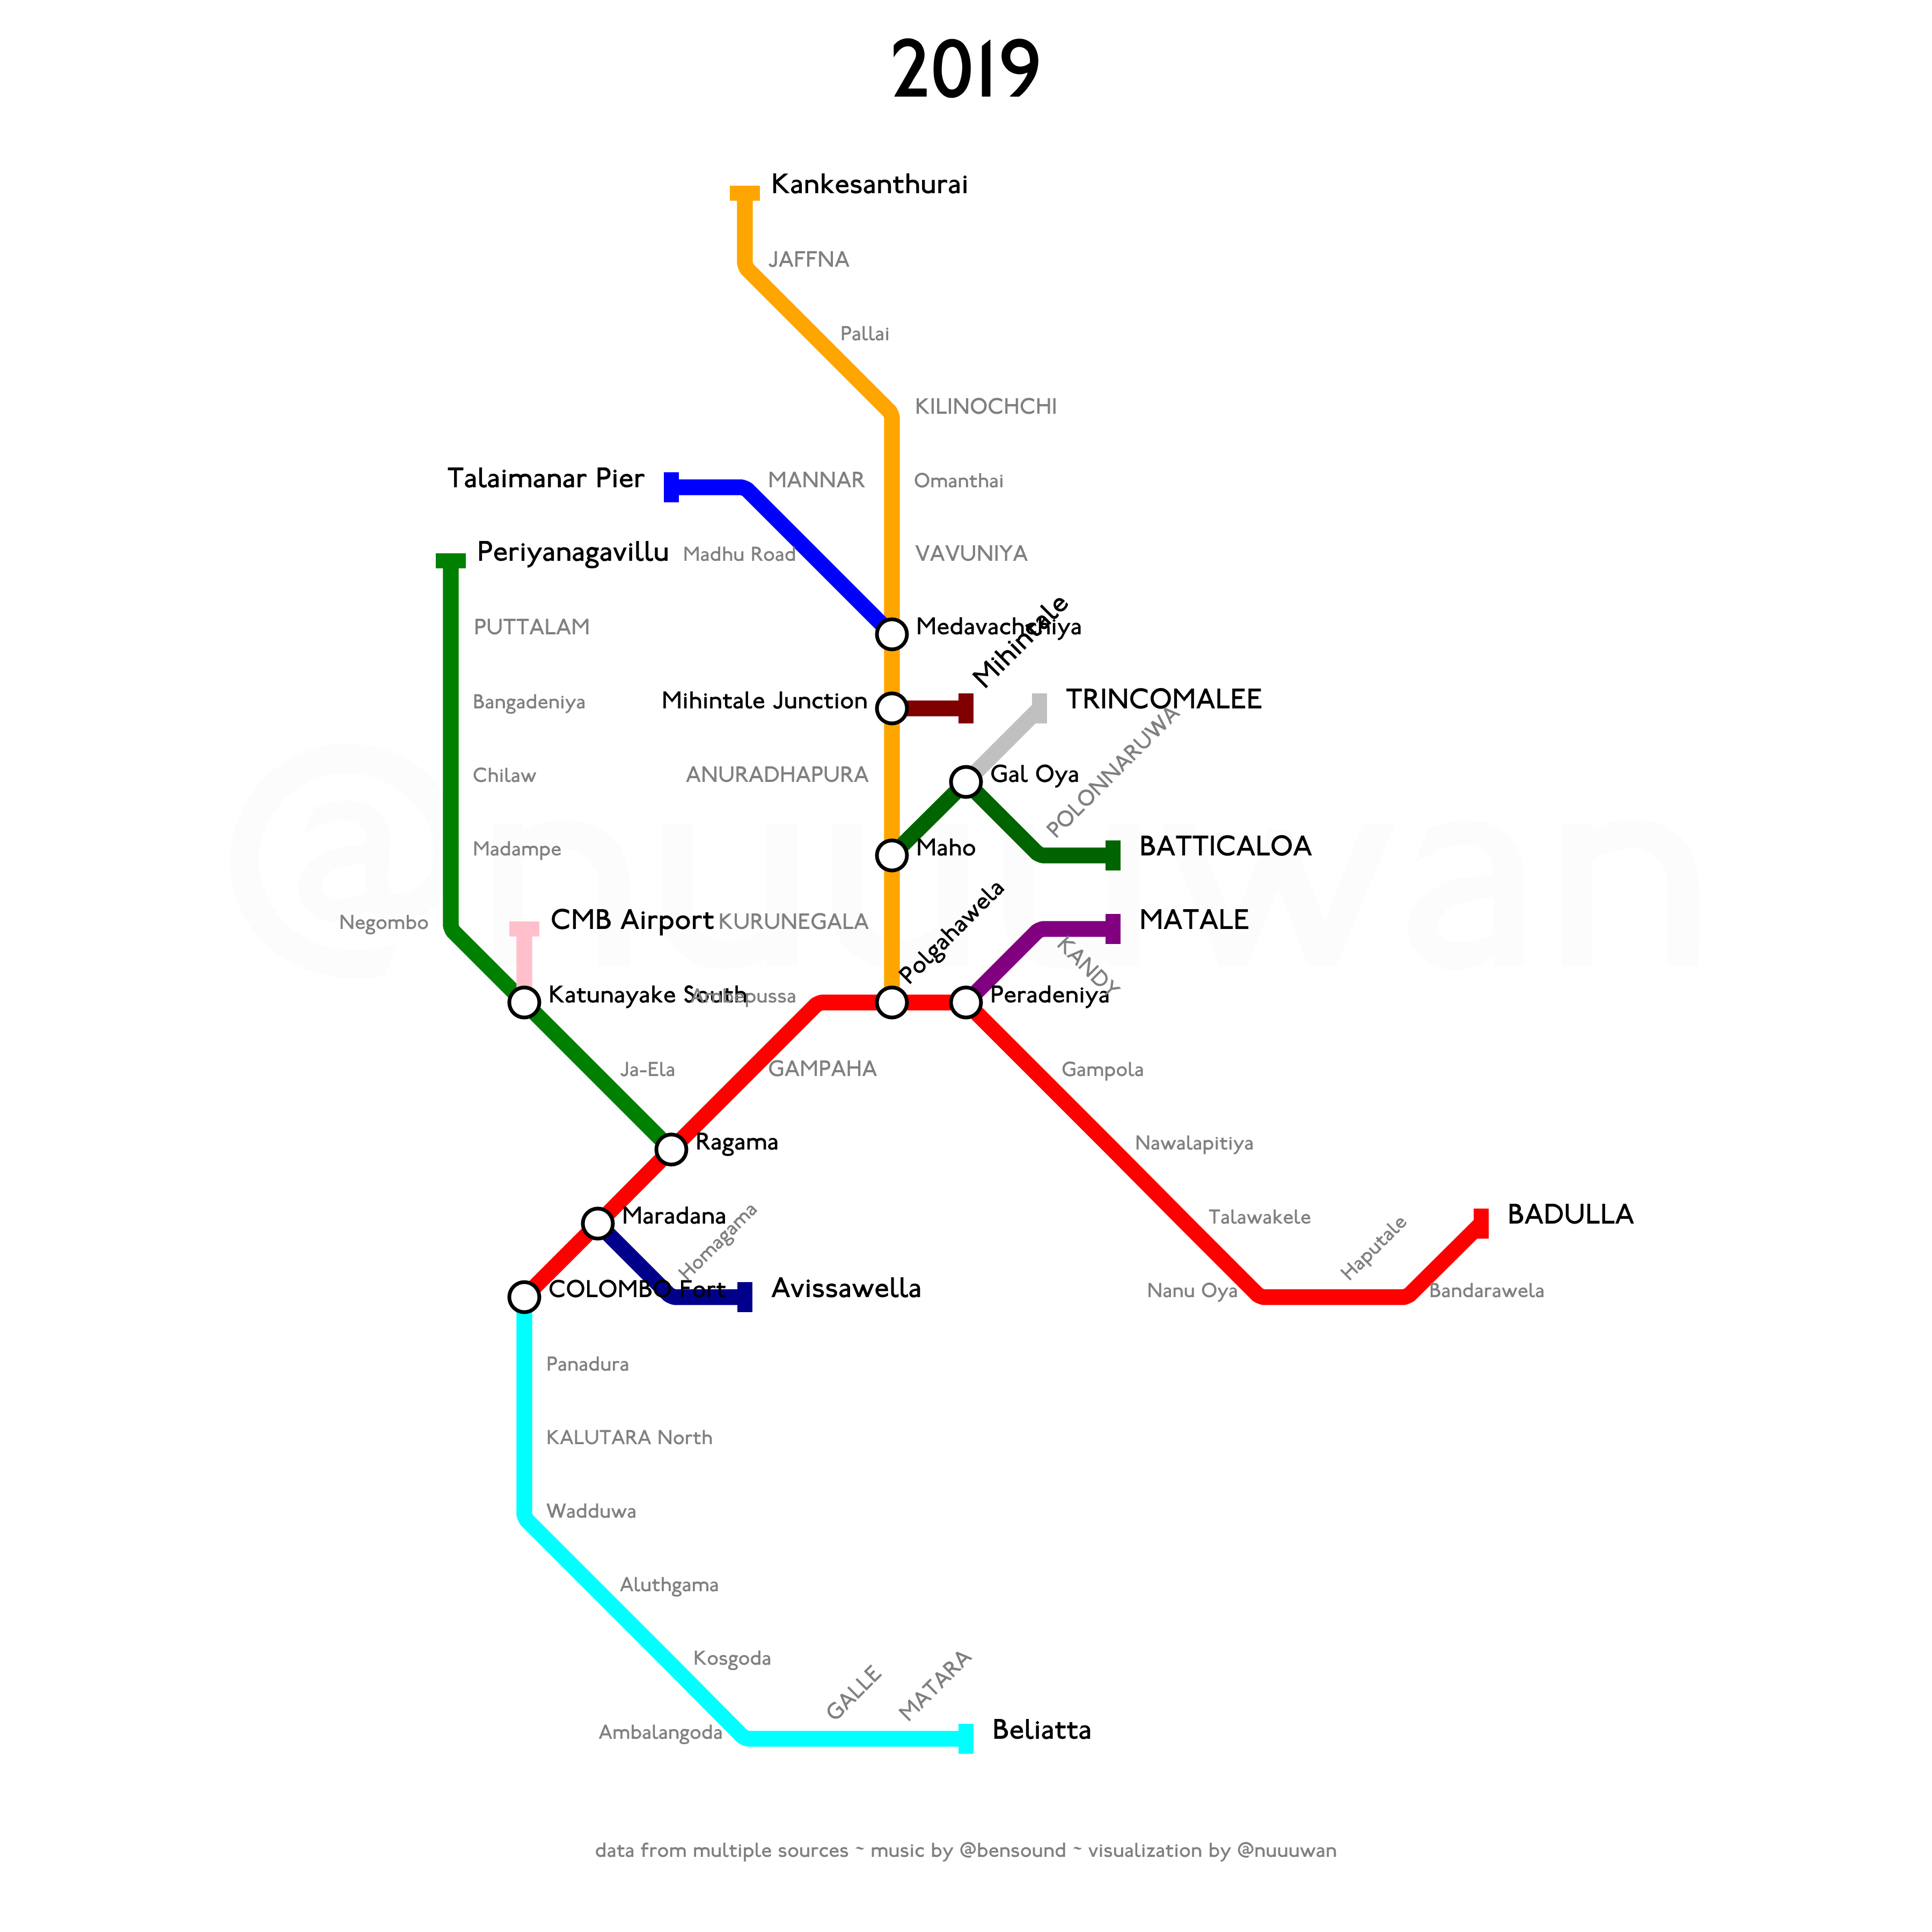
Notes:
The Coastal Line was extended from Matara to Beliatta on 8 April 2019.
Various plans have been proposed to extend the Railway Network in Sri Lanka, including an extension of the Coastal Line to Kataragama via Hambantota, and to reopen the Kelani Valley Line from Avissawella to Opanayaka.
But these plans are yet to be realized.
Thank's for watching.
And let me know what you think of this video in the comments below.

